Slide 1


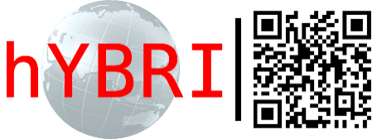

Monitoring system for the Govorun supercomputer and
HybriLIT platform
Bulatov Andrey, Butenko Yuri
Heterogeneous Computation Team HybriLIT
Laboratory of Informational Technologies, JINR
23/10/2019
Notes:
Complex GIMM FPEIP is intended for simulation of thermal processes
in materials irradiated by heavy ion beams.

Slide 2
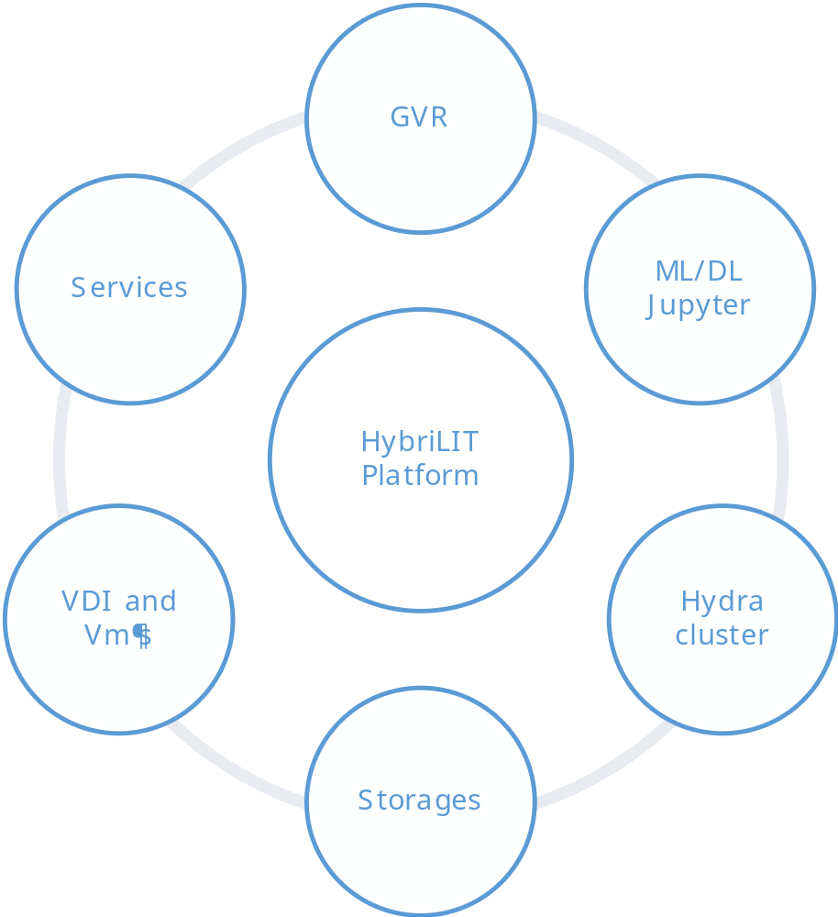

Slide 3
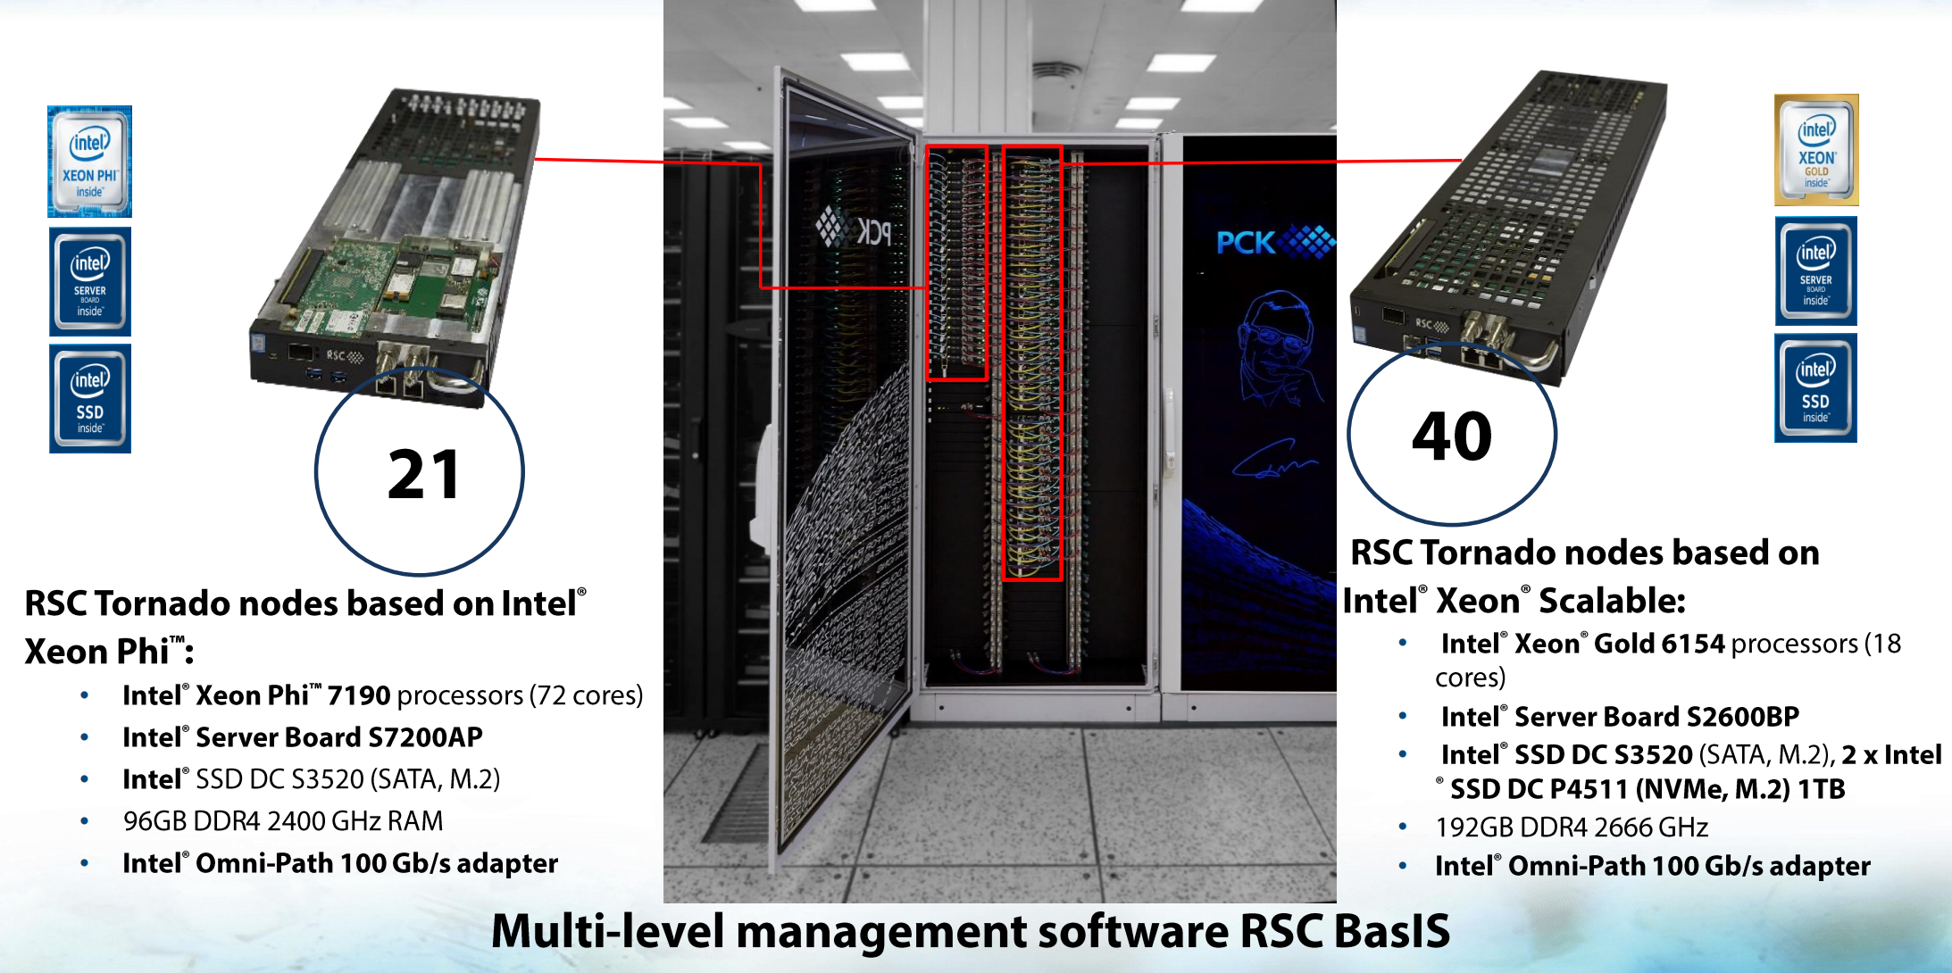
Govorun: CPU

Slide 4
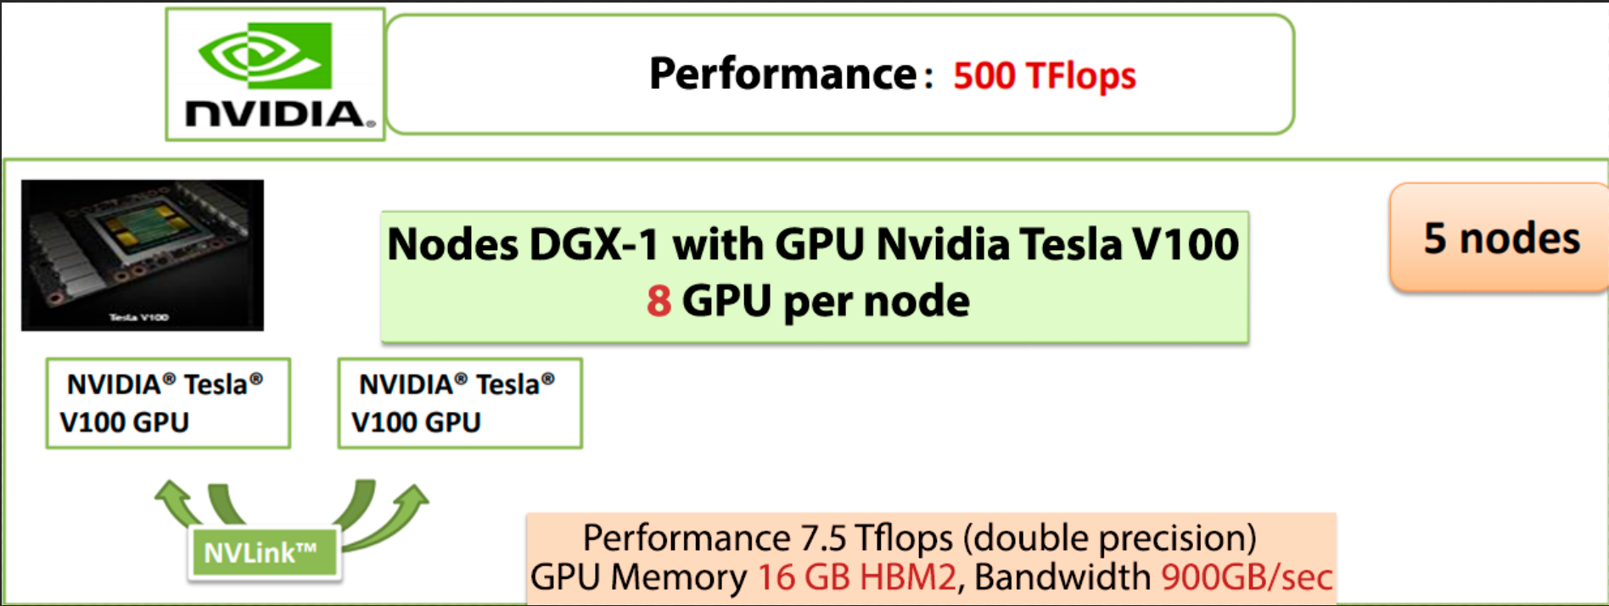
Govorun: GPU

Slide 5
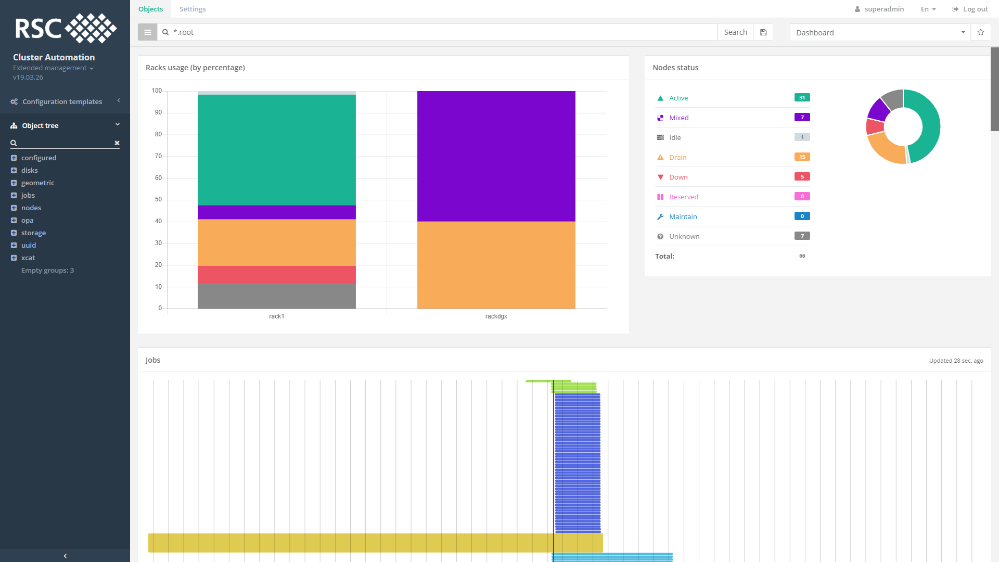
Govorun: RSC Cluster Automation

Slide 6
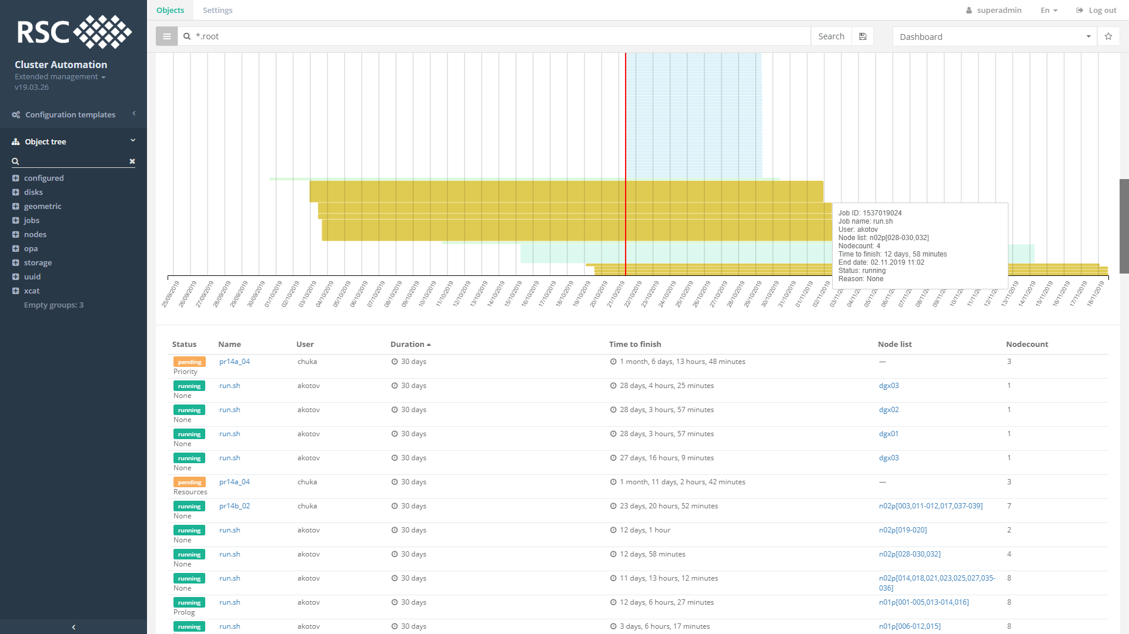
Govorun: RSC Cluster Automation

Slide 7
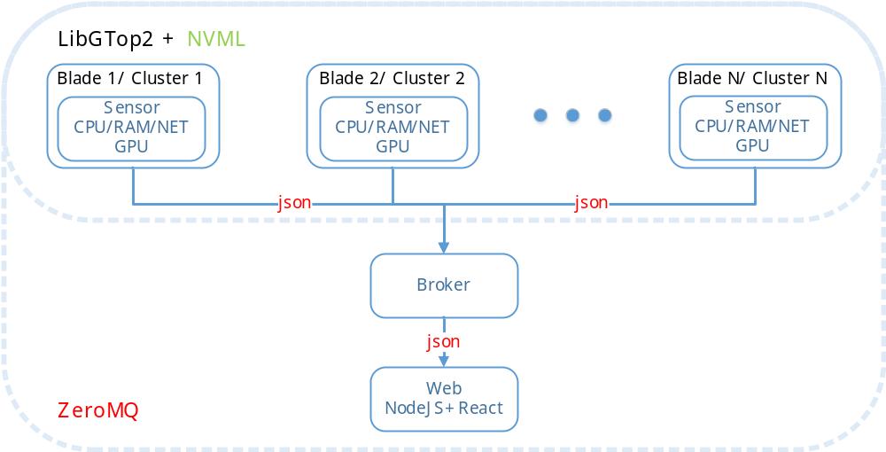
OBmon

Slide 8
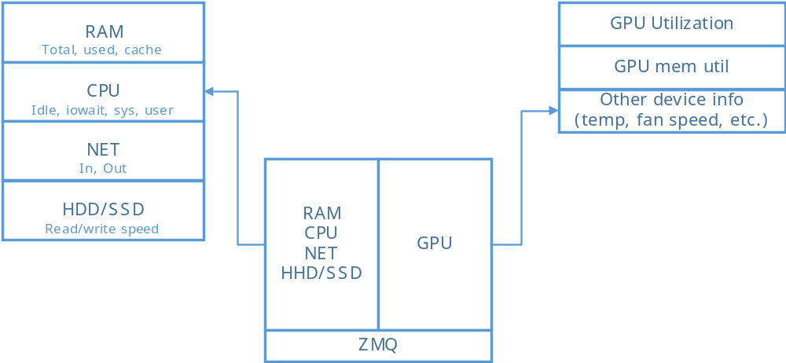
OBmon

Slide 9
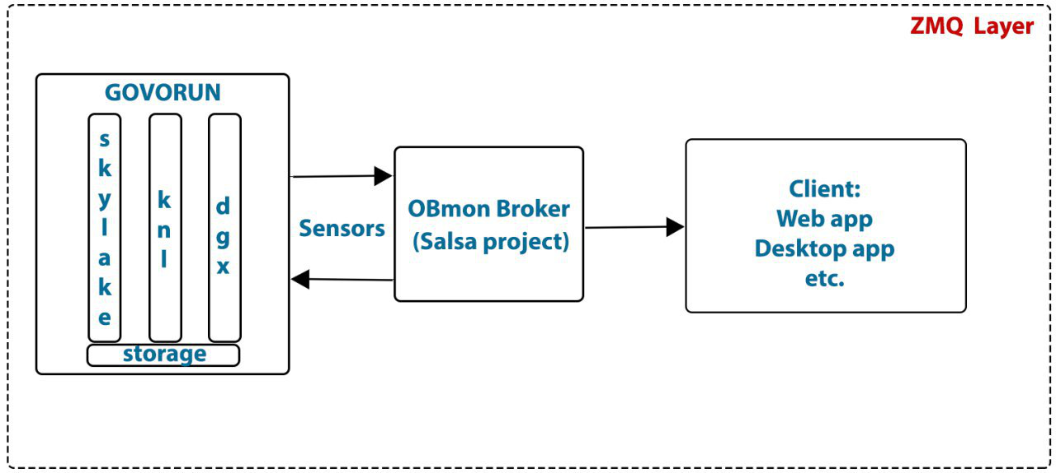
OBmon: Govorun

Slide 10
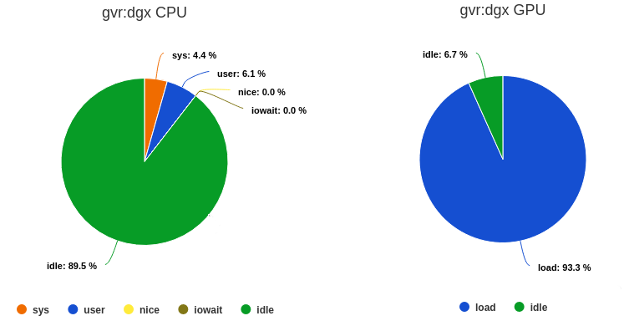
OBmon: Visualization

Slide 11
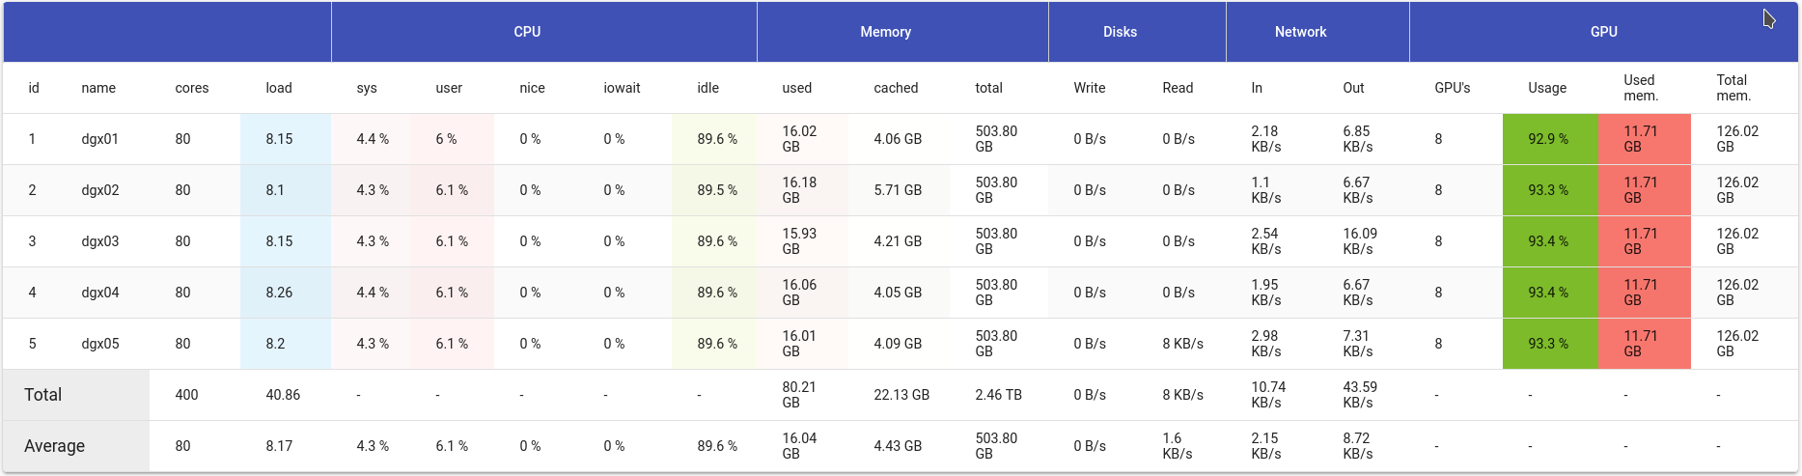
OBmon: Visualization

Slide 12
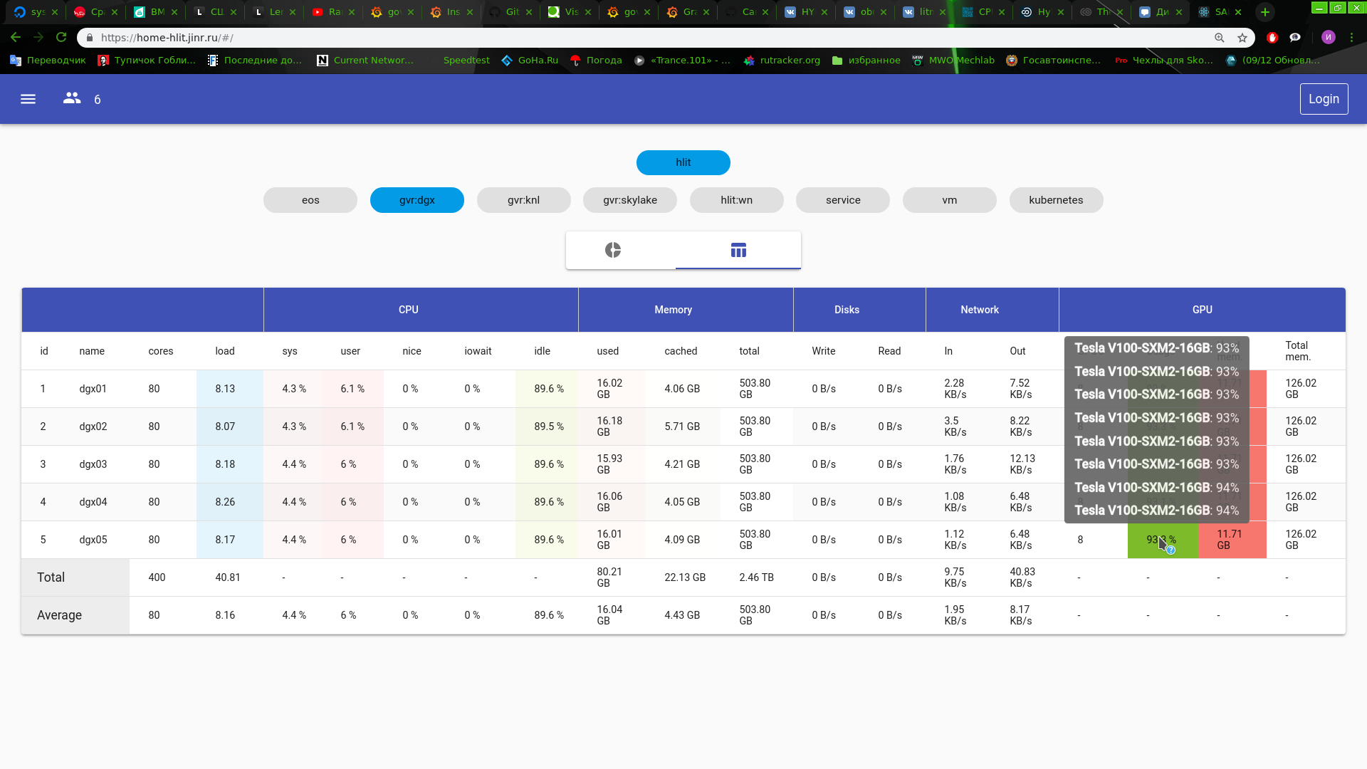
OBmon: Visualization

Slide 13
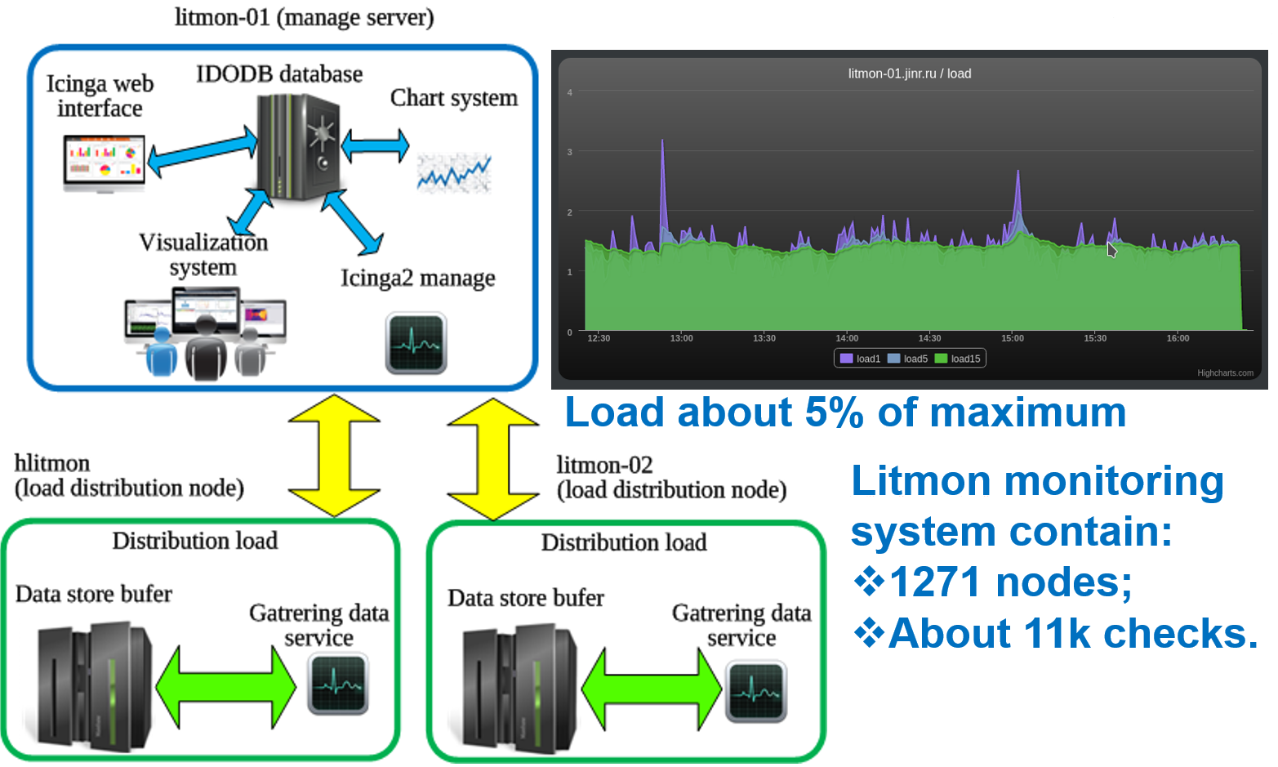
LITmon integration

Slide 14
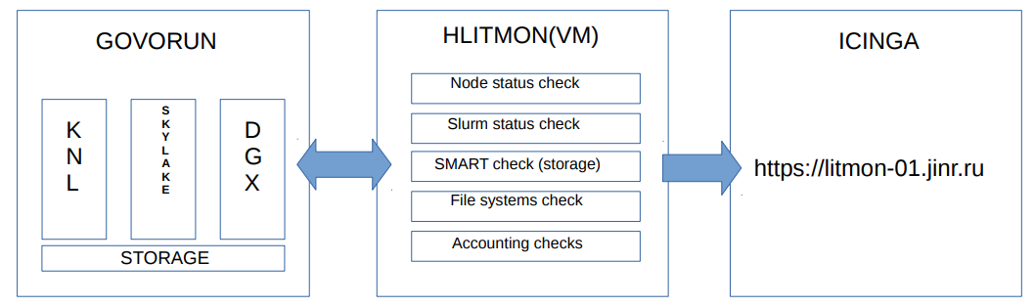
LITmon integration

Slide 15
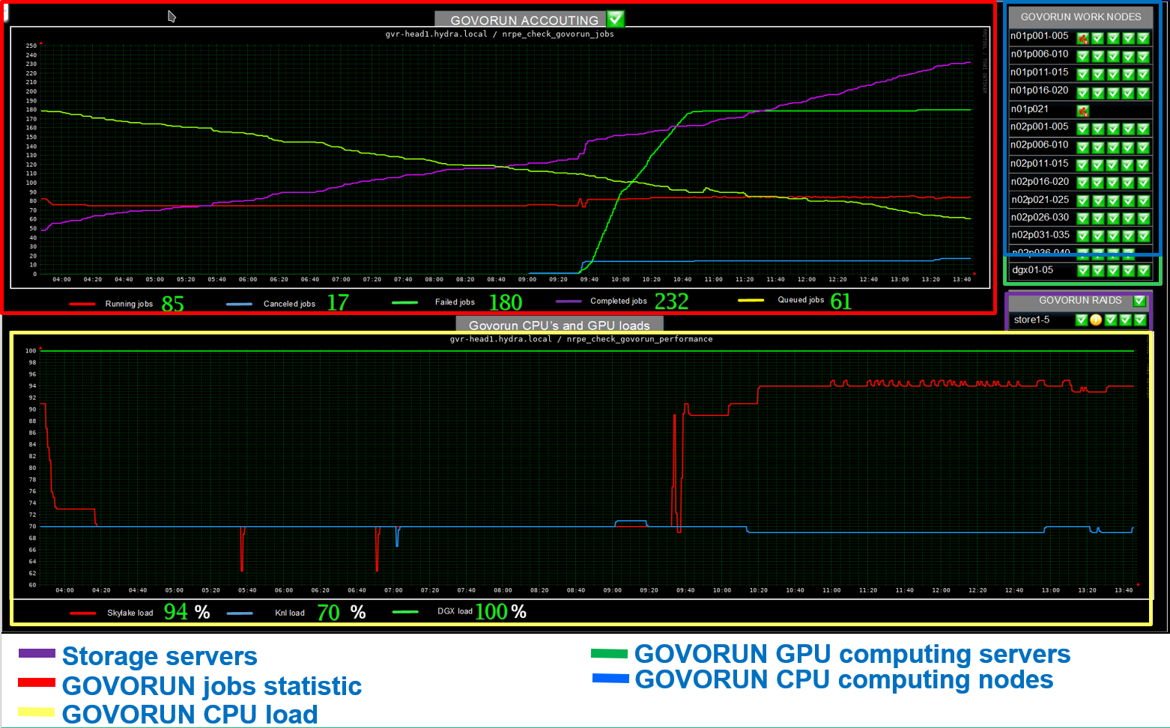
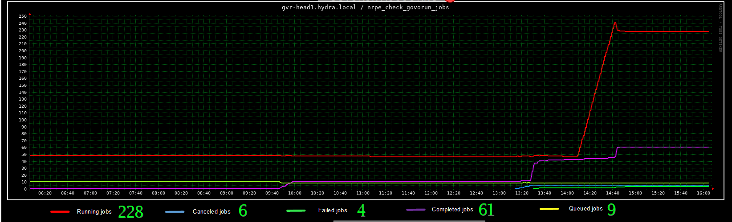
LITmon: Govorun dashboard

Slide 16
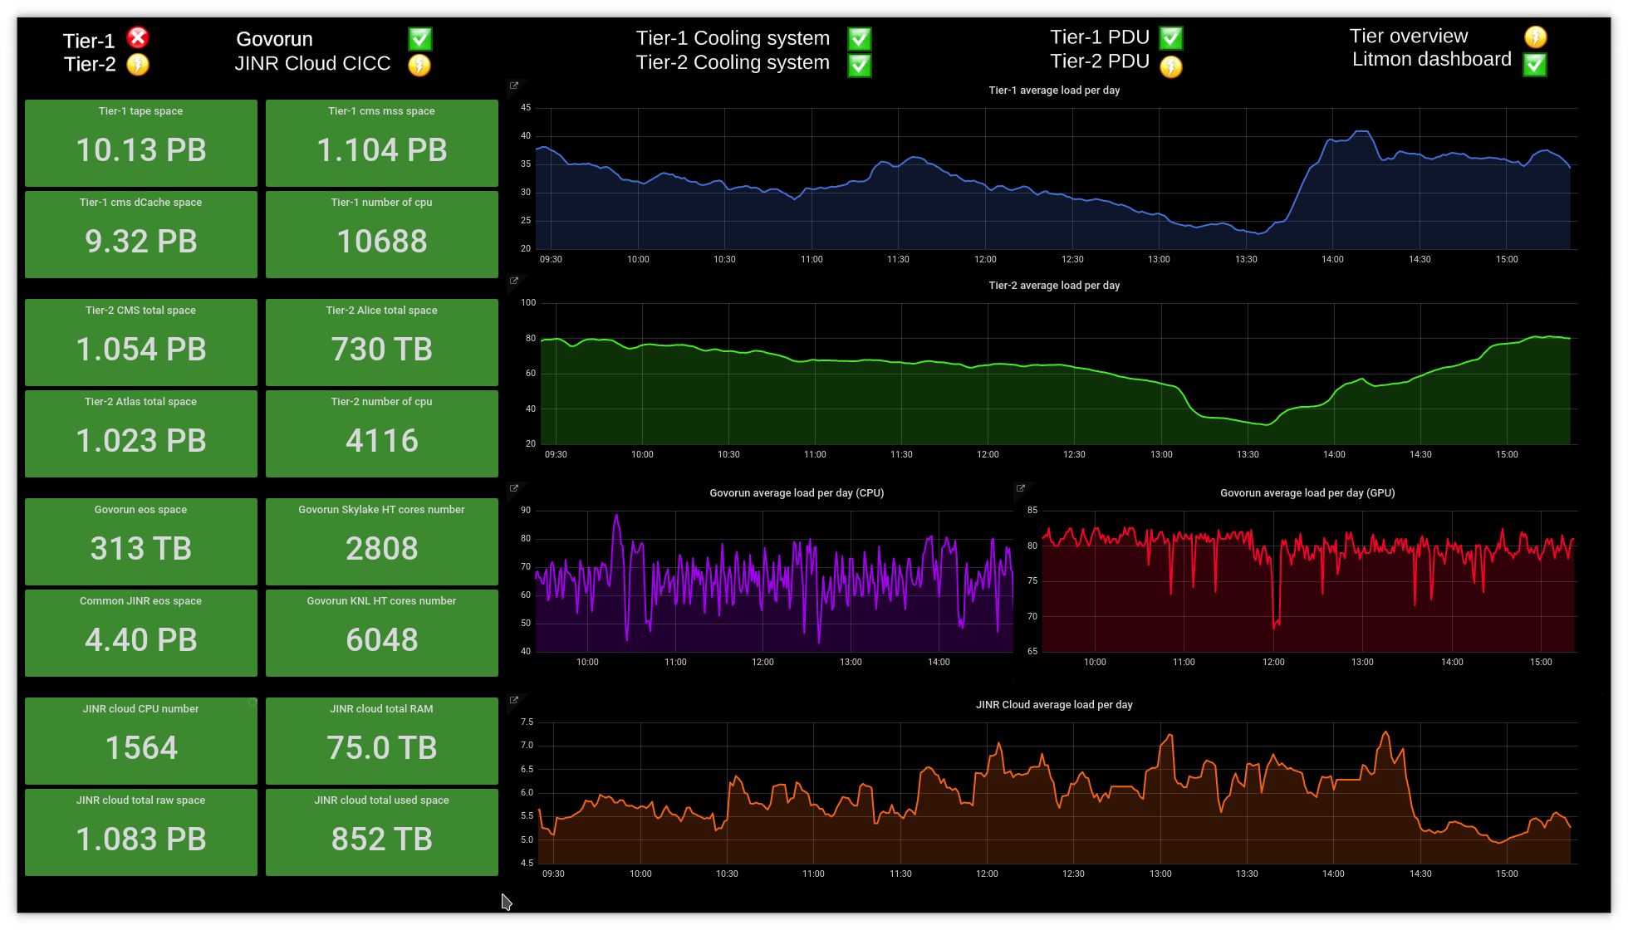
LITmon: MICC dashboard with GVR

Slide 17
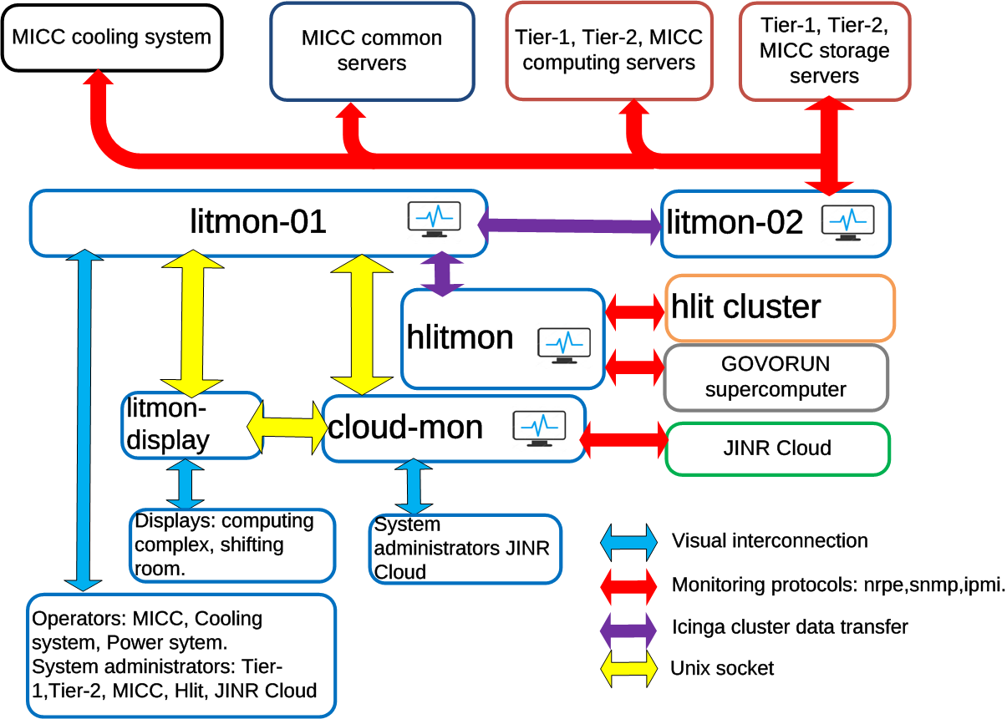
Govorun interconnection

Slide 18
Thanks for your attention!

