Slide 1




Supercomputer Govorun for fundamental research at JINR
Yuri Butenko
Heterogeneous Computation Team HybriLIT
Laboratory of Informational Technologies , JINR
23/10/2019

Slide 2
LIT Fundamentals
User policies
Computing infrastructure
Mathematical and software support
Corporative information system
Training, education and user support
LIT

Slide 3
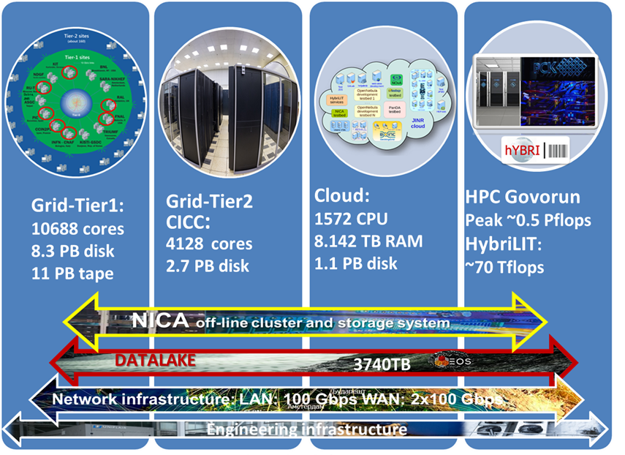

JINR MICC

Slide 4
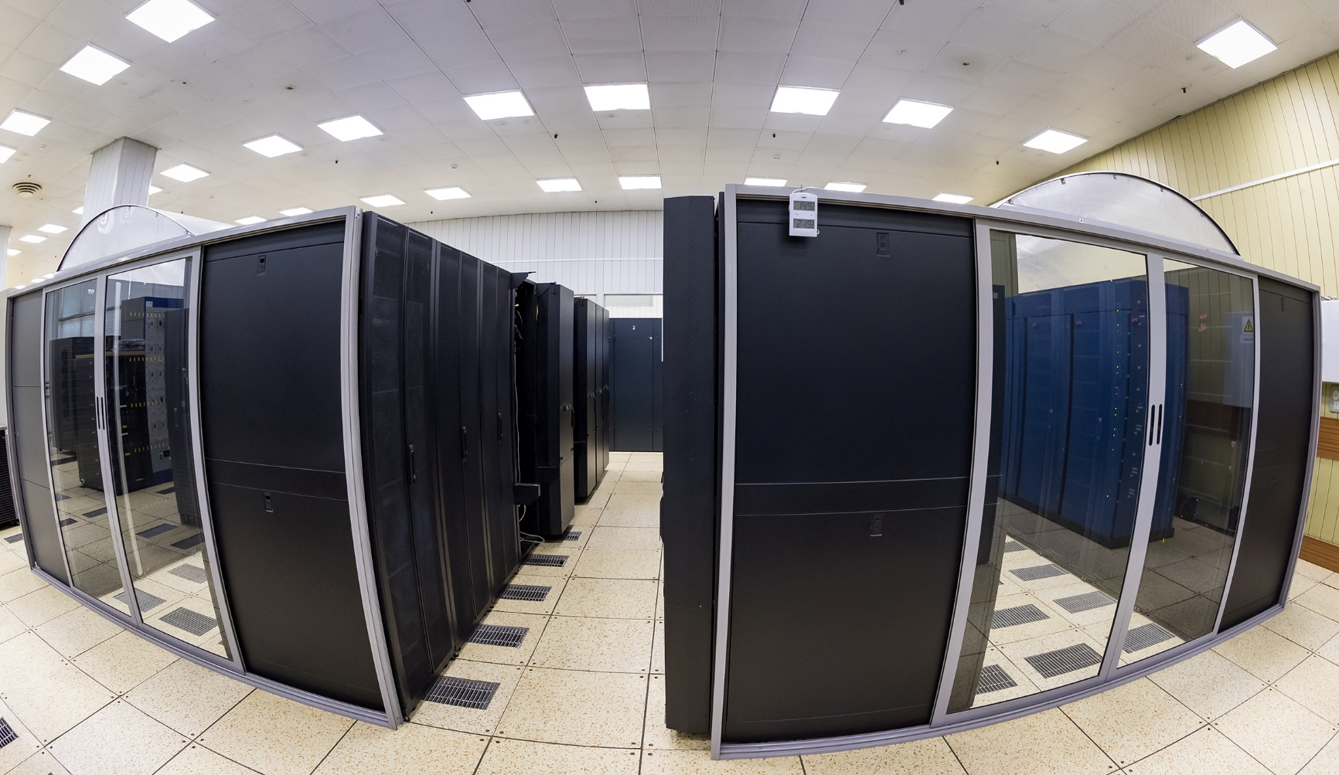
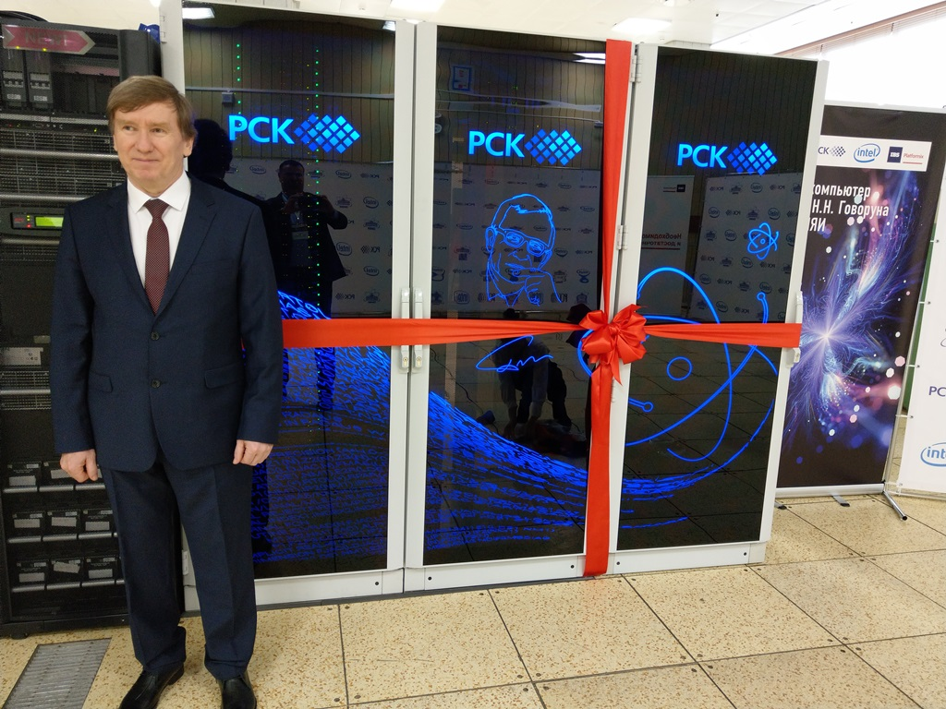
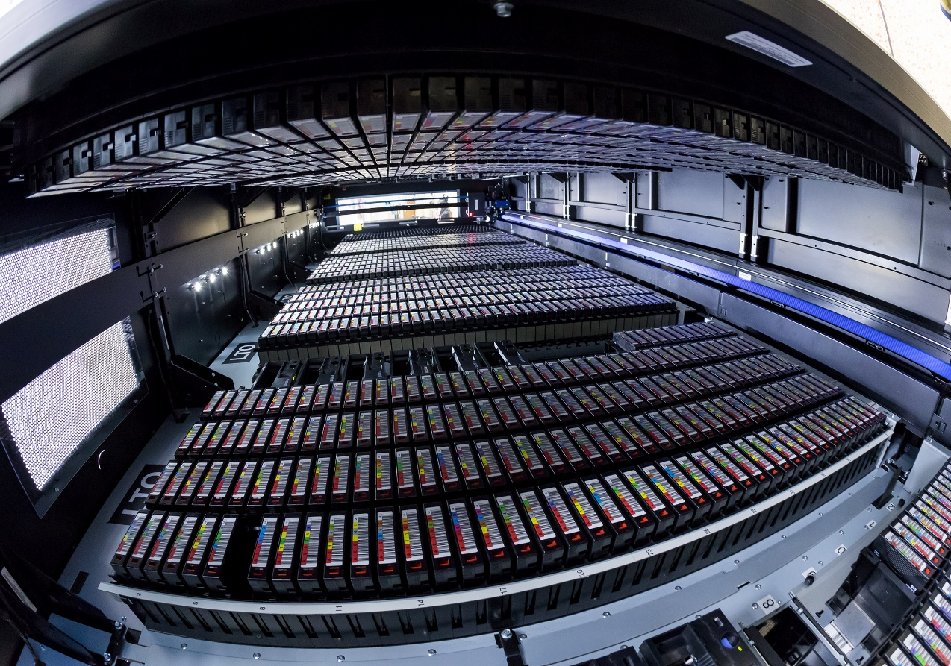
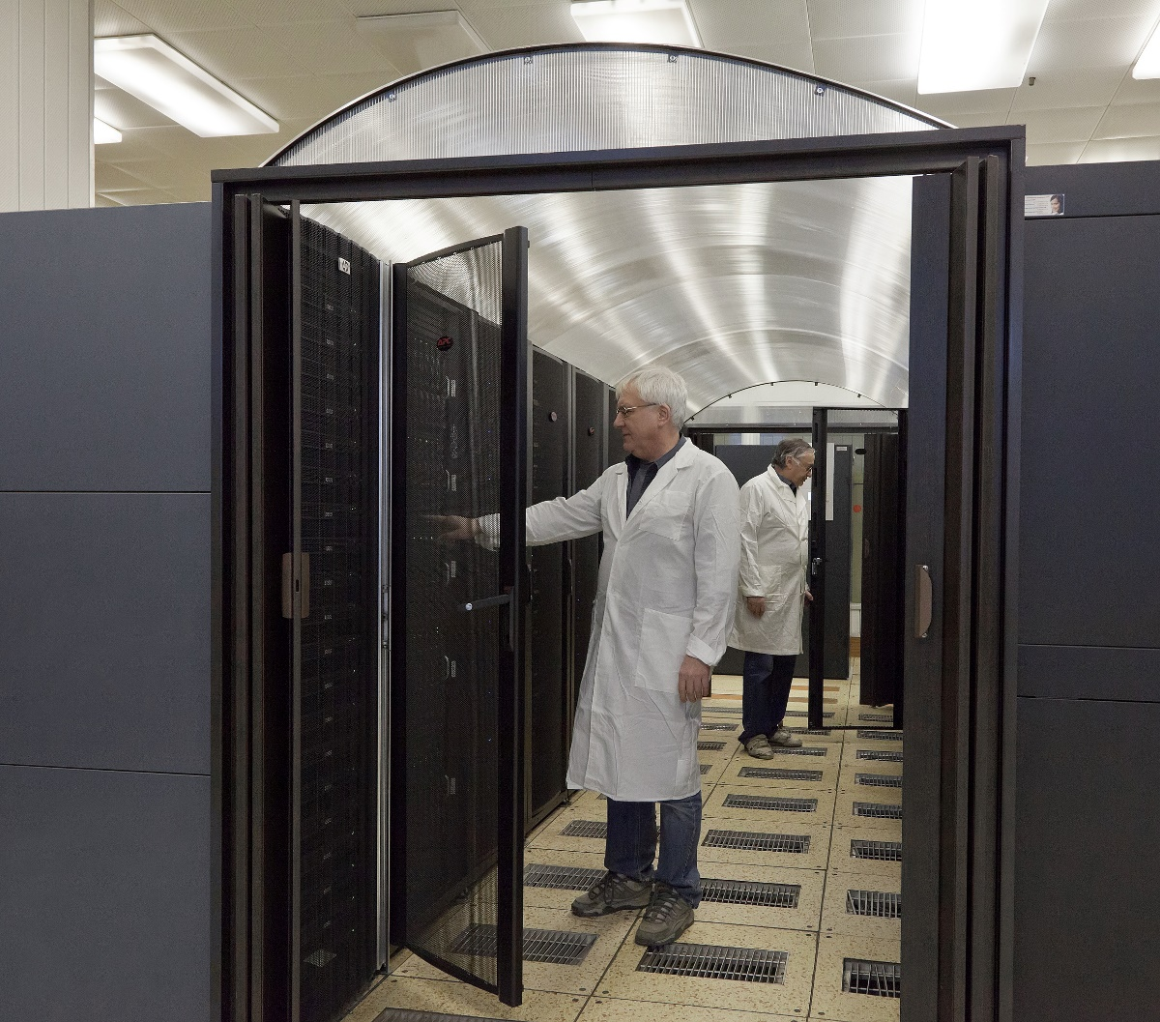
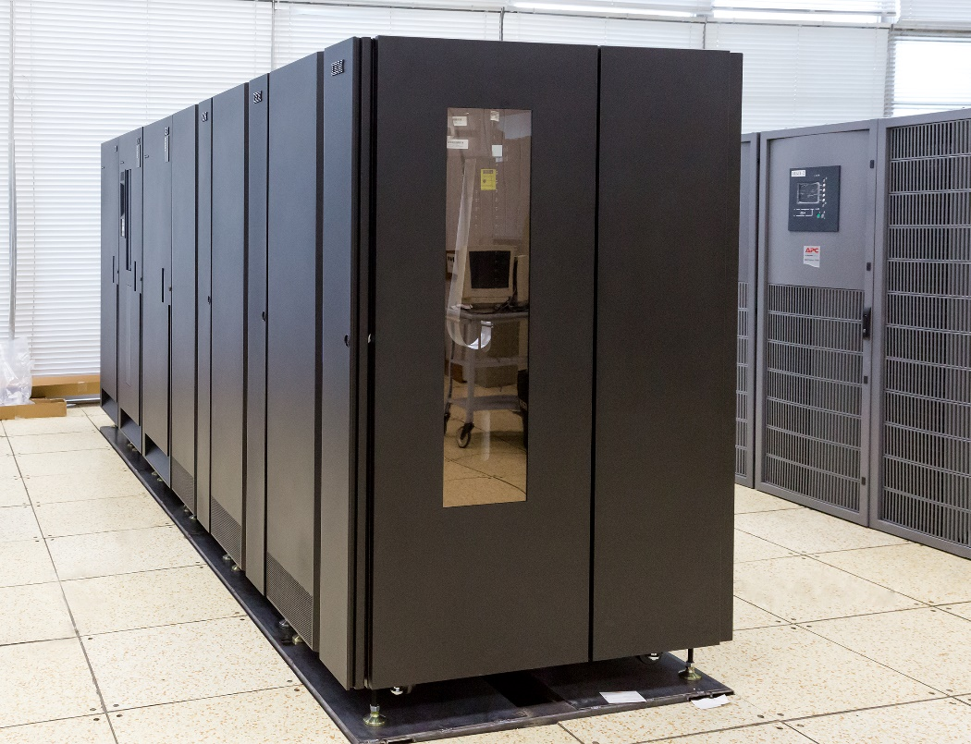
LIT computing infrastructure
Network infrastructure
3 x 100 Gb/sec
Grid infrastructure
- Tier1-center for CMS
- Tier2-center for all
LHC experiments
Cloud infrastructure uniting the clouds of the JINR Member States
Supercomputer «GOVORUN»
Advanced storage system

Slide 5
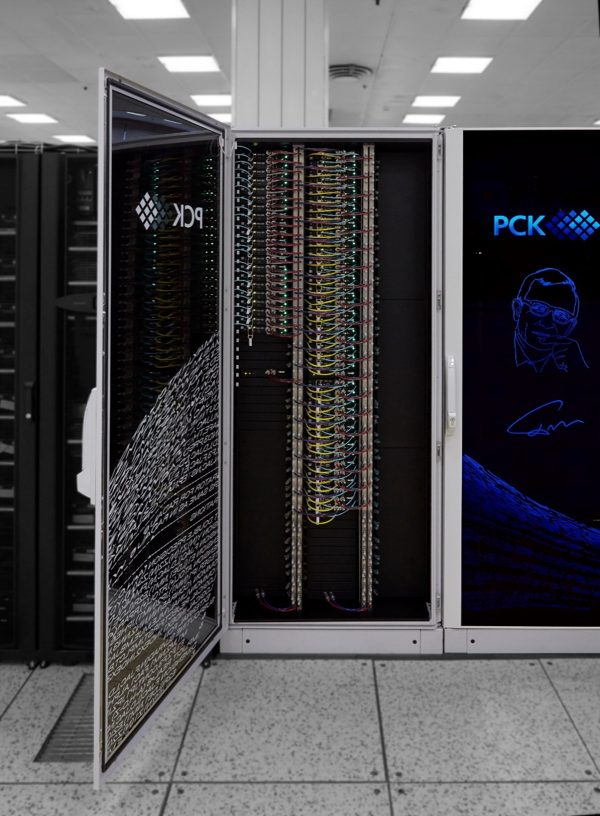
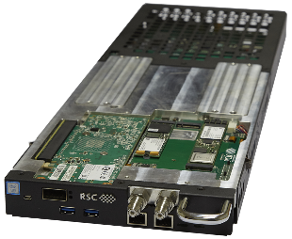
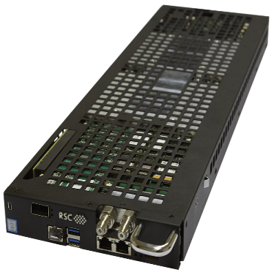




Current CPU-component
40
21
RSC Tornado nodes based on
Intel® Xeon® Scalable:
  Intel® Xeon® Gold 6154 processors (18 cores)
  Intel® Server Board S2600BP
  Intel® SSD DC S3520 (SATA, M.2), 2 x Intel ® SSD DC P4511 (NVMe, M.2) 1TB
  192GB DDR4 2666 GHz
  Intel® Omni-Path 100 Gb/s adapter
RSC Tornado nodes based on Intel®
Xeon Phi™:
  Intel® Xeon Phi™ 7190 processors (72 cores)
  Intel® Server Board S7200AP
  Intel® SSD DC S3520 (SATA, M.2)
  96GB DDR4 2400 GHz RAM
  Intel® Omni-Path 100 Gb/s adapter
Multi-level management software RSC BasIS

Slide 6
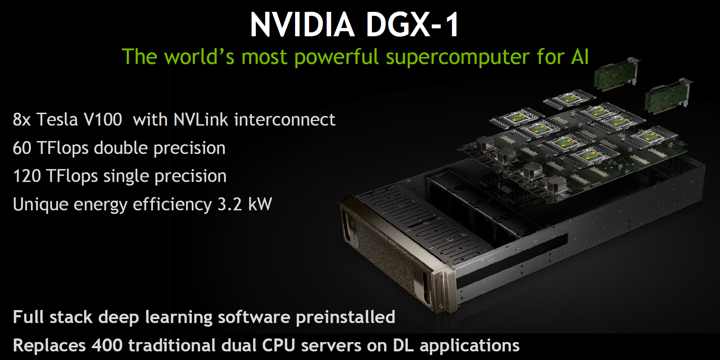
Current GPU-component

Slide 7


Heterogeneous platform “HybriLIT”
Unified software and information environment
Education and testing
polygon HybriLIT
Supercomputer GOVORUN
Skylake
1440 cores
KNL
1512 cores
CPU-component
Intel Skylake
Intel
Xeon
Intel
Xeon Phi
40 nodes
CPU-component
Intel Xeon Phi (KNL)
Volta
205 000 CUDA cores
26 000 Tensor cores
K40, K80
78 000 CUDA cores
21 nodes
NVIDIA Tesla K20
NVIDIA Tesla K40
NVIDIA Tesla K80
GPU-component
GPU DGX-1 Volta
(NVIDIA Tesla V100)
5 nodes
10 computational nodes
Total peak performance:
1 PFlops for single precision
0,5 PFlops for double precision

Slide 8
SLURM
(workload manager)
System Level
Software for parallel computing:
OpenMPI 1.8.8, 2.0.1, 2.1.2, 3.1.3;
CUDA 7.0, 8.0, 9.1, 9.2, 10.0;
GNU 4.8.5, 4.9.3, 6.2.0, 7.2.0, 8.2.0;
Intel Parallel Studio XE 2018, 2019
Licensed math. software
COMSOL 5.3а
MATLAB R2017b
Mathematica 11.2
Maple 2017.3
OS: Scientific
Linux 7.6
xCAT
(Cluster Administration Toolkit)
FS: NFS
FS: ZFS
FS: EOS
HybriLIT
Software and Information Environment
CernVM-FS
(Virtual Software Appliance)
FreeIPA
(identity manager solution)
MODULES
HybriLIT web-site
http://hybrilit.jinr.ru/
User level
Indico:
http://indico-hybrilit.jinr.ru
GitLab:
https://gitlab-hybrilit.jinr.ru
Ecosystem for ML/DL
HybriLIT user support:
https://pm.jinr.ru/projects/hybrilit-user-support
HLIT-VDI
Monitoring:
https://home-hlit.jinr.ru/
Monitoring (MobiLIT):
http://hybrilit.jinr.ru/mobilit/

Slide 9
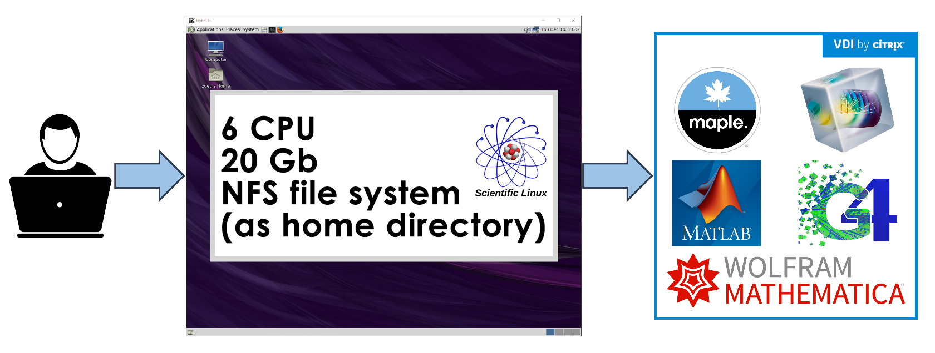
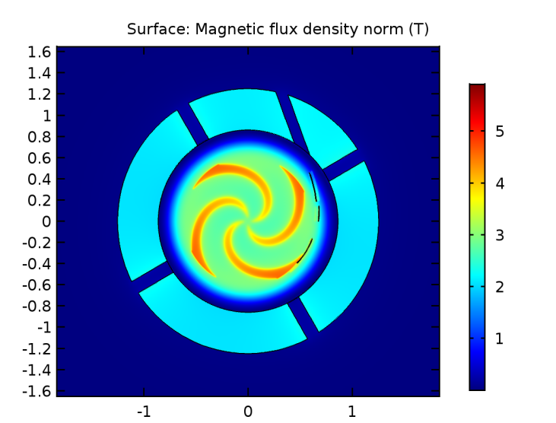
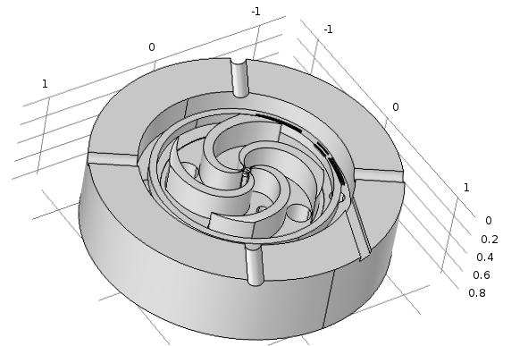
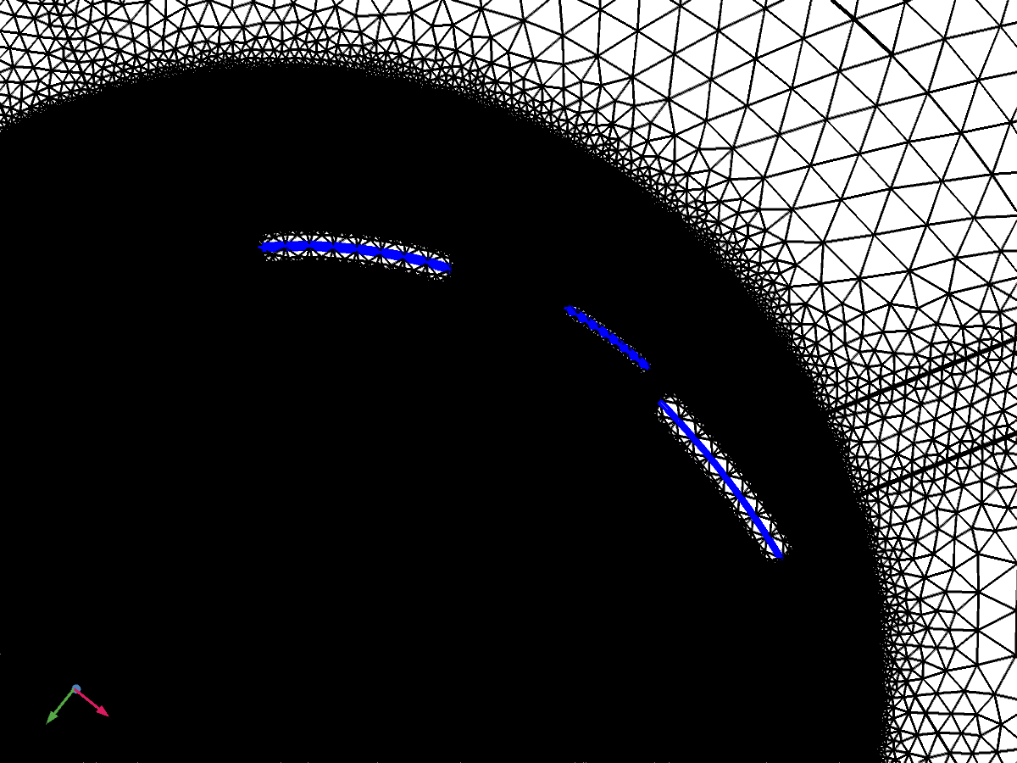
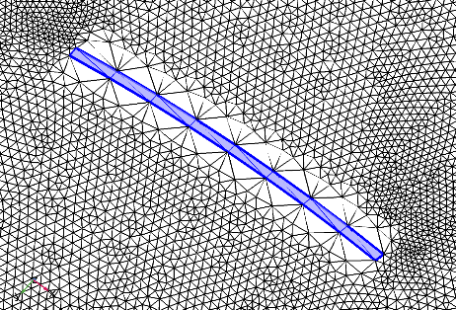
HLIT-VDI – Virtual desktops system
Superconducting magnet SC200
designed for medical application
Magnetic field distribution at
median plane of the magnet
Computational mesh
Notes:
Example using of HLIT-VDI service. Modelling and simulation of the magnetic field distribution for design and production of the superconducting magnet SC200 with COMSOL Multiphysics

Slide 10
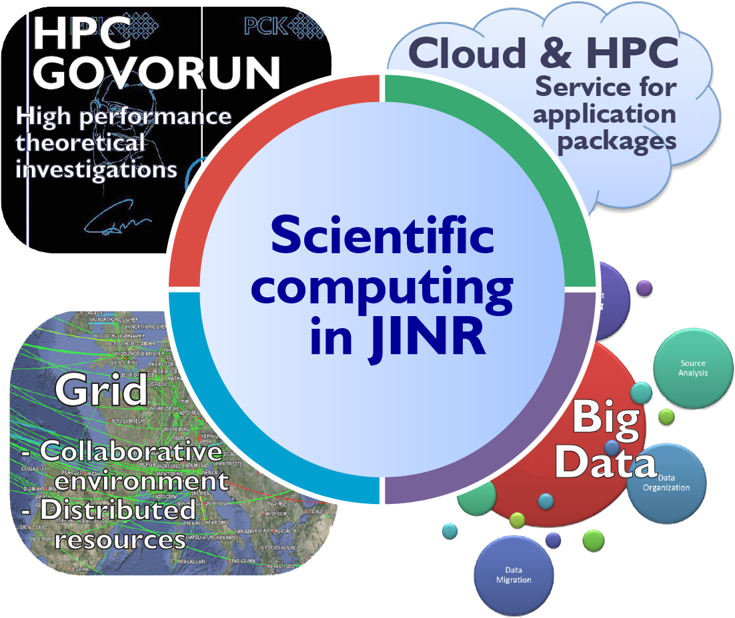
Computing in High Energy and Nuclear Physics
Big variety of
  architectures,
  platforms,
  operational systems,
  network protocols,
  software products.
Notes:
The interface of the uniform environment should provide a way for organization of collective development, solution of problems of various complexity and subject matter, management and processing of data of various volumes and structures, training and organization of scientific and research processes.
=======
Интерфейс единой среды должен обеспечивать возможность организации коллективного развития, решения проблем различной сложности и тематики, управления и обработки данных различных объемов и структур, обучения и организации научно-исследовательских процессов.

Slide 11
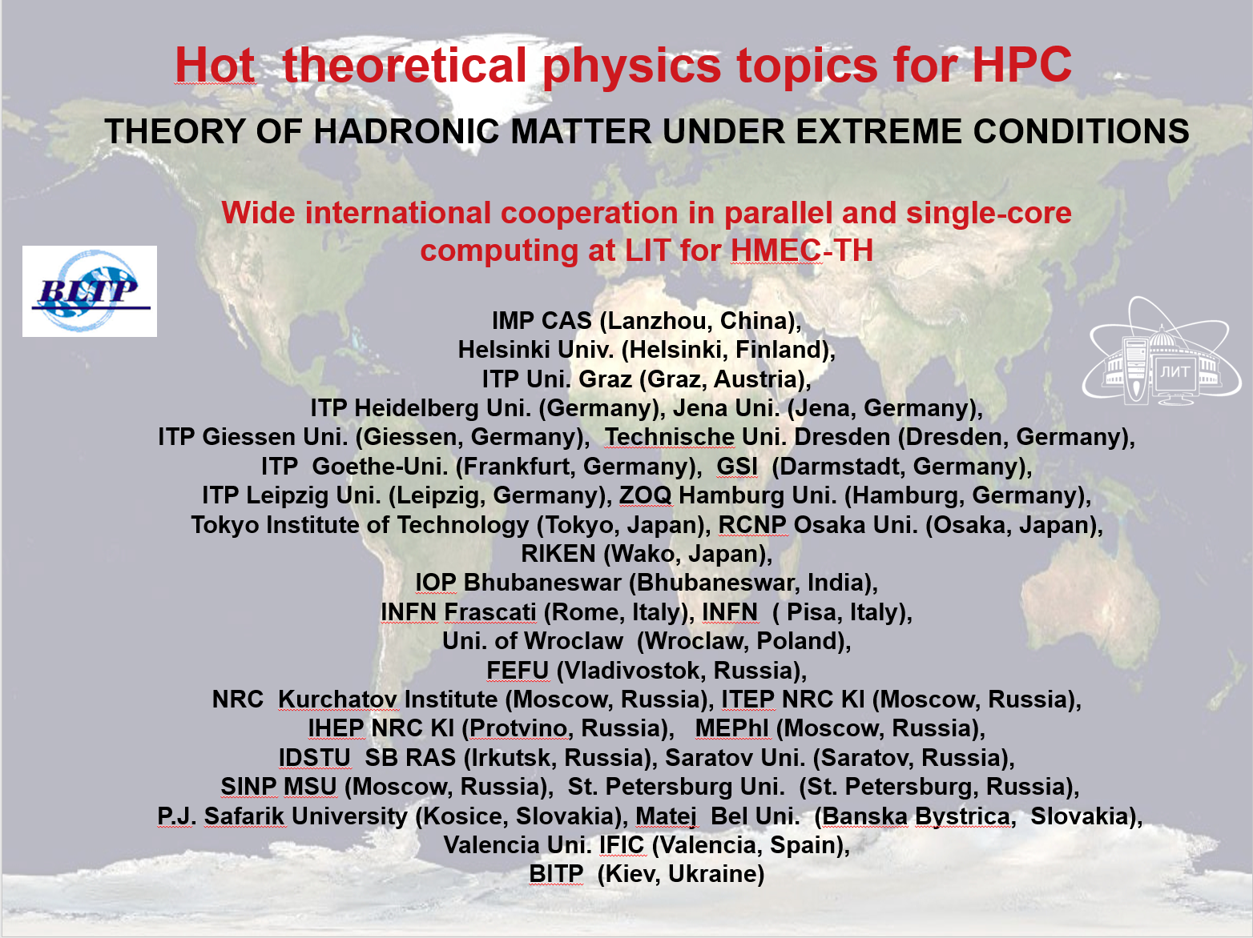
Computing in High Energy and Nuclear Physics
Notes:
The interface of the uniform environment should provide a way for organization of collective development, solution of problems of various complexity and subject matter, management and processing of data of various volumes and structures, training and organization of scientific and research processes.
=======
Интерфейс единой среды должен обеспечивать возможность организации коллективного развития, решения проблем различной сложности и тематики, управления и обработки данных различных объемов и структур, обучения и организации научно-исследовательских процессов.

Slide 12

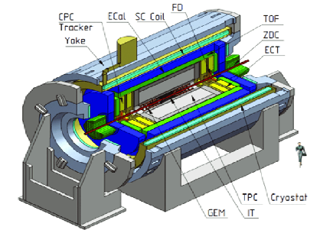

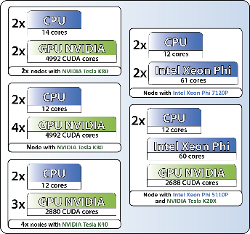


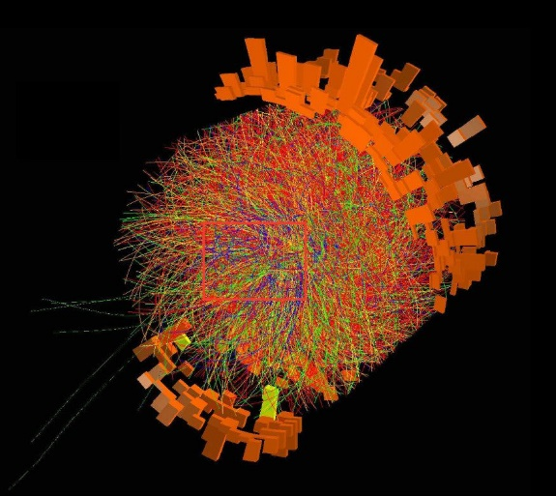
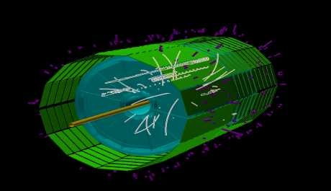
Computing for megaproject NICA
on supercomputer GOVORUN
GOVORUN
“Cold” Data Storage
EOS FS
“Cold” Data Storage
ZFS FS
“Hot” Data Storage
Lustre FS
Modeling:
physical events;
receiving data from detectors.
Data storage organization.
MpdRoot
Geant
A simulation toolkit
Particles generator
- internal
- external
Events reconstruction

Slide 13
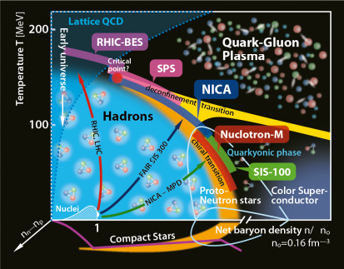
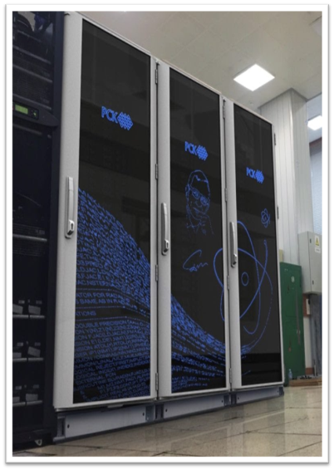
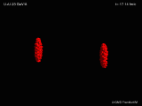
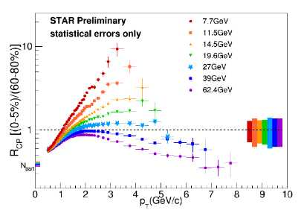
NICA computing challenge
MPD experiment
GOVORUN
QCD phase diagram
Events reconstruction
Simulations
Physics analysis

Slide 14
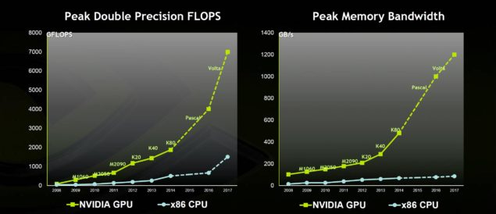
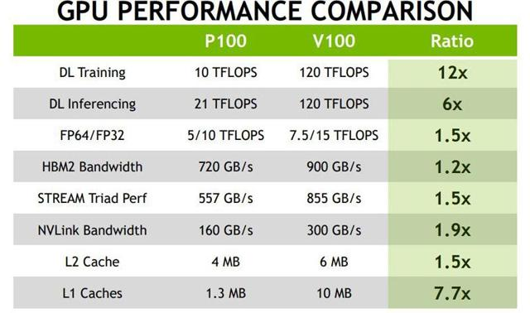
GPU Performance trend

Slide 15

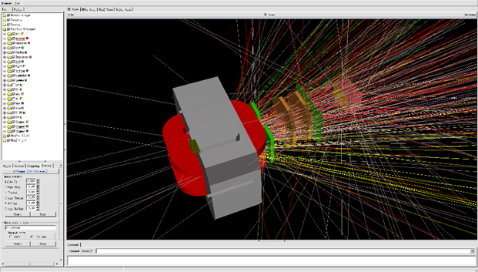
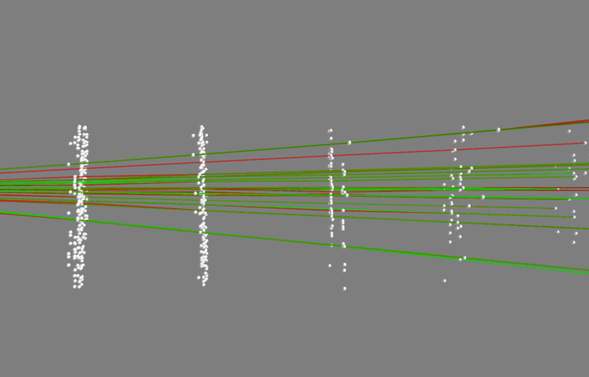
ML Tracks Reconstruction
BM@N
Machine learning algorithms bring a lot of potential to the tracks reconstruction problem due to their capability to learn effective representations of high-dimensional data through training, and to parallelize on HPC architectures.
Simulation data
Input data for the first step algorithm were simulated by GEANT in MPDRoot framework for the real BM@N configuration.
Real track
True found track
White dots are
both hits and fakes.
Ghost track
G.Ososkov et al. Deep learning for tracking NEC-2017
Efficiency 97,5%

Slide 16
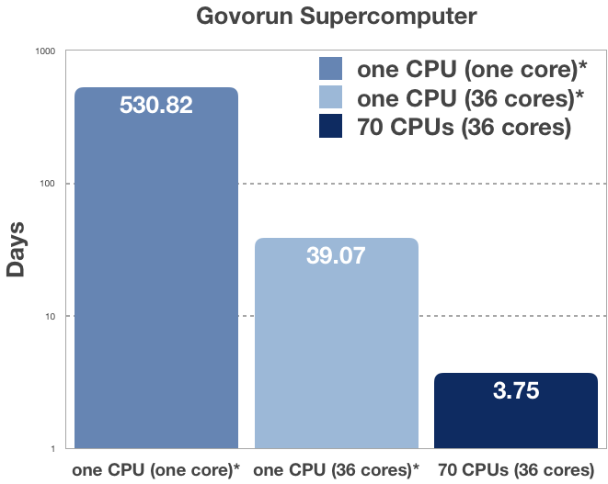
Optimization problem for the heat equation towards improvement of the “temperature valves” characteristics
1000
A hybrid algorithm MPI+OpenMP has been developed for solving optimization problem for nonlinear unsteady heat equation. The optimization problem has been formulated in order to improve design of the so-called “temperature valves” technique for the pulse injection (in the millisecond range) of working gases into the multiply charged ion source ionization chamber.
~ 1.5 years
100
Acceleration
on Govorun:
142 times
~ 1.5 month
10
1
The work has been done in collaboration with colleagues from VBLHEP and IEP SAS (Kosice, Slovakia)
A. Ayriyan, J. Busa Jr., E. E. Donets, H. Grigorian, J. Pribis. Applied Thermal Engineering (2016), v. 94, pp. 151-158.
A. Ayriyan, J. Busa Jr. et al. Hybrid algorithm for optimization problem. (in preparation)

Slide 17
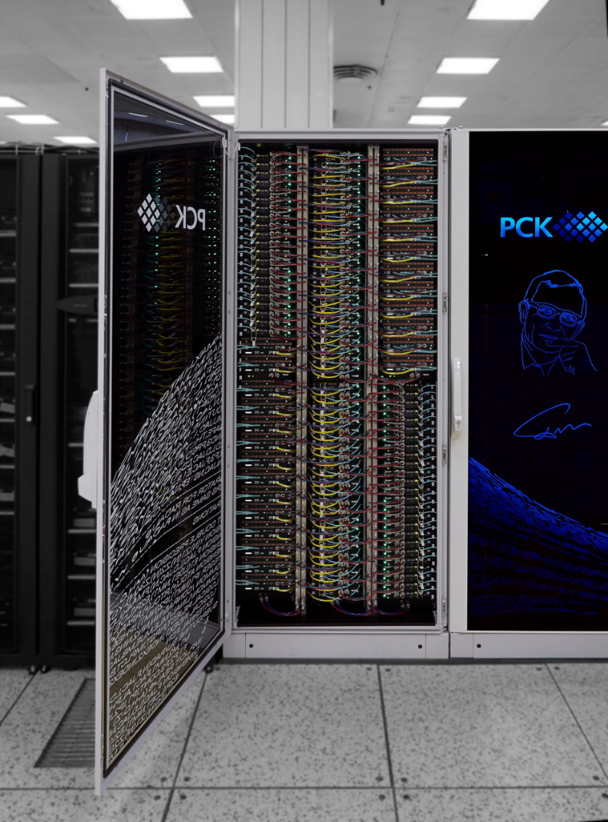
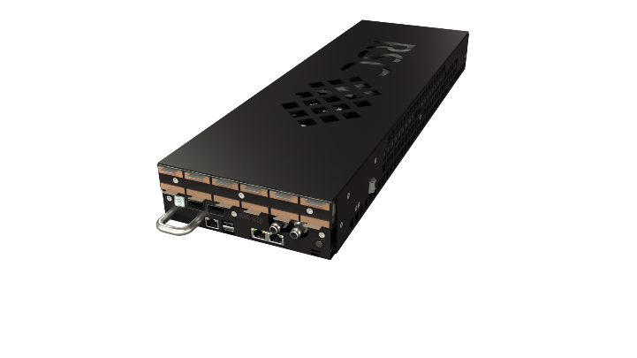

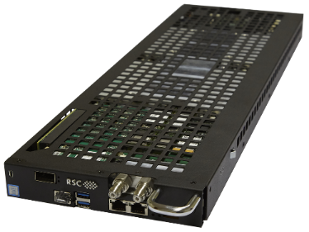
Proposed GOVORUN system extension
12
Modules of fast parallel data processing and analysis
14
Modules of fast scalable parallel file system (Lustre, EOS etc.)
40
Modules for additional workload and data analysis
RSC BasIS software to support Software Defined File System-on-Demand service for hyper-converged system
Hyper-converged system allows to use all Storage nodes as computing ones in parallel with store/retrieve data. This will add 230 TFlops to GOVORUN system, almost doubling the CPU part performance.

Slide 18
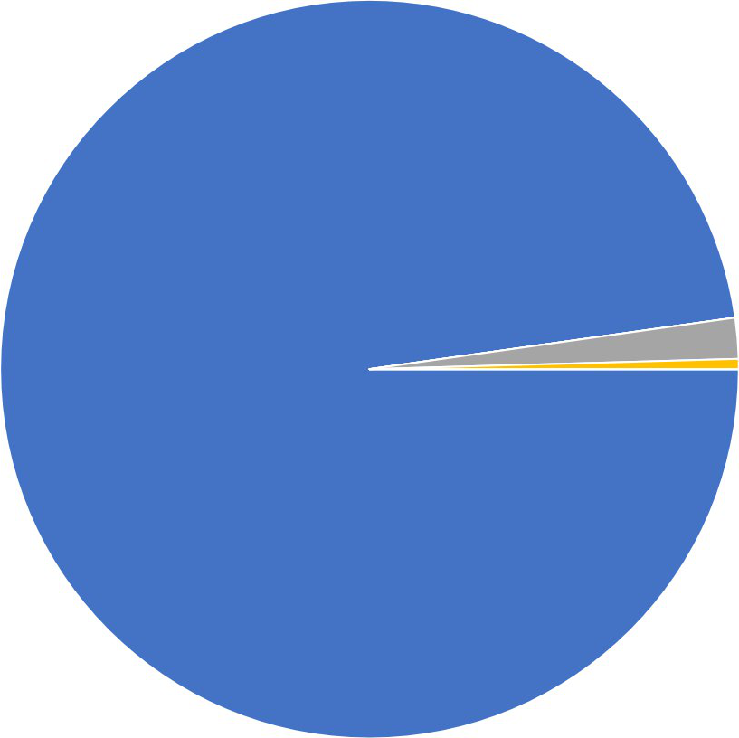
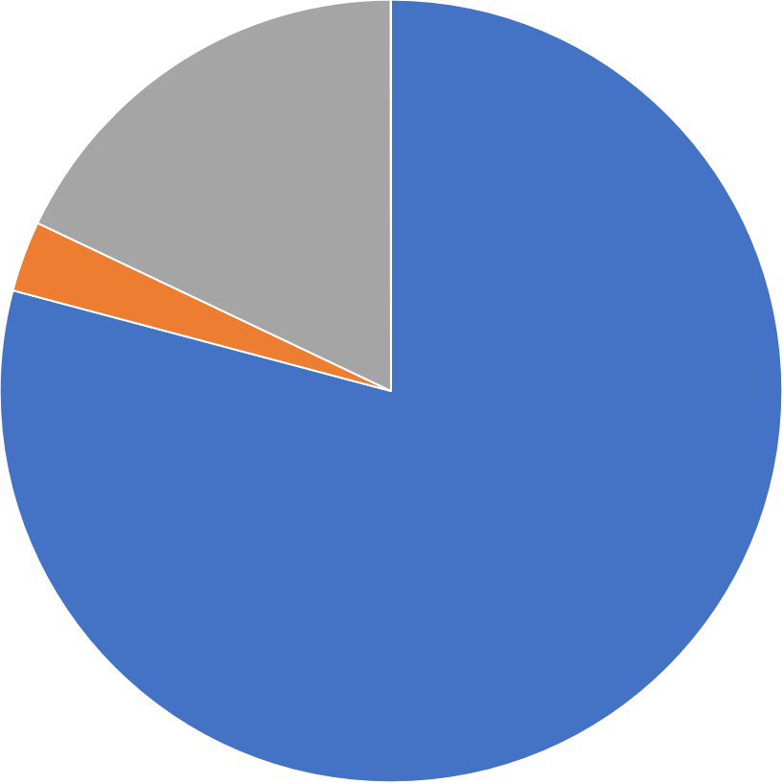
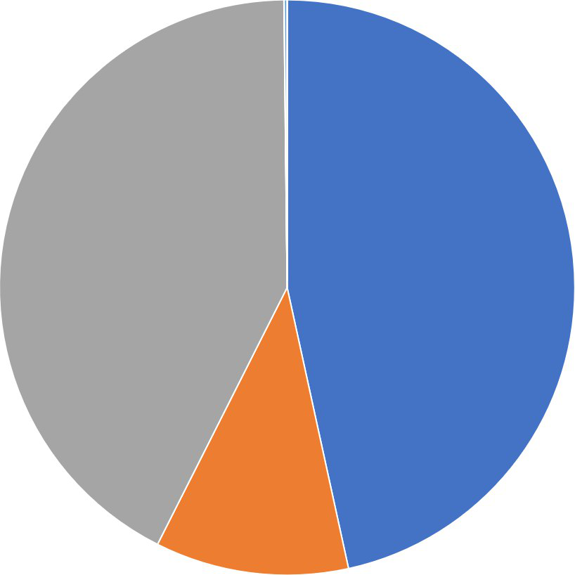
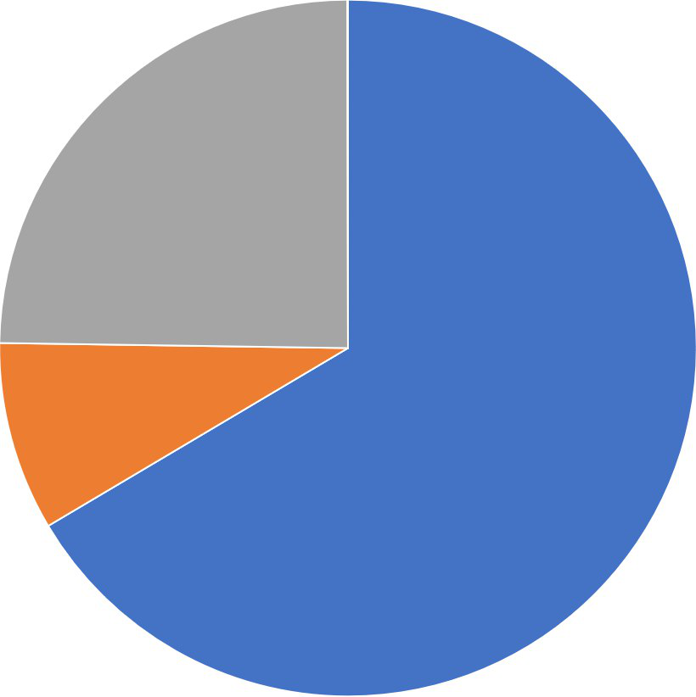
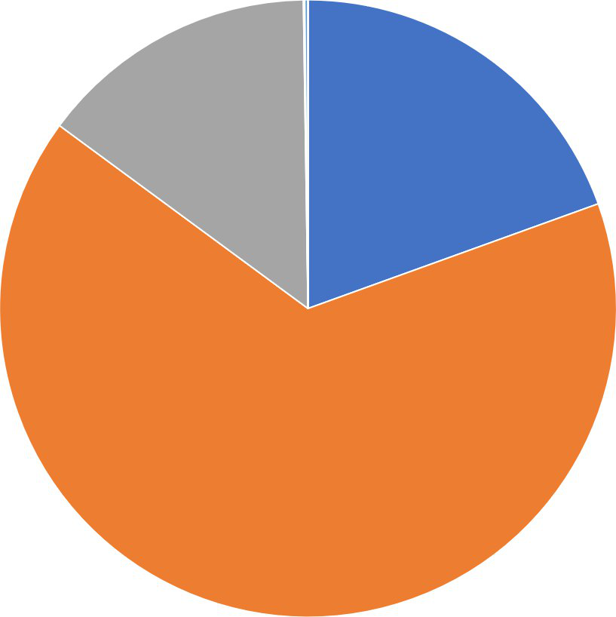
Some statistics for last year
DGX
KNL
SKYLAKE
10.8%
VBLHEP
LIT 1.9%
BLTP
46.5%
BLTP
79.1%
LIT
18%
BLTP
97.7%
DLNP 0.4%
VBLHEP 2.9%
LIT 42.7%
RESOURCES
TASKS
LIT
15%
BLTP
19.5%
LIT
24.7%
8.9%
VBLHEP
BLTP
66.4%
VBLHEP
65.5%

Slide 19
Conclusions
Various computing models for the NICA megaproject require confirmation of operability, i.e. checking requirements for the temporal characteristics of receiving data and its further processing, analysis and storage, as well as requirements for the effectiveness of modeling and processing events in the experiment.
For these purposes, it is necessary to carry out tests in a real software and computing environment, which should contain all the required components, taking into account physical characteristics of the experiment and development plans for computer technology.
BLTP
46.5%
BLTP
79.1%
LIT
18%
BLTP
97.7%
LIT 42.7%
LIT
15%
BLTP
19.5%
LIT
24.7%
BLTP
66.4%
VBLHEP
65.5%

Slide 20
Conclusions
Simulation results
Determining the throughput of the system for taking, storing, analyzing experimental data, choosing the optimal distributed file systems, selecting hardware and software components of the solution
Search and elimination of potential bottlenecks in the hardware and software complex of the experiment computing infrastructure
Defining the architecture of all components of the computing complex for the NICA megaproject
BLTP
46.5%
BLTP
79.1%
LIT
18%
BLTP
97.7%
LIT 42.7%
LIT
15%
BLTP
19.5%
LIT
24.7%
BLTP
66.4%
VBLHEP
65.5%

Slide 21

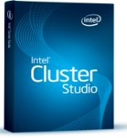















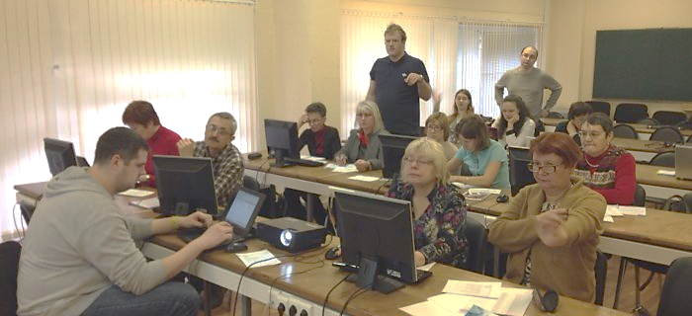

Educational program on the HybriLIT platform
Tutorials, master classes, lectures
HybriLIT team and leading scientists from JINR and JINR Member States
Leading companies of advanced computing architectures and software
Parallel Programming Technologies
Tools for for debugging and profiling applications
Framework and tools for ML / DL tasks
Work with application packages
Heterogeneous Computation Team, HybriLIT

Slide 22

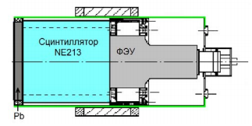
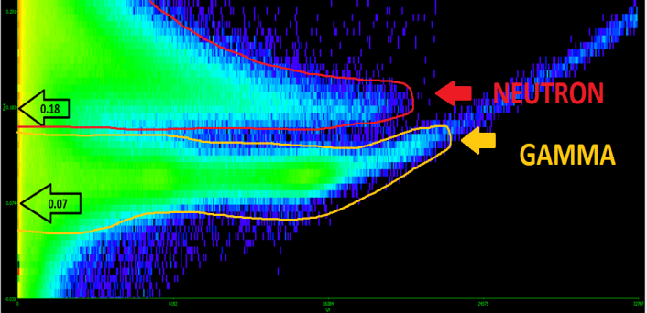
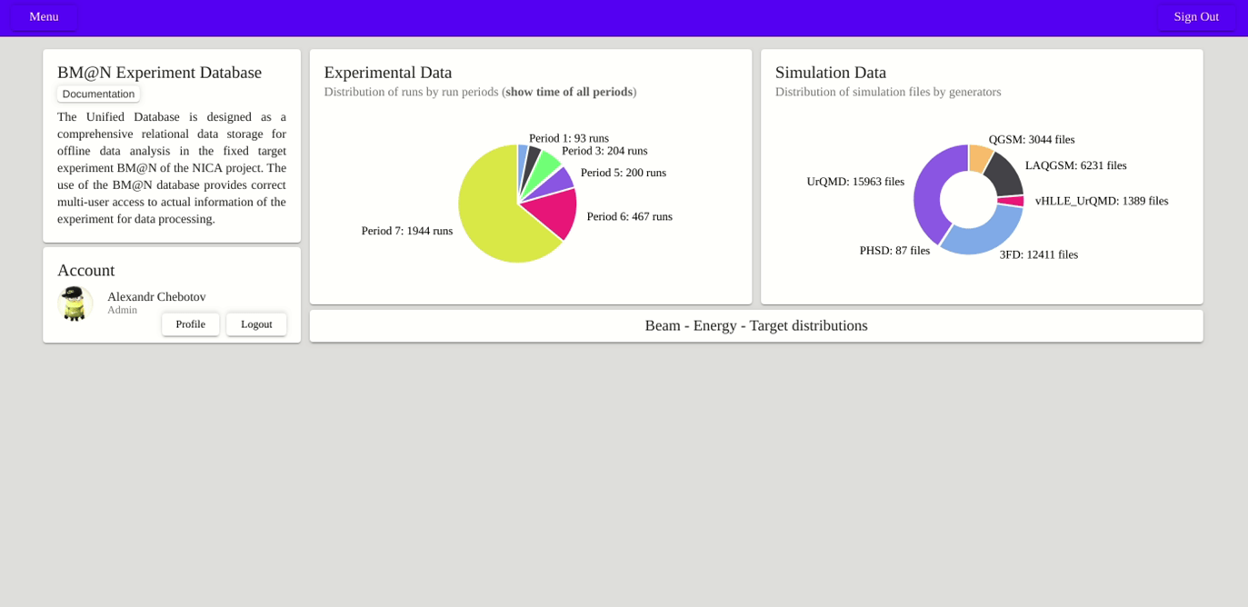
HybriLIT based IT training
Bachelor's and master's theses performed by students in JINR projects
Yu. Butenko
Master’s thesis
gamma-neutron separation problem for the DEMON spectrometer using machine learning methods
Supervisor: Korenkov V. V.
Consultants: Streltsova O. I.,
Streltsov A.I. (Germany)
Spectrometer DEMON
(DEtecteur MOdulaire de Neutrons)
With collaboration group of E.M. Kozulin (FLNR)
A. Chebotov
Master’s thesis
BM@N Experiment Stored Data Visualization System
Supervisor: Korenkov V.V..
Consultants:
Streltsova O. I.(LIT, Dubna University)
Gertsenberger K.V. (VBLHEP),
Vala M. (Slovakia)
http://hlit.jinr.ru/about_hybrilit/collaboration_dubna_uni/

Slide 23
Thanks for your attention!
Please, your questions …
http://hlit.jinr.ru

