Slide 1
HPC CLUSTER DEVELOPMENT AND OPERATION EXPERIENCE FOR SOLVING THE INVERSE PROBLEMS OF SEISMIC PROSPECTING
Biryaltsev E.V., Galimov M.R., Demidov D.E., Elizarov A.M.
Notes:
1

Slide 2


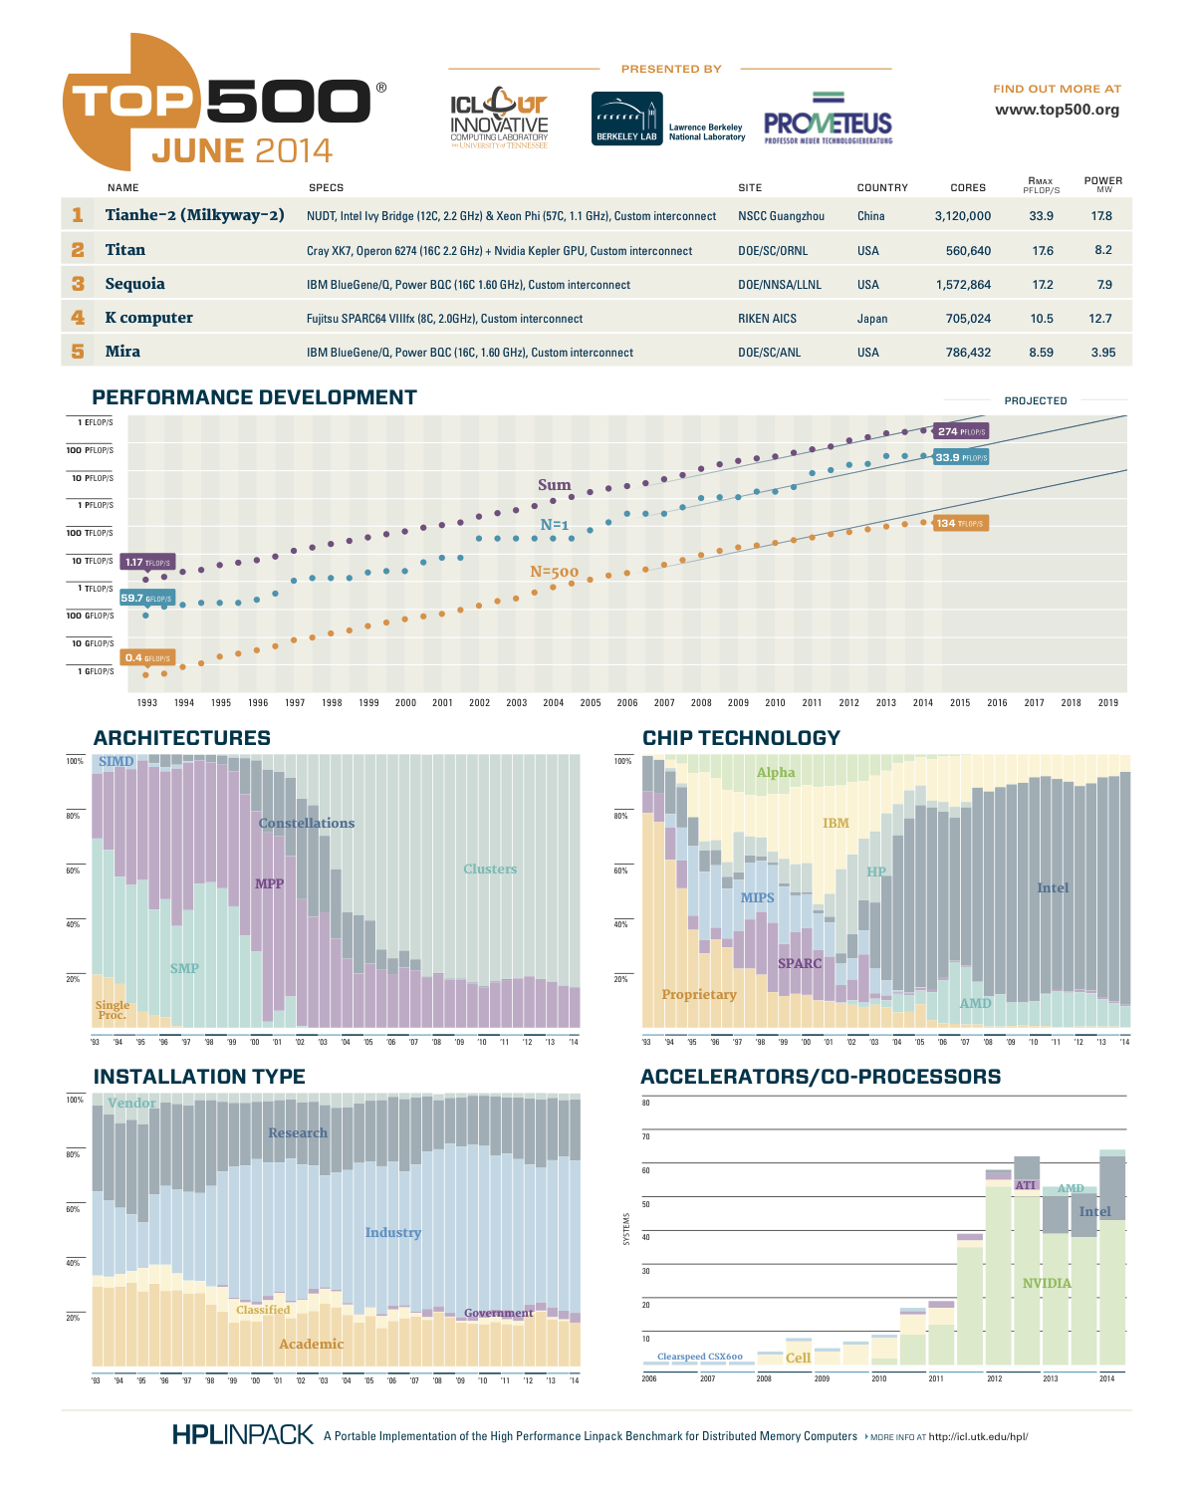
2
HPC - INDUSTRIAL DEPLOYMENT
MASS MARKET READY
Notes:
2

Slide 3

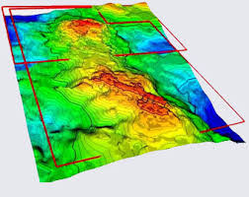
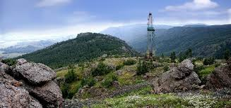
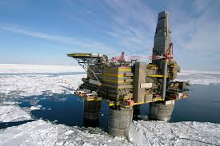
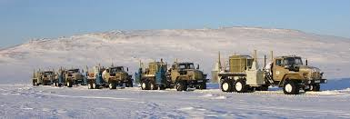
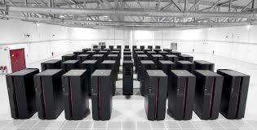
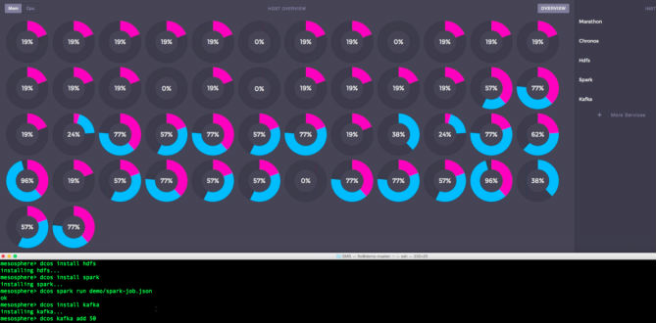
3
OIL & GAS INDUSTRY AND TECHNOLOGY REPLACEMENT
PRICE DROP
PRODUCTION & EXPLORATION COMPLEXITY
NEW SOLUTIONS REQUIRED
Notes:
3

Slide 4
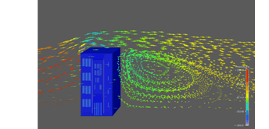
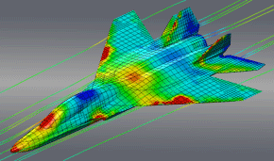
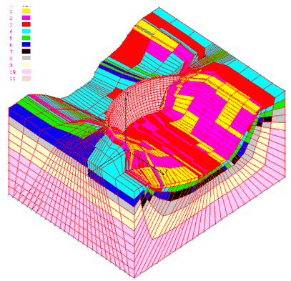
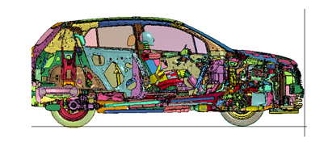
4
NUMERICAL SIMULATION
GRID SIMULATION METHODS
Notes:
4

Slide 5
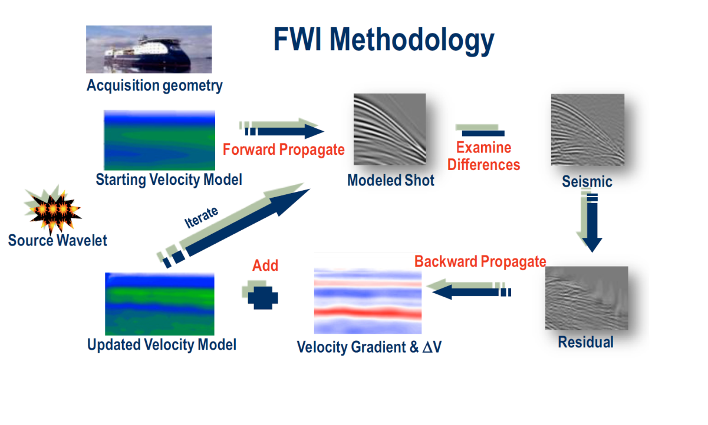
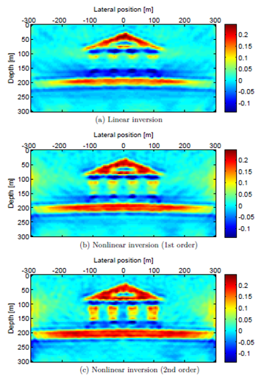
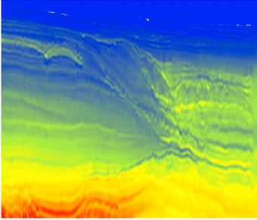
5
FULL WAVE INVERSION
Notes:
5

Slide 6
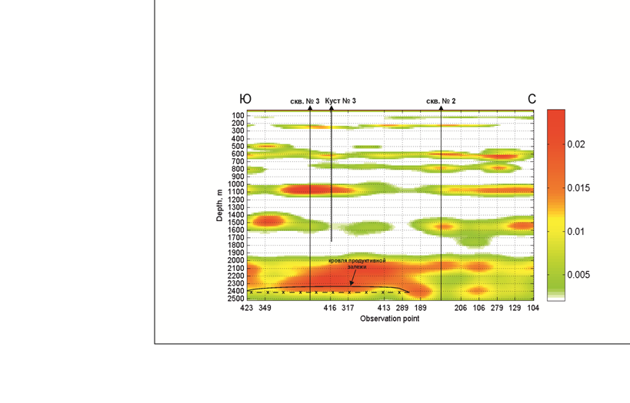
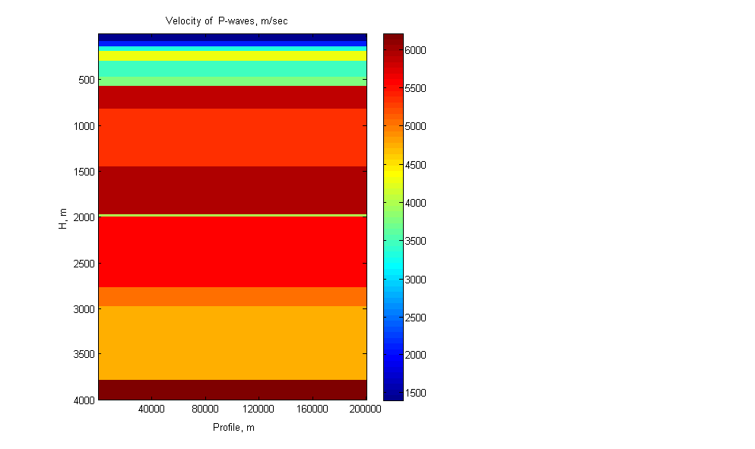
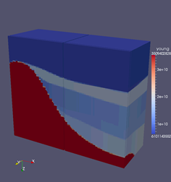
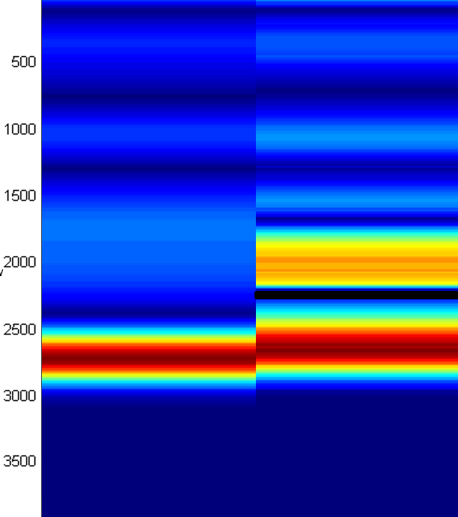
6
LOW-FREQUENCY SEISMIC SOUNDING (LFS)
Notes:
6

Slide 7
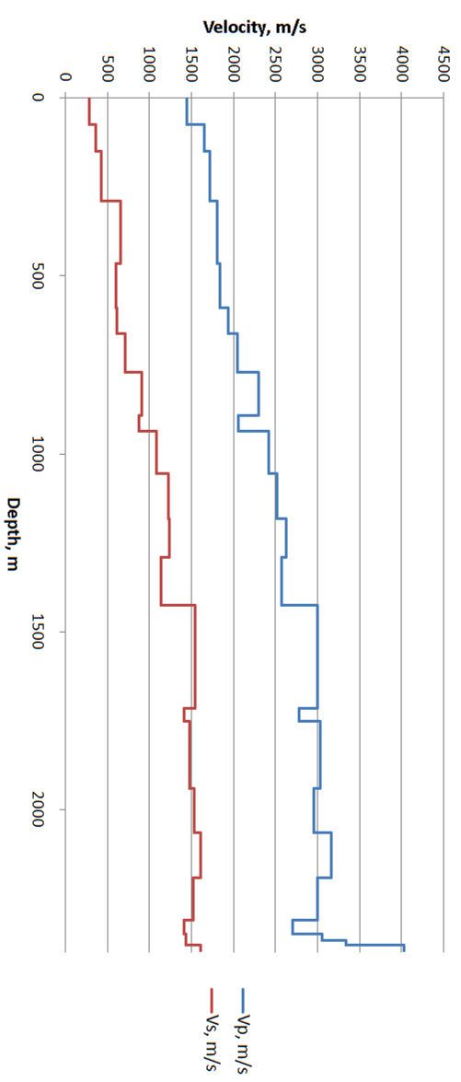
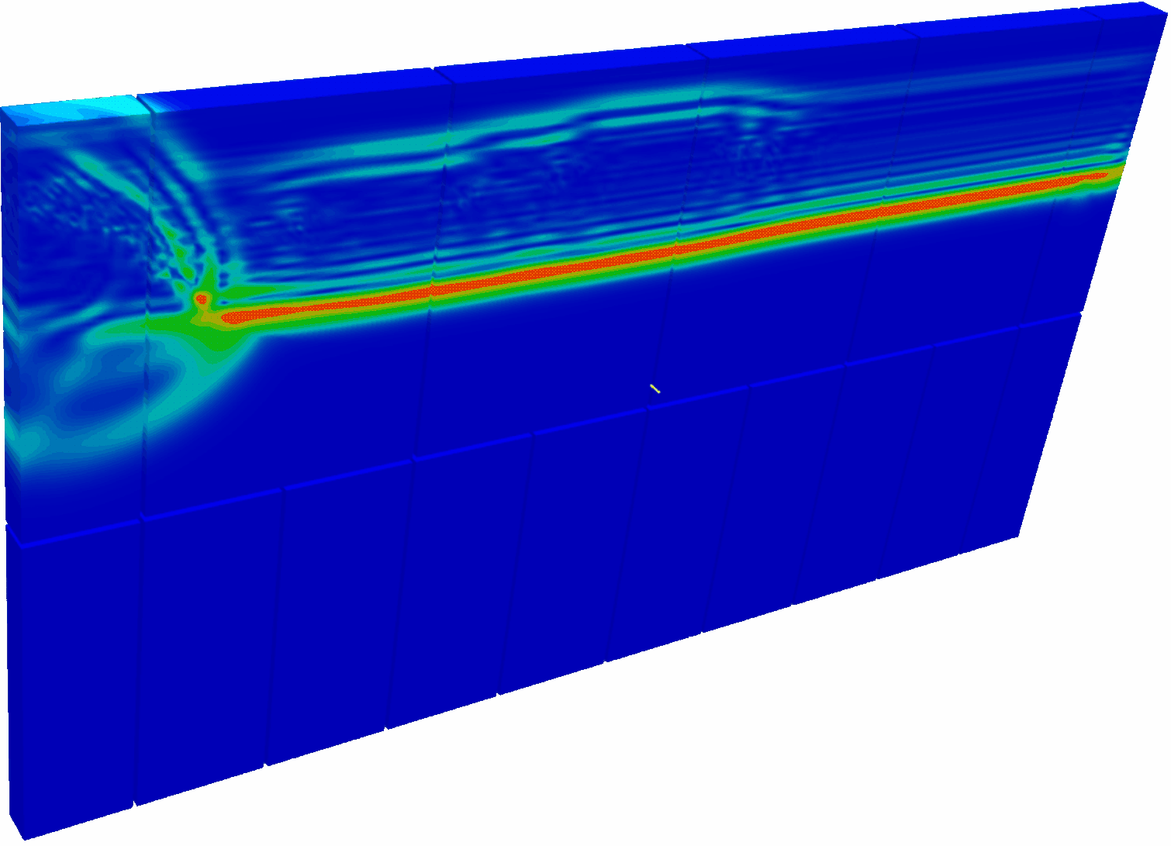
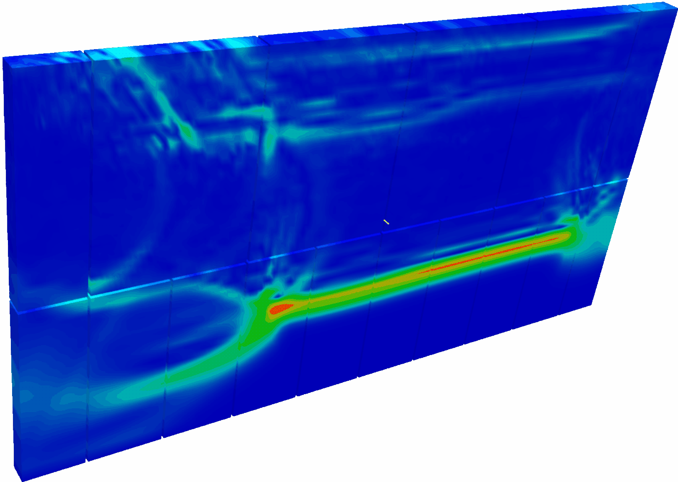
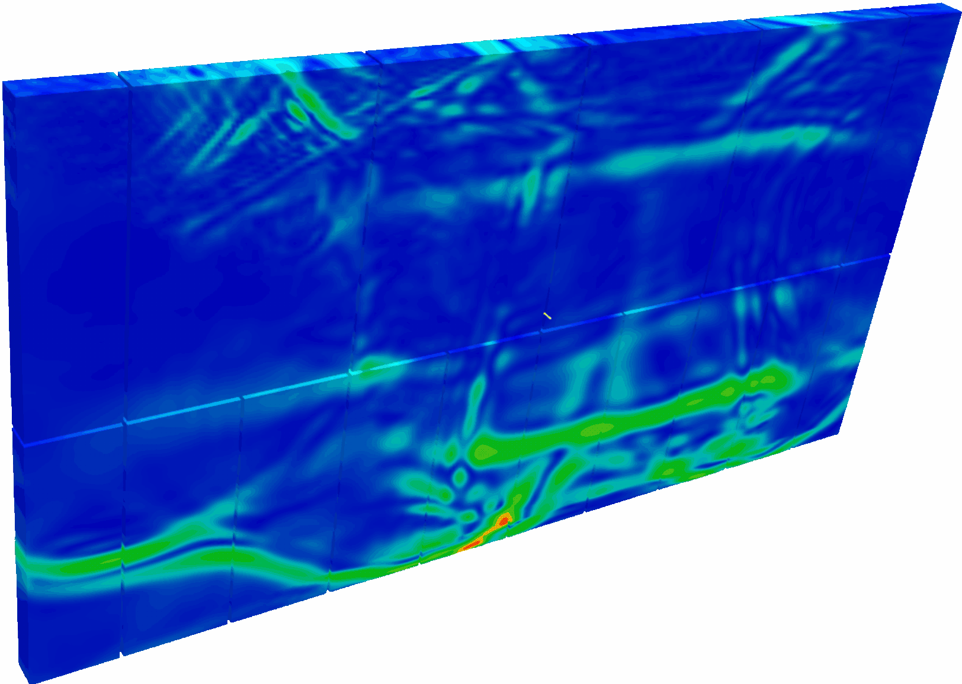
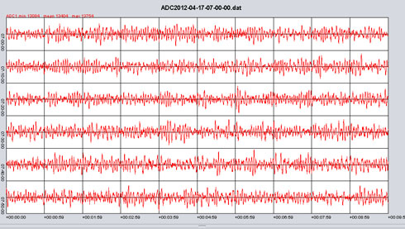
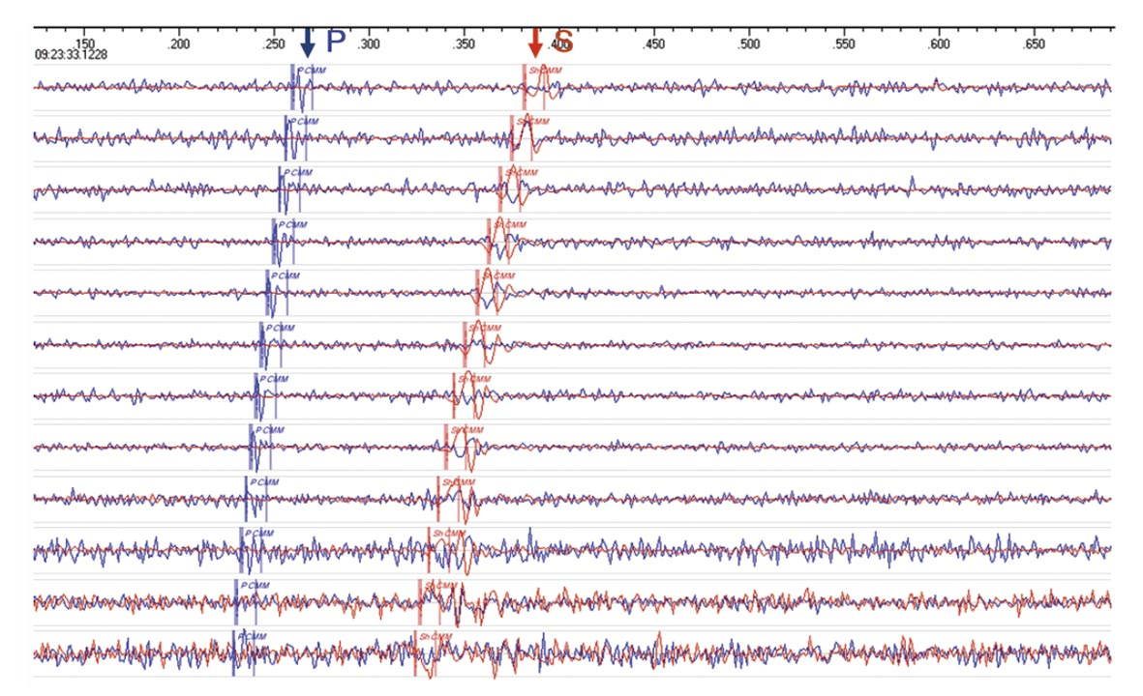
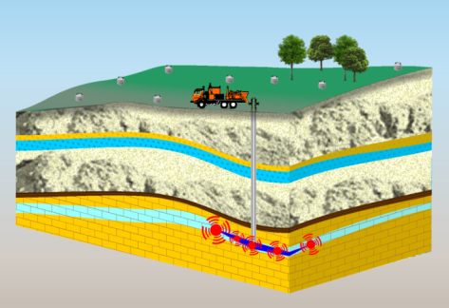
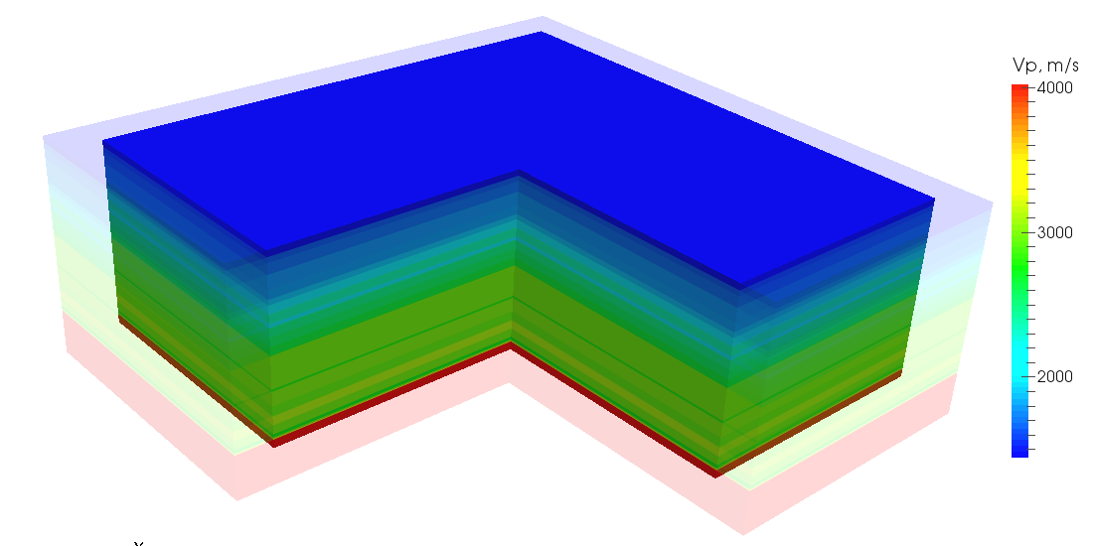
7
APPLICATIONS
Oil & gas prospecting
Fracturing control
Borehole environment monitoring
Notes:
7

Slide 8
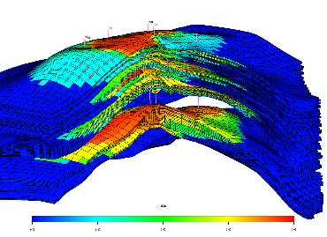


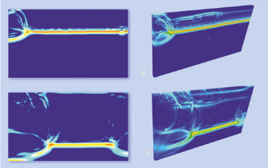


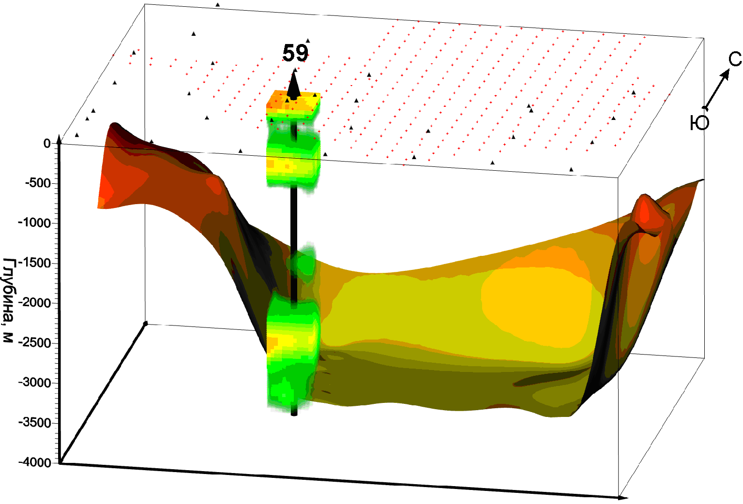
8
REQUIREMENTS
30 000 models per cycle
PERFORMANCE
10⁹ – 10¹² cells
VISUALIZATION
~1 Tb per model
BIG DATA ARRAYS
ACCESSIBILITY
Notes:
8

Slide 9


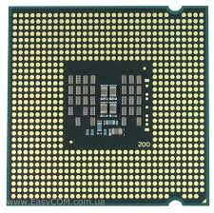
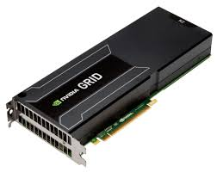
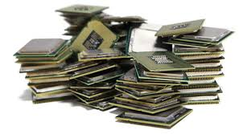
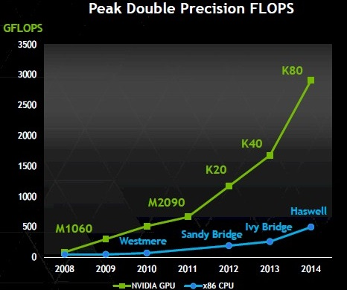
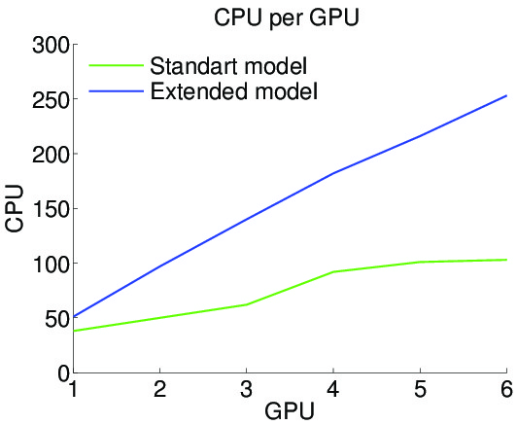


9
RESEARCH & DEVELOPMENT
GPU — EFFICIENT CHOICE
1. The best performance for the massive parallelism tasks.
2. High computation density per equipment units.
3. Perspective technology.
Notes:
9

Slide 10
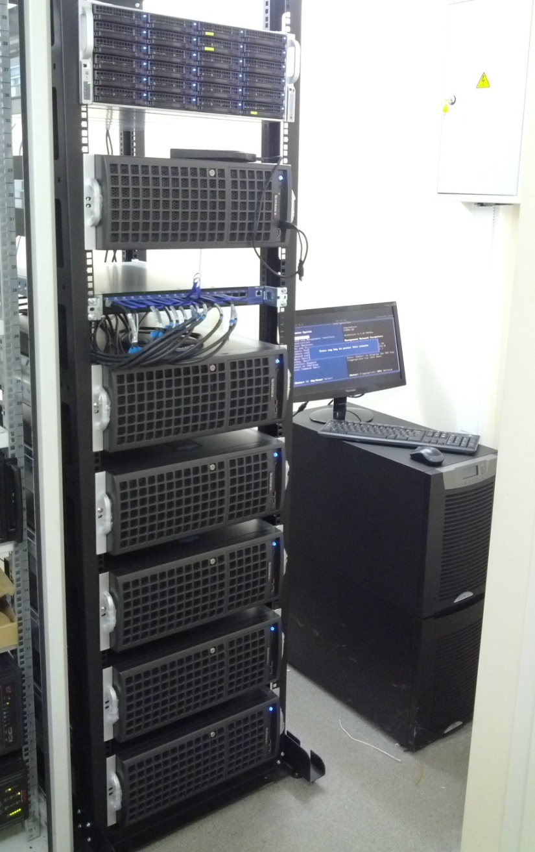
10
GPU CLUSTER
Server
>80 Tb Data storage space + SSD cache
Performance
35,6/64,9 Tflops
38th
position in
Russian top 50
supercomputers rating
Virtualization server
Citirix XenServer platform
2 x NVIDIA GK104GL with
NVIDIA GRID K2 technology
Mellanox InfiniBand
network switch
56 Gbit/s
RAM –
320 Gb
Overall disk space volumes
86 Тb
6 GPU cluster nodes
4 x AMD FirePro W9100 (16Gb GDDR5, 5.24 Tflops peak)
2 x Intel Xeon E5-2643 v2 (25M cache, 3.50 GHz,
12 threads)
UPS Eaton 9155
Power Rating 8000 / 7200 (VA/Watts)
0.7 Power factor
Notes:
10

Slide 11
11
HARDWARE & SOFTWARE ENVIRONMENT
1. GPU clusters
ОC Gentoo & Open Grid Engine
2. VexCL (vector expression template library)
OpenCL/CUDA
3. Simulation & analyze software system
С++, MPI, Java
4. VDI server
Citix XenDesktop & NVidia GRID
5. Data warehouse
PostgreSQL & NFS (RAID)
3D
GPU
VDI
Notes:
11

Slide 12
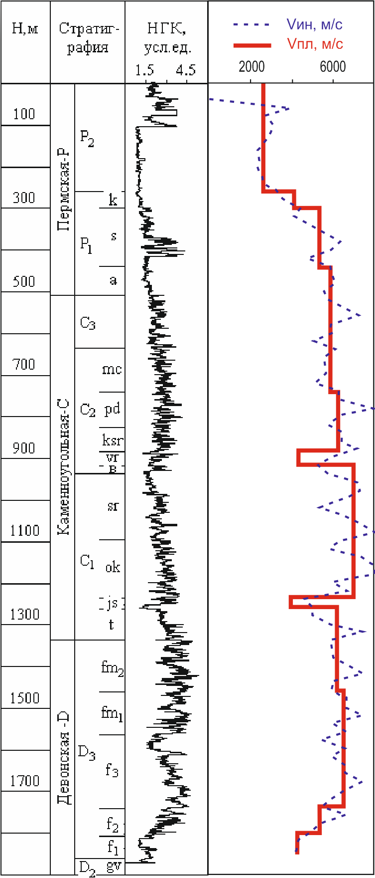
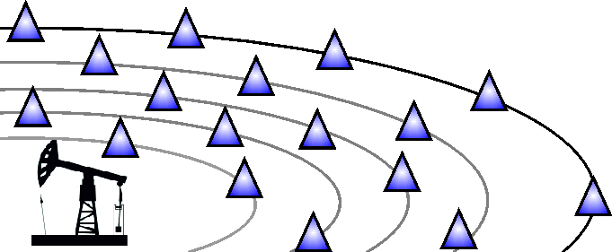
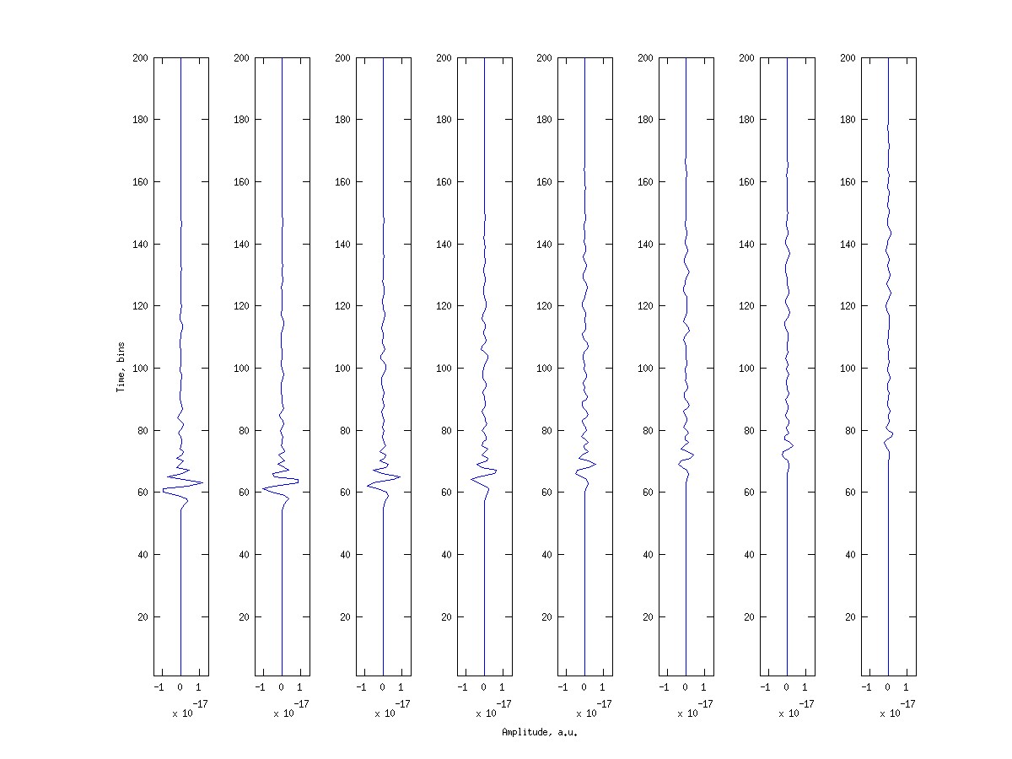
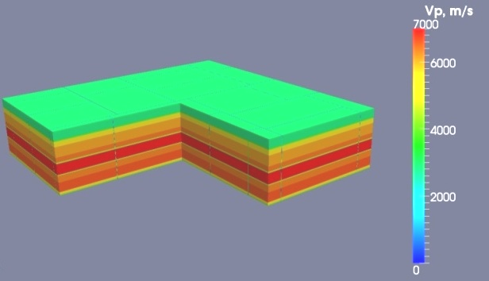
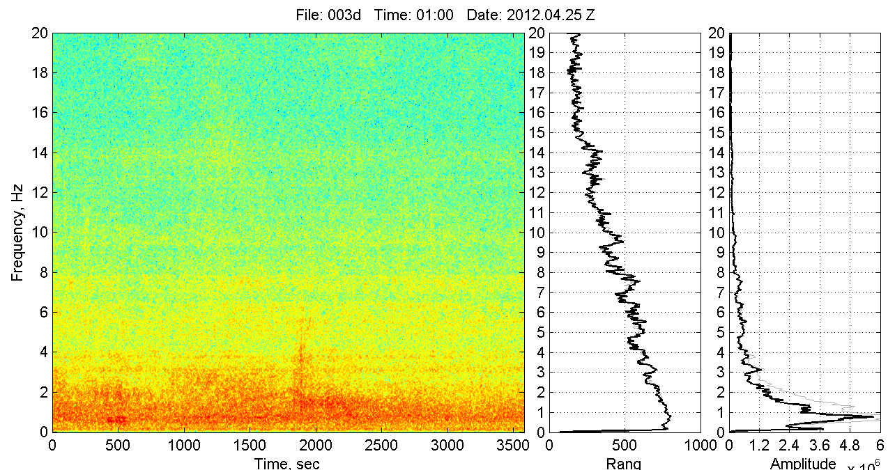
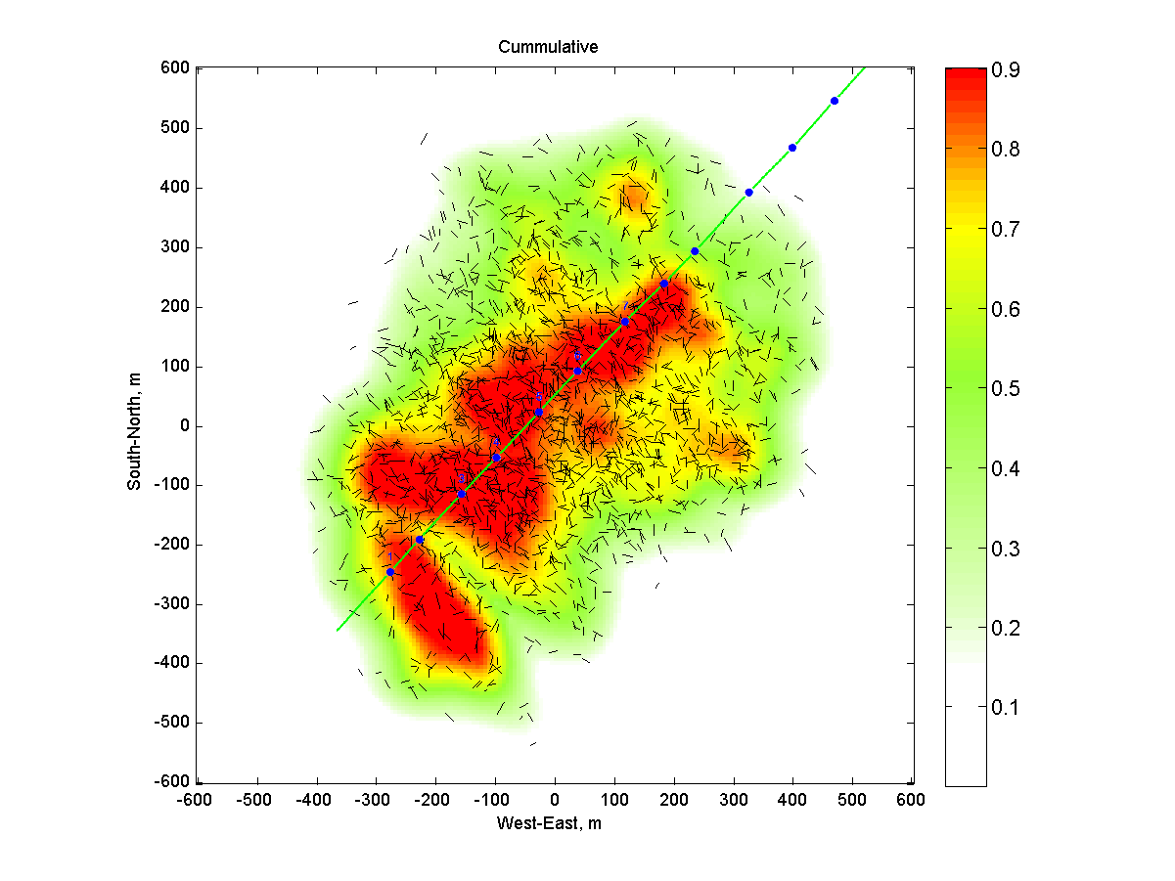
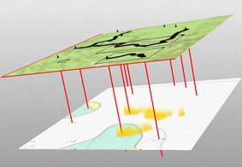
12
WORKFLOW
3D full wave simulation
Simulation data
Sensors data
Processing
Interpretation
GPU cluster
Notes:
12

Slide 13

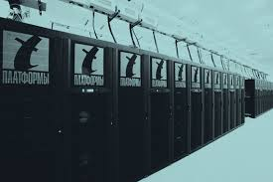



13
SUCCESSFUL SOLUTIONS
HARDWARE – GPU CLUSTER
Local solution
T-platforms, Meijin, ARBYTE SC, STSS
Cloud solution
Amazon
SOFTWARE – HPC ENVIRONMENT
OpenCL, CUDA, OpenMP, MPI
Notes:
13

Slide 14




14
PROBLEMS
DISTRIBUTED RENDERING
BIG DATA MANAGMENT
REMOTE & SHARED ACCESS
INTEGRATION
HPC
2D&3D
RD
Store
Notes:
14

Slide 15
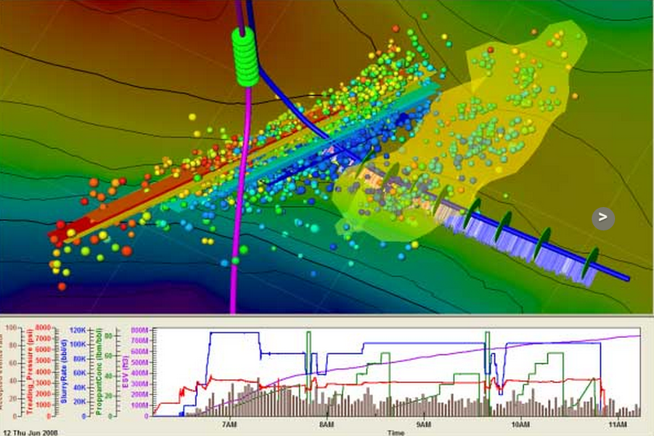
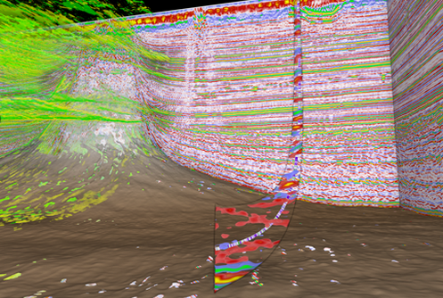
15
INTEGRATED FRAMEWORKS
SCHLUMBERGER OCEAN
NVIDIA INDEX
HUE SPACE
C++, .NET, Java
COMMERCIAL AND PROPRIETARY
NVIDIA TECHNOLOGY
Notes:
15

Slide 16


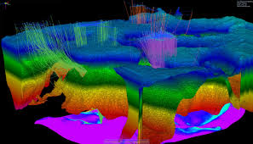
16
SPECIALIZED FRAMEWORKS
NVidia CUDA Toolkit, AMD OpenCL SDK ...
HPC
Hadoop, HPCC, Array-based DBMS (Rasdaman, SciDB) ...
Big Data
Open Inventor, Nvidia Engines (SceniX, OptiX…), Equalizer, Chromium ...
Визуализация
Notes:
16

Slide 17



17
CONCLUSION
HPC HARWARE & SOFTWARE EXISTS
SOFTWARE FRAMEWORKS
HARD CHOICE
COMMON HPC SOFTWARE ECOSYSTEM
INDUSTRIAL SPECIALIZATION
COMPLETE DATA & PROCESSES
INTEGRATION METHODOLOGY
Notes:
17

Slide 18
18
THANK YOU
FOR YOUR ATTENTION!
Notes:
18

