Slide 1
Direct numerical simulation study
of a turbulent stably stratified air flow
above the wavy water surface.
O. A. Druzhinin, Y. I. Troitskaya
Institute of Applied Physics, RAS, Nizhny Novgorod, Russia
and
S.S. Zilitinkevich
Finnish Meteorological Institute, Helsinki, Finland
Notes:
Interaction of the wind flow with surface waves is one of the central questions in the wave modeling. Of special interest are the cases of steep and breaking waves, when strong nonlinear phenomena such as sheltering, flow separation, etc occur. These features are too complicated for theoretical and numerical modeling, that is why we tried to investigate the detailed structure of the turbulent layer over the waves experimentally.
The main difficulties in this experiments are connected with measurements of the wind flow close to the water surface, especially below the crests of the waves. These measurements can be realized directly by the method of particle image velosimentry, when the flow is seeded by small particles, visualized by the laser light and then fixed by the digital camera. This technique was applied by Reul etal and revealed the effect of flow separation at the crest of the breaking wave. In the same time it should be emphasized, that PIV technique provides the instant picture of the velocity field. And since the wind over waves is a turbulent flow we need repeated experiments for statistical averaging. In the present work we tried to obtain the statictical ensemble by means of high-speed video shooting and subsequent processing of the video-films by PIV algorithm.

Slide 2
OBJECTIVE
In this work the detailed structure and statistical characteristics of a turbulent, stably stratified atmospheric boundary layer over waved water surface are studied by direct numerical simulation (DNS). Two-dimensional water wave with wave slope up to ka = 0.2 and bulk Reynolds number up to Re = 80000 and different values of the bulk Richardson number Ri is considered. The shape of the water wave is prescribed and does not evolve under the action of the wind. The full, 3D Navier-Stokes equations under the Boussinesq approximation are solved in curvilinear coordinates in a frame of reference moving the phase velocity of the wave. The shear driving the flow is created by an upper plane boundary moving horizontally with a bulk velocity in the x-direction.
Notes:
Interaction of the wind flow with surface waves is one of the central questions in the wave modeling. Of special interest are the cases of steep and breaking waves, when strong nonlinear phenomena such as sheltering, flow separation, etc occur. These features are too complicated for theoretical and numerical modeling, that is why we tried to investigate the detailed structure of the turbulent layer over the waves experimentally.
The main difficulties in this experiments are connected with measurements of the wind flow close to the water surface, especially below the crests of the waves. These measurements can be realized directly by the method of particle image velosimentry, when the flow is seeded by small particles, visualized by the laser light and then fixed by the digital camera. This technique was applied by Reul etal and revealed the effect of flow separation at the crest of the breaking wave. In the same time it should be emphasized, that PIV technique provides the instant picture of the velocity field. And since the wind over waves is a turbulent flow we need repeated experiments for statistical averaging. In the present work we tried to obtain the statictical ensemble by means of high-speed video shooting and subsequent processing of the video-films by PIV algorithm.

Slide 3
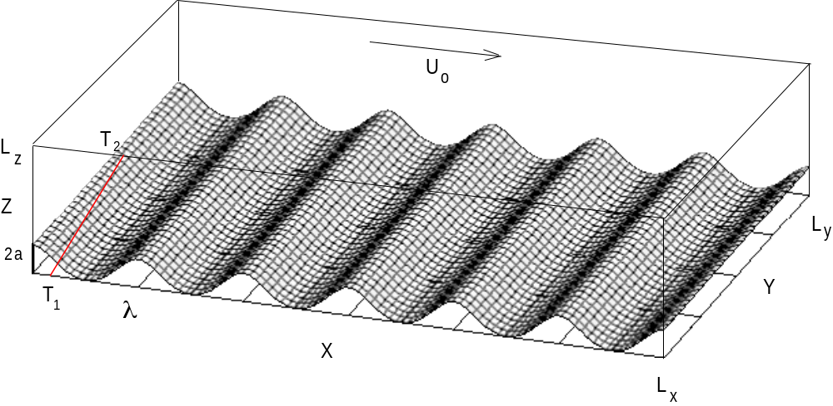
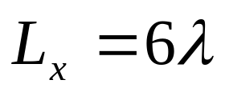
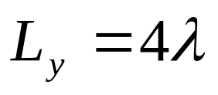
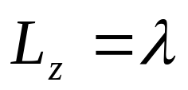
Schematic of numerical experiment
Notes:
Interaction of the wind flow with surface waves is one of the central questions in the wave modeling. Of special interest are the cases of steep and breaking waves, when strong nonlinear phenomena such as sheltering, flow separation, etc occur. These features are too complicated for theoretical and numerical modeling, that is why we tried to investigate the detailed structure of the turbulent layer over the waves experimentally.
The main difficulties in this experiments are connected with measurements of the wind flow close to the water surface, especially below the crests of the waves. These measurements can be realized directly by the method of particle image velosimentry, when the flow is seeded by small particles, visualized by the laser light and then fixed by the digital camera. This technique was applied by Reul etal and revealed the effect of flow separation at the crest of the breaking wave. In the same time it should be emphasized, that PIV technique provides the instant picture of the velocity field. And since the wind over waves is a turbulent flow we need repeated experiments for statistical averaging. In the present work we tried to obtain the statictical ensemble by means of high-speed video shooting and subsequent processing of the video-films by PIV algorithm.

Slide 4
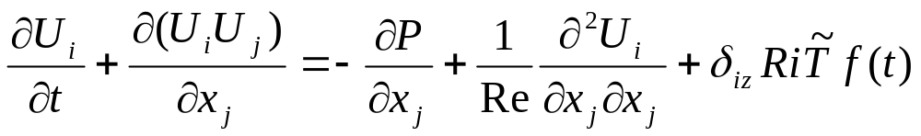
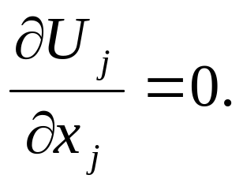
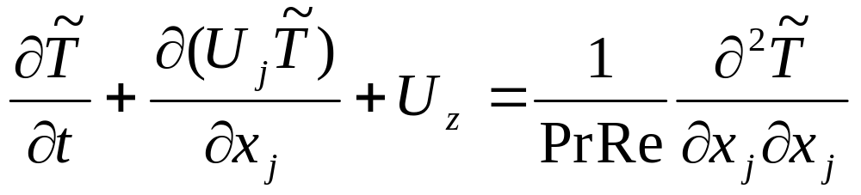
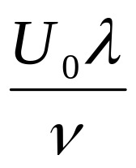
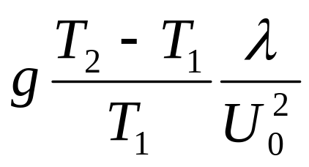


GOVERNING EQUATIONS
Re =
Ri =
Notes:
Interaction of the wind flow with surface waves is one of the central questions in the wave modeling. Of special interest are the cases of steep and breaking waves, when strong nonlinear phenomena such as sheltering, flow separation, etc occur. These features are too complicated for theoretical and numerical modeling, that is why we tried to investigate the detailed structure of the turbulent layer over the waves experimentally.
The main difficulties in this experiments are connected with measurements of the wind flow close to the water surface, especially below the crests of the waves. These measurements can be realized directly by the method of particle image velosimentry, when the flow is seeded by small particles, visualized by the laser light and then fixed by the digital camera. This technique was applied by Reul etal and revealed the effect of flow separation at the crest of the breaking wave. In the same time it should be emphasized, that PIV technique provides the instant picture of the velocity field. And since the wind over waves is a turbulent flow we need repeated experiments for statistical averaging. In the present work we tried to obtain the statictical ensemble by means of high-speed video shooting and subsequent processing of the video-films by PIV algorithm.

Slide 5
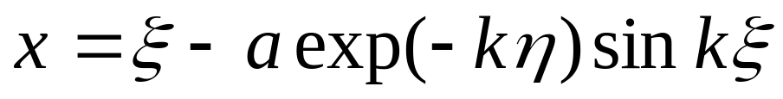
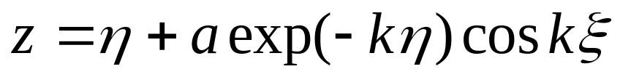
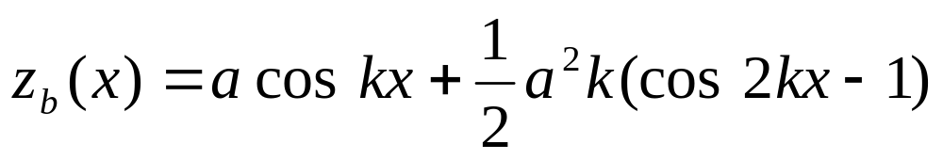
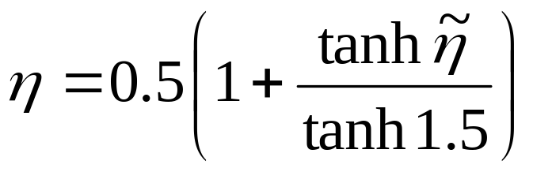
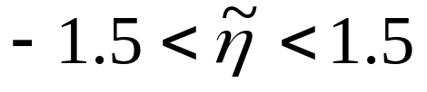
CURVILINEAR COORDINATES
Mapping over η:
Notes:
Interaction of the wind flow with surface waves is one of the central questions in the wave modeling. Of special interest are the cases of steep and breaking waves, when strong nonlinear phenomena such as sheltering, flow separation, etc occur. These features are too complicated for theoretical and numerical modeling, that is why we tried to investigate the detailed structure of the turbulent layer over the waves experimentally.
The main difficulties in this experiments are connected with measurements of the wind flow close to the water surface, especially below the crests of the waves. These measurements can be realized directly by the method of particle image velosimentry, when the flow is seeded by small particles, visualized by the laser light and then fixed by the digital camera. This technique was applied by Reul etal and revealed the effect of flow separation at the crest of the breaking wave. In the same time it should be emphasized, that PIV technique provides the instant picture of the velocity field. And since the wind over waves is a turbulent flow we need repeated experiments for statistical averaging. In the present work we tried to obtain the statictical ensemble by means of high-speed video shooting and subsequent processing of the video-films by PIV algorithm.

Slide 6
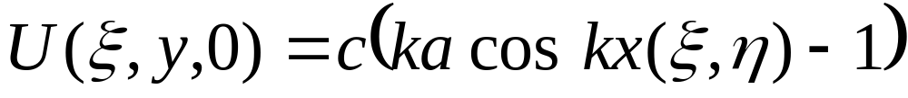
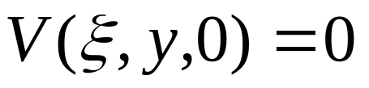
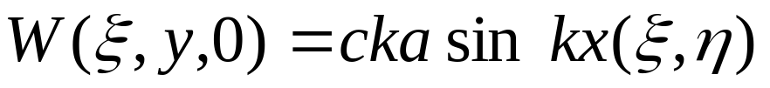
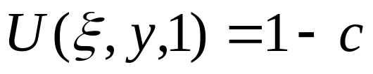
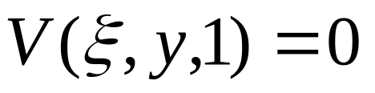
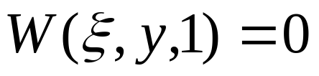
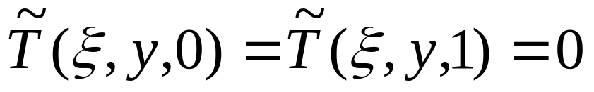
BOUNDARY CONDITIONS
Bottom plane:
Top plane:
All fields are x and y periodic
Notes:
Interaction of the wind flow with surface waves is one of the central questions in the wave modeling. Of special interest are the cases of steep and breaking waves, when strong nonlinear phenomena such as sheltering, flow separation, etc occur. These features are too complicated for theoretical and numerical modeling, that is why we tried to investigate the detailed structure of the turbulent layer over the waves experimentally.
The main difficulties in this experiments are connected with measurements of the wind flow close to the water surface, especially below the crests of the waves. These measurements can be realized directly by the method of particle image velosimentry, when the flow is seeded by small particles, visualized by the laser light and then fixed by the digital camera. This technique was applied by Reul etal and revealed the effect of flow separation at the crest of the breaking wave. In the same time it should be emphasized, that PIV technique provides the instant picture of the velocity field. And since the wind over waves is a turbulent flow we need repeated experiments for statistical averaging. In the present work we tried to obtain the statictical ensemble by means of high-speed video shooting and subsequent processing of the video-films by PIV algorithm.

Slide 7
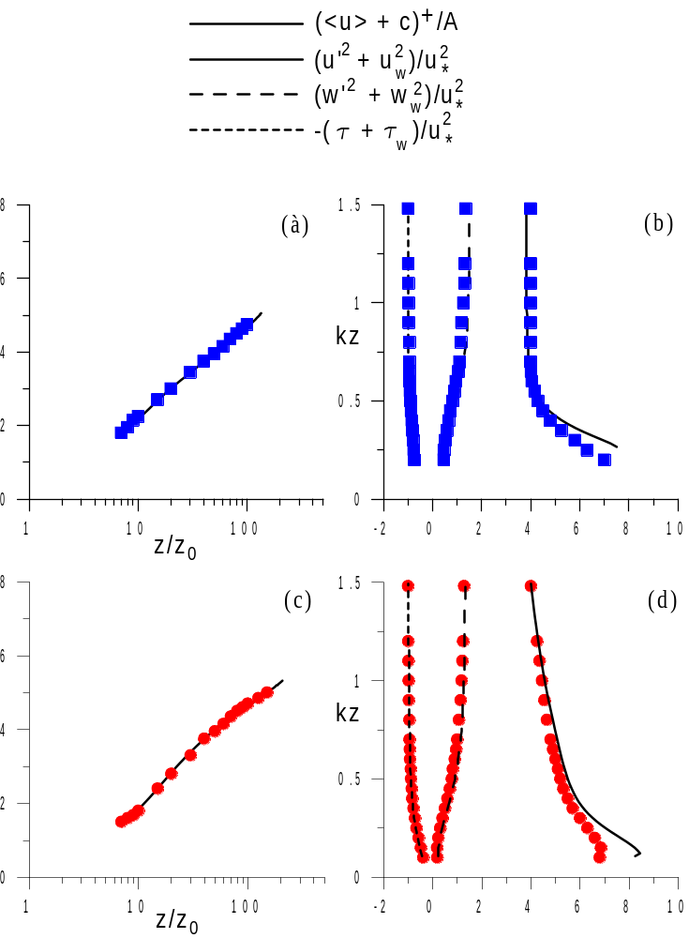
NON-STRATIFIED FLOW ABOVE WAVY BOUNDARY: COMPARISON WITH DNS BY SULLIVAN ET AL. (2000)
Re = 10000, c=0.25
ka = 0.2
ka = 0.1
Notes:
Interaction of the wind flow with surface waves is one of the central questions in the wave modeling. Of special interest are the cases of steep and breaking waves, when strong nonlinear phenomena such as sheltering, flow separation, etc occur. These features are too complicated for theoretical and numerical modeling, that is why we tried to investigate the detailed structure of the turbulent layer over the waves experimentally.
The main difficulties in this experiments are connected with measurements of the wind flow close to the water surface, especially below the crests of the waves. These measurements can be realized directly by the method of particle image velosimentry, when the flow is seeded by small particles, visualized by the laser light and then fixed by the digital camera. This technique was applied by Reul etal and revealed the effect of flow separation at the crest of the breaking wave. In the same time it should be emphasized, that PIV technique provides the instant picture of the velocity field. And since the wind over waves is a turbulent flow we need repeated experiments for statistical averaging. In the present work we tried to obtain the statictical ensemble by means of high-speed video shooting and subsequent processing of the video-films by PIV algorithm.

Slide 8
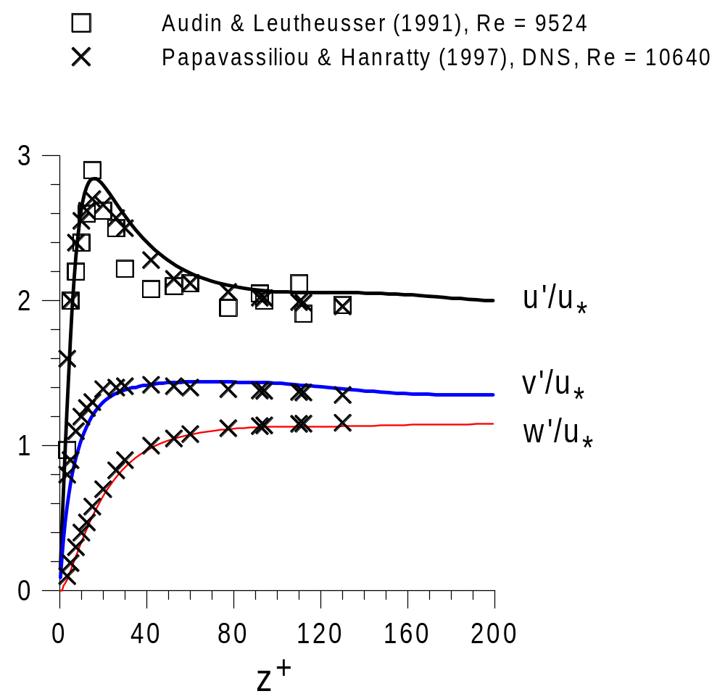
NON-STRATIFIED FLOW ABOVE FLAT BOUNDARY: COMPARISON WITH PREVIOUS RESULTS
Notes:
Interaction of the wind flow with surface waves is one of the central questions in the wave modeling. Of special interest are the cases of steep and breaking waves, when strong nonlinear phenomena such as sheltering, flow separation, etc occur. These features are too complicated for theoretical and numerical modeling, that is why we tried to investigate the detailed structure of the turbulent layer over the waves experimentally.
The main difficulties in this experiments are connected with measurements of the wind flow close to the water surface, especially below the crests of the waves. These measurements can be realized directly by the method of particle image velosimentry, when the flow is seeded by small particles, visualized by the laser light and then fixed by the digital camera. This technique was applied by Reul etal and revealed the effect of flow separation at the crest of the breaking wave. In the same time it should be emphasized, that PIV technique provides the instant picture of the velocity field. And since the wind over waves is a turbulent flow we need repeated experiments for statistical averaging. In the present work we tried to obtain the statictical ensemble by means of high-speed video shooting and subsequent processing of the video-films by PIV algorithm.

Slide 9
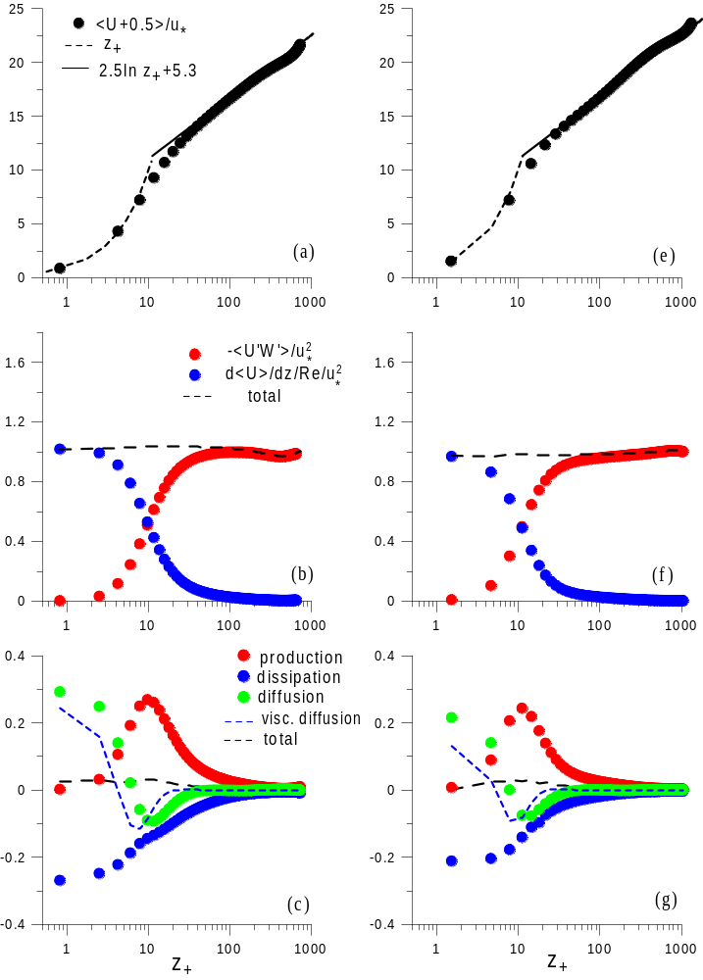
NON-STRATIFIED FLOW ABOVE FLAT BOUNDARY
Re=40000
Re=80000
Mean velocity
profile
Re = 40000:
u* = 0.0256
z* = 0.001
Momentum flux
budget
Re = 80000:
u* = 0.0235
z* = 0.00053
Kinetic energy
budget
Notes:
Interaction of the wind flow with surface waves is one of the central questions in the wave modeling. Of special interest are the cases of steep and breaking waves, when strong nonlinear phenomena such as sheltering, flow separation, etc occur. These features are too complicated for theoretical and numerical modeling, that is why we tried to investigate the detailed structure of the turbulent layer over the waves experimentally.
The main difficulties in this experiments are connected with measurements of the wind flow close to the water surface, especially below the crests of the waves. These measurements can be realized directly by the method of particle image velosimentry, when the flow is seeded by small particles, visualized by the laser light and then fixed by the digital camera. This technique was applied by Reul etal and revealed the effect of flow separation at the crest of the breaking wave. In the same time it should be emphasized, that PIV technique provides the instant picture of the velocity field. And since the wind over waves is a turbulent flow we need repeated experiments for statistical averaging. In the present work we tried to obtain the statictical ensemble by means of high-speed video shooting and subsequent processing of the video-films by PIV algorithm.

Slide 10
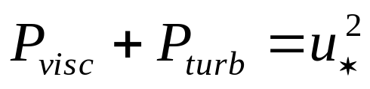
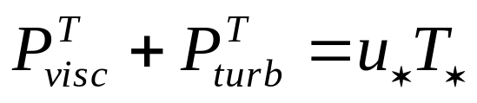
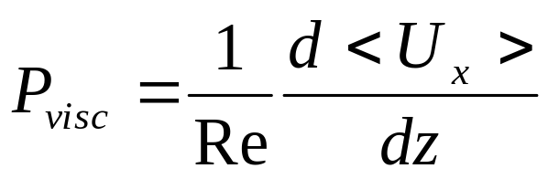
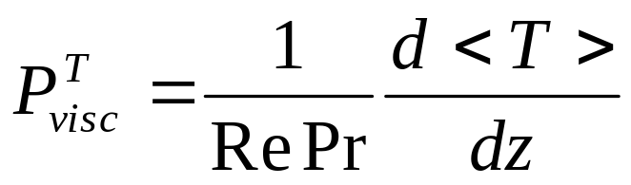
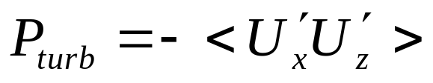
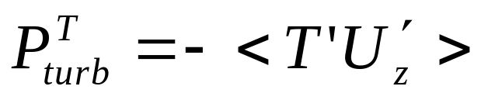
MOMENTUM AND HEAT FLUXES BUDGET
IN THE STATIONARY STATE FOR FLAT BOUNDARY
Momentum flux budget:
Heat flux budget:
Notes:
Interaction of the wind flow with surface waves is one of the central questions in the wave modeling. Of special interest are the cases of steep and breaking waves, when strong nonlinear phenomena such as sheltering, flow separation, etc occur. These features are too complicated for theoretical and numerical modeling, that is why we tried to investigate the detailed structure of the turbulent layer over the waves experimentally.
The main difficulties in this experiments are connected with measurements of the wind flow close to the water surface, especially below the crests of the waves. These measurements can be realized directly by the method of particle image velosimentry, when the flow is seeded by small particles, visualized by the laser light and then fixed by the digital camera. This technique was applied by Reul etal and revealed the effect of flow separation at the crest of the breaking wave. In the same time it should be emphasized, that PIV technique provides the instant picture of the velocity field. And since the wind over waves is a turbulent flow we need repeated experiments for statistical averaging. In the present work we tried to obtain the statictical ensemble by means of high-speed video shooting and subsequent processing of the video-films by PIV algorithm.

Slide 11
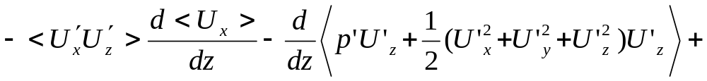
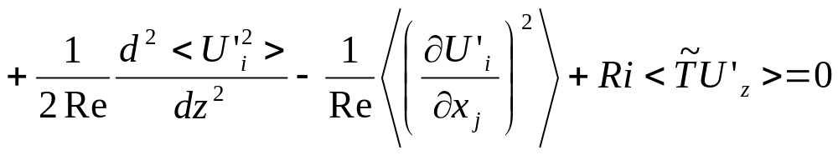
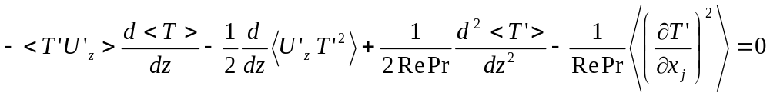
KINETIC AND POTENTIAL ENERGY BUDGET IN THE STATIONARY STATE FOR FLAT BOUNDARY
Kinetic energy:
Potential energy:
Notes:
Interaction of the wind flow with surface waves is one of the central questions in the wave modeling. Of special interest are the cases of steep and breaking waves, when strong nonlinear phenomena such as sheltering, flow separation, etc occur. These features are too complicated for theoretical and numerical modeling, that is why we tried to investigate the detailed structure of the turbulent layer over the waves experimentally.
The main difficulties in this experiments are connected with measurements of the wind flow close to the water surface, especially below the crests of the waves. These measurements can be realized directly by the method of particle image velosimentry, when the flow is seeded by small particles, visualized by the laser light and then fixed by the digital camera. This technique was applied by Reul etal and revealed the effect of flow separation at the crest of the breaking wave. In the same time it should be emphasized, that PIV technique provides the instant picture of the velocity field. And since the wind over waves is a turbulent flow we need repeated experiments for statistical averaging. In the present work we tried to obtain the statictical ensemble by means of high-speed video shooting and subsequent processing of the video-films by PIV algorithm.

Slide 12
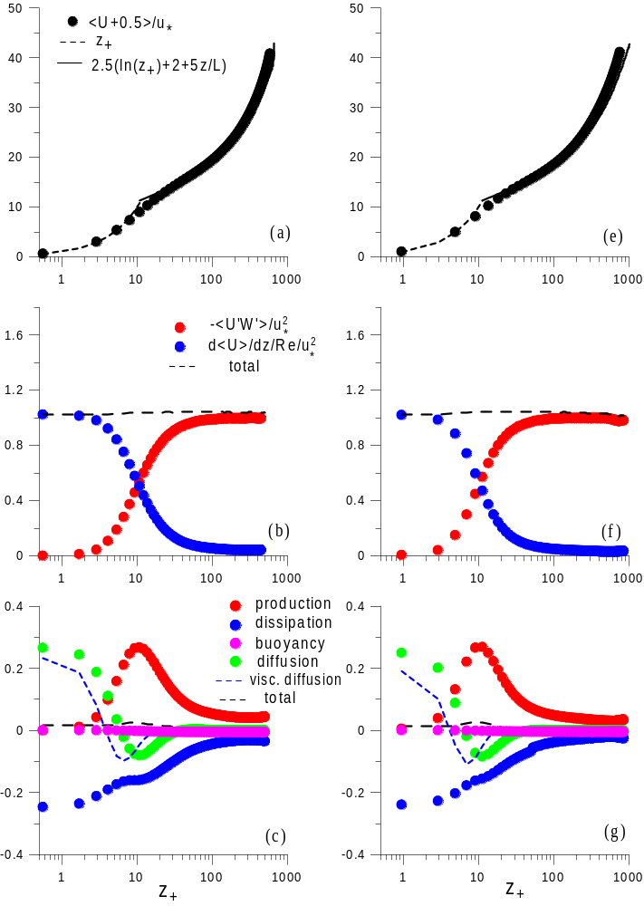
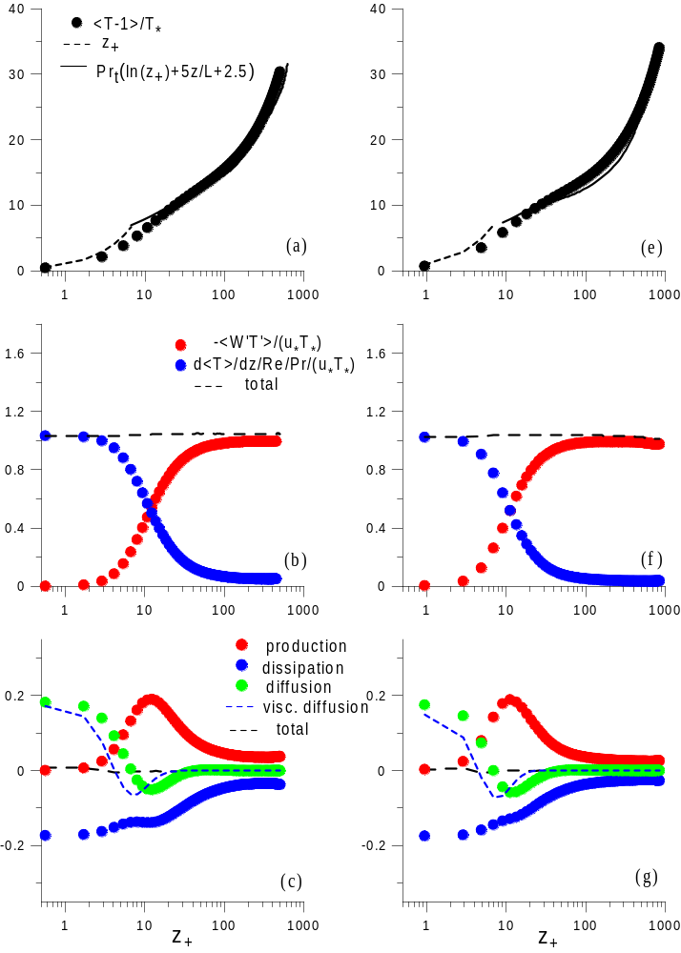
STRATIFIED FLOW ABOVE FLAT BOUNDARY, Ri = 0.05
Re = 40000
Re = 80000
Re = 40000
Re = 80000
Mean velocity
and temperature
profiles
Momentum and
heat flux budget
Kinetic and
potential energy
budget
Notes:
Interaction of the wind flow with surface waves is one of the central questions in the wave modeling. Of special interest are the cases of steep and breaking waves, when strong nonlinear phenomena such as sheltering, flow separation, etc occur. These features are too complicated for theoretical and numerical modeling, that is why we tried to investigate the detailed structure of the turbulent layer over the waves experimentally.
The main difficulties in this experiments are connected with measurements of the wind flow close to the water surface, especially below the crests of the waves. These measurements can be realized directly by the method of particle image velosimentry, when the flow is seeded by small particles, visualized by the laser light and then fixed by the digital camera. This technique was applied by Reul etal and revealed the effect of flow separation at the crest of the breaking wave. In the same time it should be emphasized, that PIV technique provides the instant picture of the velocity field. And since the wind over waves is a turbulent flow we need repeated experiments for statistical averaging. In the present work we tried to obtain the statictical ensemble by means of high-speed video shooting and subsequent processing of the video-films by PIV algorithm.

Slide 13
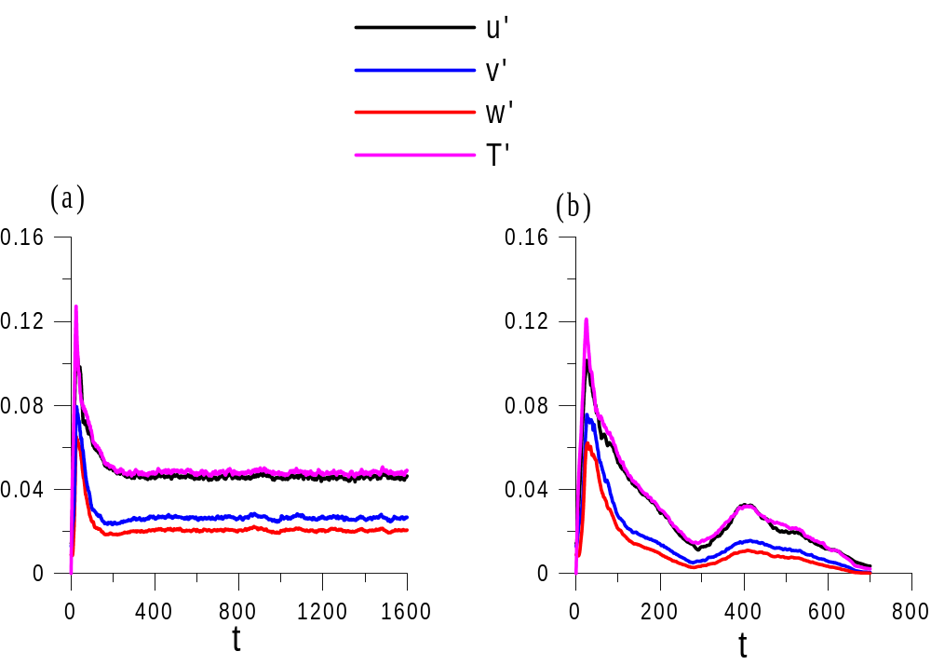
RELAMINARIZATION OF STRATIFIED FLOW ABOVE THE FLAT BOUNDARY
(Re = 40000)
Fluctuations
amplitudes
Ri = 0.05
Ri = 0.1
Turbulent regime
Laminar regime
Notes:
Interaction of the wind flow with surface waves is one of the central questions in the wave modeling. Of special interest are the cases of steep and breaking waves, when strong nonlinear phenomena such as sheltering, flow separation, etc occur. These features are too complicated for theoretical and numerical modeling, that is why we tried to investigate the detailed structure of the turbulent layer over the waves experimentally.
The main difficulties in this experiments are connected with measurements of the wind flow close to the water surface, especially below the crests of the waves. These measurements can be realized directly by the method of particle image velosimentry, when the flow is seeded by small particles, visualized by the laser light and then fixed by the digital camera. This technique was applied by Reul etal and revealed the effect of flow separation at the crest of the breaking wave. In the same time it should be emphasized, that PIV technique provides the instant picture of the velocity field. And since the wind over waves is a turbulent flow we need repeated experiments for statistical averaging. In the present work we tried to obtain the statictical ensemble by means of high-speed video shooting and subsequent processing of the video-films by PIV algorithm.

Slide 14
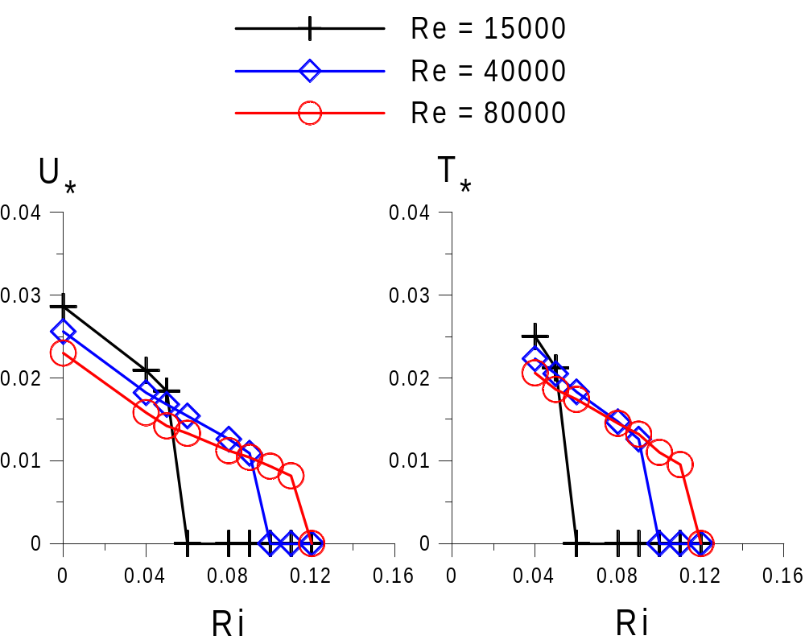
RELAMINARIZATION OF STABLY STRATIFIED FLOW ABOVE THE FLAT BOUNDARY
Notes:
Interaction of the wind flow with surface waves is one of the central questions in the wave modeling. Of special interest are the cases of steep and breaking waves, when strong nonlinear phenomena such as sheltering, flow separation, etc occur. These features are too complicated for theoretical and numerical modeling, that is why we tried to investigate the detailed structure of the turbulent layer over the waves experimentally.
The main difficulties in this experiments are connected with measurements of the wind flow close to the water surface, especially below the crests of the waves. These measurements can be realized directly by the method of particle image velosimentry, when the flow is seeded by small particles, visualized by the laser light and then fixed by the digital camera. This technique was applied by Reul etal and revealed the effect of flow separation at the crest of the breaking wave. In the same time it should be emphasized, that PIV technique provides the instant picture of the velocity field. And since the wind over waves is a turbulent flow we need repeated experiments for statistical averaging. In the present work we tried to obtain the statictical ensemble by means of high-speed video shooting and subsequent processing of the video-films by PIV algorithm.

Slide 15
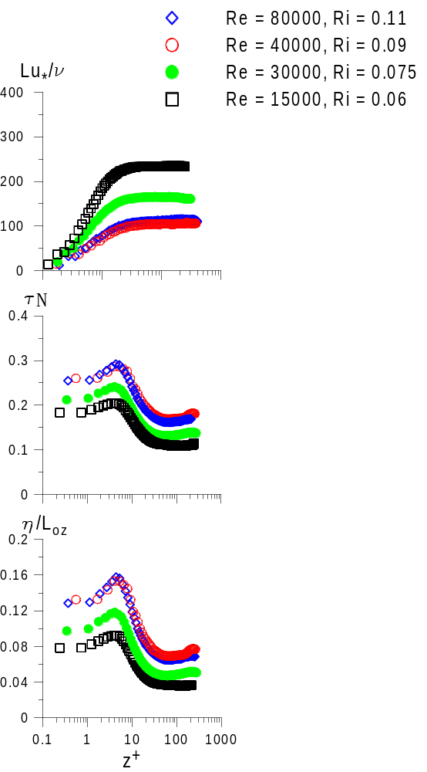
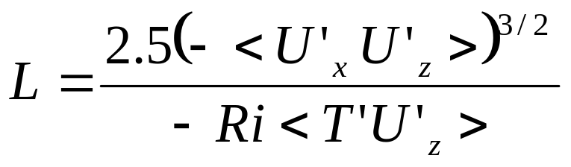
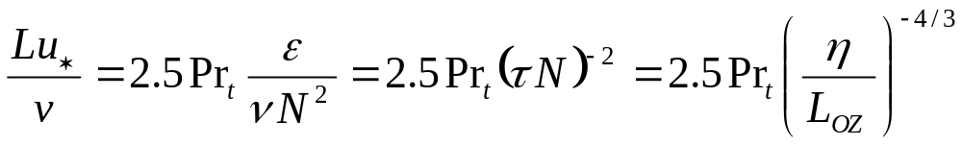
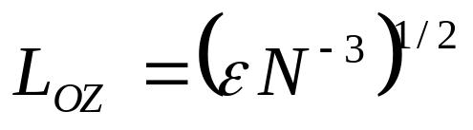
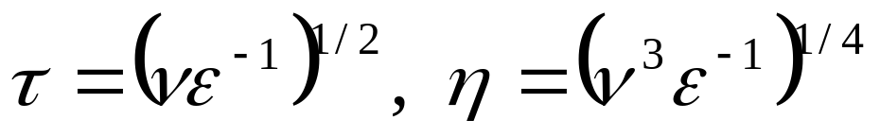
RELAMINARIZATION OF STRATIFIED FLOW ABOVE THE FLAT BOUNDARY
Flores & Riley (2011): L₊>100 for
stationary turbulent regime
Notes:
Interaction of the wind flow with surface waves is one of the central questions in the wave modeling. Of special interest are the cases of steep and breaking waves, when strong nonlinear phenomena such as sheltering, flow separation, etc occur. These features are too complicated for theoretical and numerical modeling, that is why we tried to investigate the detailed structure of the turbulent layer over the waves experimentally.
The main difficulties in this experiments are connected with measurements of the wind flow close to the water surface, especially below the crests of the waves. These measurements can be realized directly by the method of particle image velosimentry, when the flow is seeded by small particles, visualized by the laser light and then fixed by the digital camera. This technique was applied by Reul etal and revealed the effect of flow separation at the crest of the breaking wave. In the same time it should be emphasized, that PIV technique provides the instant picture of the velocity field. And since the wind over waves is a turbulent flow we need repeated experiments for statistical averaging. In the present work we tried to obtain the statictical ensemble by means of high-speed video shooting and subsequent processing of the video-films by PIV algorithm.

Slide 16
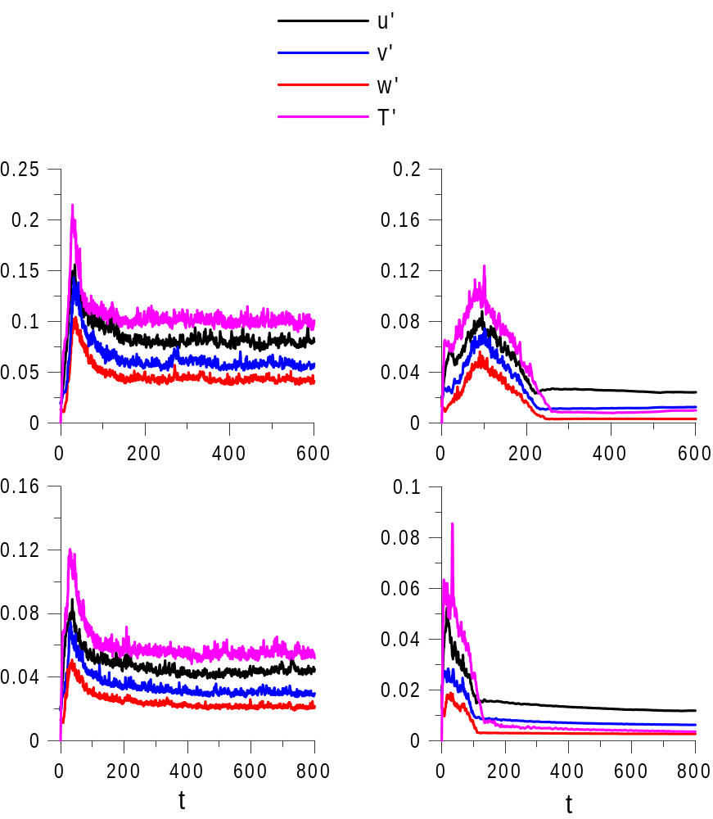
EFFECT OF THE WAVE
(ka = 0.2, c = 0.05)
Fluctuations
amplitudes
Ri = 0.04
Ri = 0.1
Re = 15000
Ri = 0.1
Ri = 0.2
Re = 40000
Turbulent regime
Wave-pumping regime
Notes:
Interaction of the wind flow with surface waves is one of the central questions in the wave modeling. Of special interest are the cases of steep and breaking waves, when strong nonlinear phenomena such as sheltering, flow separation, etc occur. These features are too complicated for theoretical and numerical modeling, that is why we tried to investigate the detailed structure of the turbulent layer over the waves experimentally.
The main difficulties in this experiments are connected with measurements of the wind flow close to the water surface, especially below the crests of the waves. These measurements can be realized directly by the method of particle image velosimentry, when the flow is seeded by small particles, visualized by the laser light and then fixed by the digital camera. This technique was applied by Reul etal and revealed the effect of flow separation at the crest of the breaking wave. In the same time it should be emphasized, that PIV technique provides the instant picture of the velocity field. And since the wind over waves is a turbulent flow we need repeated experiments for statistical averaging. In the present work we tried to obtain the statictical ensemble by means of high-speed video shooting and subsequent processing of the video-films by PIV algorithm.

Slide 17
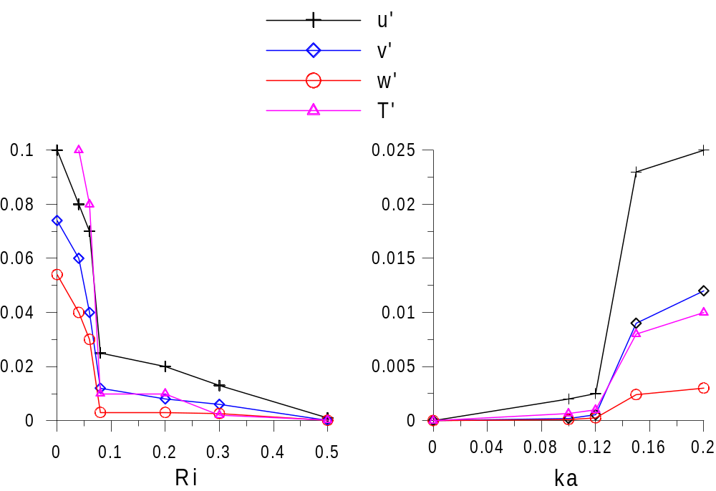
EFFECT OF THE WAVE
(c = 0.05, Re = 15000)
ka = 0.2
Ri = 0.08
Turbulent
regime
Wave-pumping
regime
Laminar
regime
Wave-pumping
regime
Notes:
Interaction of the wind flow with surface waves is one of the central questions in the wave modeling. Of special interest are the cases of steep and breaking waves, when strong nonlinear phenomena such as sheltering, flow separation, etc occur. These features are too complicated for theoretical and numerical modeling, that is why we tried to investigate the detailed structure of the turbulent layer over the waves experimentally.
The main difficulties in this experiments are connected with measurements of the wind flow close to the water surface, especially below the crests of the waves. These measurements can be realized directly by the method of particle image velosimentry, when the flow is seeded by small particles, visualized by the laser light and then fixed by the digital camera. This technique was applied by Reul etal and revealed the effect of flow separation at the crest of the breaking wave. In the same time it should be emphasized, that PIV technique provides the instant picture of the velocity field. And since the wind over waves is a turbulent flow we need repeated experiments for statistical averaging. In the present work we tried to obtain the statictical ensemble by means of high-speed video shooting and subsequent processing of the video-films by PIV algorithm.

Slide 18
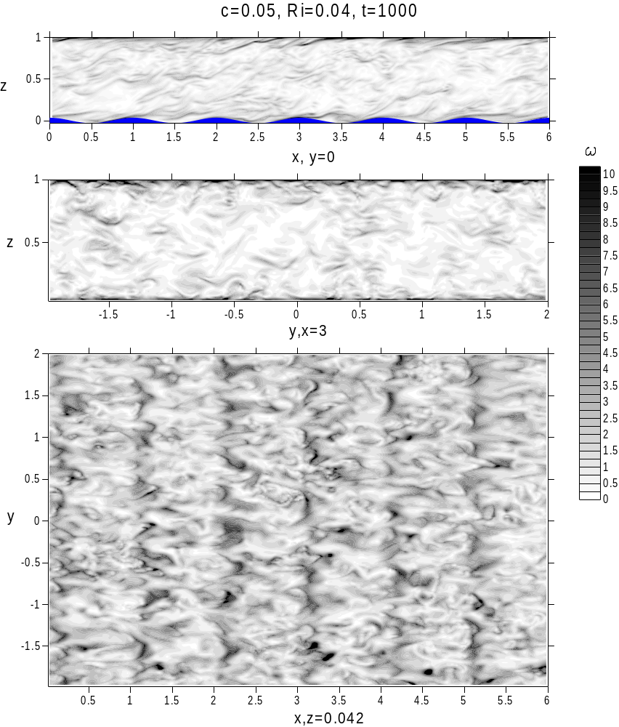
INSTANTANEOUS VORTICITY MODULUS FIELD:
TURBULENT REGIME
Notes:
Interaction of the wind flow with surface waves is one of the central questions in the wave modeling. Of special interest are the cases of steep and breaking waves, when strong nonlinear phenomena such as sheltering, flow separation, etc occur. These features are too complicated for theoretical and numerical modeling, that is why we tried to investigate the detailed structure of the turbulent layer over the waves experimentally.
The main difficulties in this experiments are connected with measurements of the wind flow close to the water surface, especially below the crests of the waves. These measurements can be realized directly by the method of particle image velosimentry, when the flow is seeded by small particles, visualized by the laser light and then fixed by the digital camera. This technique was applied by Reul etal and revealed the effect of flow separation at the crest of the breaking wave. In the same time it should be emphasized, that PIV technique provides the instant picture of the velocity field. And since the wind over waves is a turbulent flow we need repeated experiments for statistical averaging. In the present work we tried to obtain the statictical ensemble by means of high-speed video shooting and subsequent processing of the video-films by PIV algorithm.

Slide 19
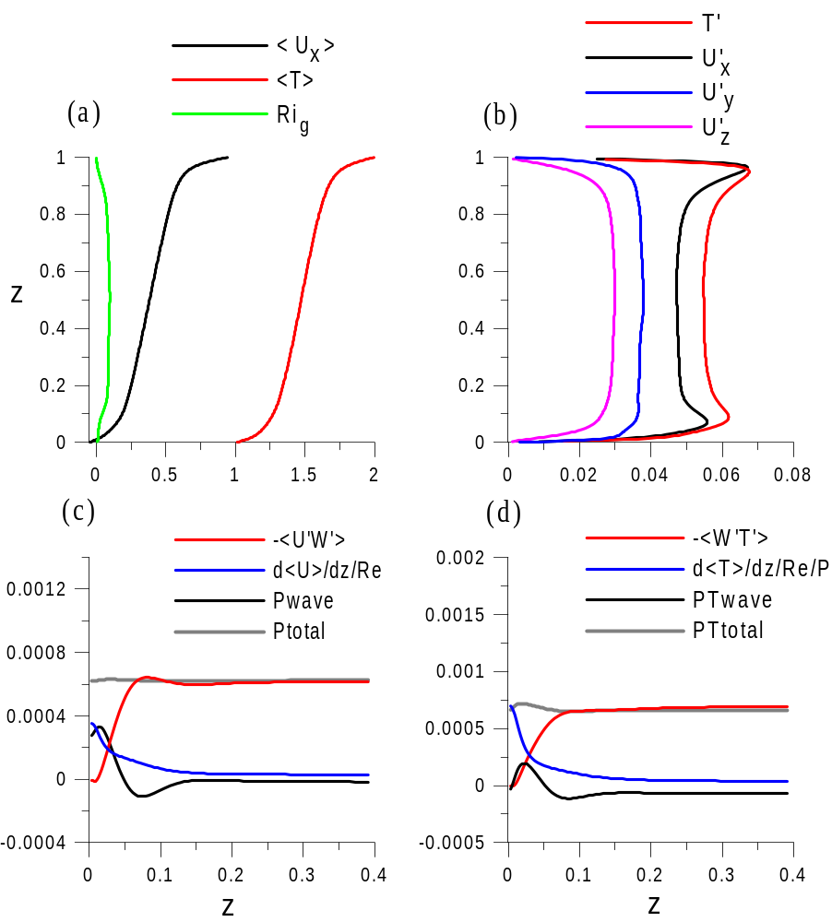
TURBULENT REGIME
(ka =0.2, c = 0.05, Ri = 0.04)
Mean velocity
and temperature
profiles
Fluctuations
profiles
Heat flux
budget
Momentum flux
budget
Notes:
Interaction of the wind flow with surface waves is one of the central questions in the wave modeling. Of special interest are the cases of steep and breaking waves, when strong nonlinear phenomena such as sheltering, flow separation, etc occur. These features are too complicated for theoretical and numerical modeling, that is why we tried to investigate the detailed structure of the turbulent layer over the waves experimentally.
The main difficulties in this experiments are connected with measurements of the wind flow close to the water surface, especially below the crests of the waves. These measurements can be realized directly by the method of particle image velosimentry, when the flow is seeded by small particles, visualized by the laser light and then fixed by the digital camera. This technique was applied by Reul etal and revealed the effect of flow separation at the crest of the breaking wave. In the same time it should be emphasized, that PIV technique provides the instant picture of the velocity field. And since the wind over waves is a turbulent flow we need repeated experiments for statistical averaging. In the present work we tried to obtain the statictical ensemble by means of high-speed video shooting and subsequent processing of the video-films by PIV algorithm.

Slide 20
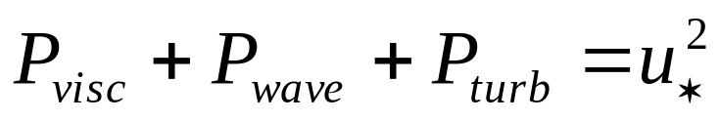
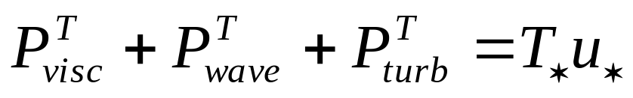
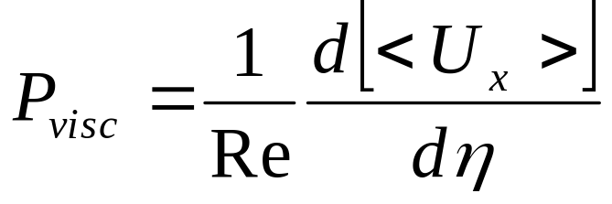
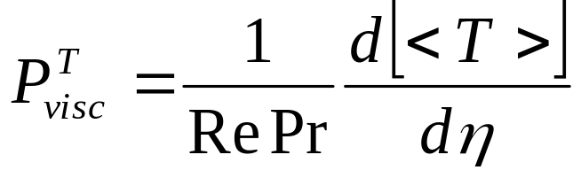




MOMENTUM AND HEAT FLUX BUDGET IN THE STATIONARY TURBULENT STATE FOR WAVY BOUNDARY
Momentum flux:
Heat flux:
Notes:
Interaction of the wind flow with surface waves is one of the central questions in the wave modeling. Of special interest are the cases of steep and breaking waves, when strong nonlinear phenomena such as sheltering, flow separation, etc occur. These features are too complicated for theoretical and numerical modeling, that is why we tried to investigate the detailed structure of the turbulent layer over the waves experimentally.
The main difficulties in this experiments are connected with measurements of the wind flow close to the water surface, especially below the crests of the waves. These measurements can be realized directly by the method of particle image velosimentry, when the flow is seeded by small particles, visualized by the laser light and then fixed by the digital camera. This technique was applied by Reul etal and revealed the effect of flow separation at the crest of the breaking wave. In the same time it should be emphasized, that PIV technique provides the instant picture of the velocity field. And since the wind over waves is a turbulent flow we need repeated experiments for statistical averaging. In the present work we tried to obtain the statictical ensemble by means of high-speed video shooting and subsequent processing of the video-films by PIV algorithm.

Slide 21

TURBULENT REGIME:COMPARISON
WITH QUASILINEAR THEORY
(ka = 0.2, Ri = 0.04, Re = 15000)
Quasi-linear
theoretical model
(Troitskaya et al. 2013)
DNS
Mean velocity and
temperature profiles
Momentum and
heat fluxes profiles
Notes:
Interaction of the wind flow with surface waves is one of the central questions in the wave modeling. Of special interest are the cases of steep and breaking waves, when strong nonlinear phenomena such as sheltering, flow separation, etc occur. These features are too complicated for theoretical and numerical modeling, that is why we tried to investigate the detailed structure of the turbulent layer over the waves experimentally.
The main difficulties in this experiments are connected with measurements of the wind flow close to the water surface, especially below the crests of the waves. These measurements can be realized directly by the method of particle image velosimentry, when the flow is seeded by small particles, visualized by the laser light and then fixed by the digital camera. This technique was applied by Reul etal and revealed the effect of flow separation at the crest of the breaking wave. In the same time it should be emphasized, that PIV technique provides the instant picture of the velocity field. And since the wind over waves is a turbulent flow we need repeated experiments for statistical averaging. In the present work we tried to obtain the statictical ensemble by means of high-speed video shooting and subsequent processing of the video-films by PIV algorithm.

Slide 22

RELAMINARIZATION OF STRATIFIED FLOW ABOVE THE WAVY BOUNDARY
Notes:
Interaction of the wind flow with surface waves is one of the central questions in the wave modeling. Of special interest are the cases of steep and breaking waves, when strong nonlinear phenomena such as sheltering, flow separation, etc occur. These features are too complicated for theoretical and numerical modeling, that is why we tried to investigate the detailed structure of the turbulent layer over the waves experimentally.
The main difficulties in this experiments are connected with measurements of the wind flow close to the water surface, especially below the crests of the waves. These measurements can be realized directly by the method of particle image velosimentry, when the flow is seeded by small particles, visualized by the laser light and then fixed by the digital camera. This technique was applied by Reul etal and revealed the effect of flow separation at the crest of the breaking wave. In the same time it should be emphasized, that PIV technique provides the instant picture of the velocity field. And since the wind over waves is a turbulent flow we need repeated experiments for statistical averaging. In the present work we tried to obtain the statictical ensemble by means of high-speed video shooting and subsequent processing of the video-films by PIV algorithm.

Slide 23

INSTANTANEOUS VORTICITY MODULUS FIELD:
WAVE-PUMPING REGIME

Slide 24

WAVE-PUMPING REGIME
(ka = 0.2, c = 0.05, Ri = 0.08)
Mean velocity and temperature,
and Ri_{g} profiles
Fluctuations profiles
Notes:
Interaction of the wind flow with surface waves is one of the central questions in the wave modeling. Of special interest are the cases of steep and breaking waves, when strong nonlinear phenomena such as sheltering, flow separation, etc occur. These features are too complicated for theoretical and numerical modeling, that is why we tried to investigate the detailed structure of the turbulent layer over the waves experimentally.
The main difficulties in this experiments are connected with measurements of the wind flow close to the water surface, especially below the crests of the waves. These measurements can be realized directly by the method of particle image velosimentry, when the flow is seeded by small particles, visualized by the laser light and then fixed by the digital camera. This technique was applied by Reul etal and revealed the effect of flow separation at the crest of the breaking wave. In the same time it should be emphasized, that PIV technique provides the instant picture of the velocity field. And since the wind over waves is a turbulent flow we need repeated experiments for statistical averaging. In the present work we tried to obtain the statictical ensemble by means of high-speed video shooting and subsequent processing of the video-films by PIV algorithm.

Slide 25

WAVE-PUMPING REGIME
(ka = 0.2, c = 0.2, Ri = 0.08)
Mean velocity and temperature,
and Ri_{g} profiles
Fluctuations profiles
Notes:
Interaction of the wind flow with surface waves is one of the central questions in the wave modeling. Of special interest are the cases of steep and breaking waves, when strong nonlinear phenomena such as sheltering, flow separation, etc occur. These features are too complicated for theoretical and numerical modeling, that is why we tried to investigate the detailed structure of the turbulent layer over the waves experimentally.
The main difficulties in this experiments are connected with measurements of the wind flow close to the water surface, especially below the crests of the waves. These measurements can be realized directly by the method of particle image velosimentry, when the flow is seeded by small particles, visualized by the laser light and then fixed by the digital camera. This technique was applied by Reul etal and revealed the effect of flow separation at the crest of the breaking wave. In the same time it should be emphasized, that PIV technique provides the instant picture of the velocity field. And since the wind over waves is a turbulent flow we need repeated experiments for statistical averaging. In the present work we tried to obtain the statictical ensemble by means of high-speed video shooting and subsequent processing of the video-films by PIV algorithm.

Slide 26


POWER SPECTRA
(ka = 0.2, c = 0.05, z = 0.08, Re = 40000)
Ri = 0.1
Ri = 0.2
Notes:
Interaction of the wind flow with surface waves is one of the central questions in the wave modeling. Of special interest are the cases of steep and breaking waves, when strong nonlinear phenomena such as sheltering, flow separation, etc occur. These features are too complicated for theoretical and numerical modeling, that is why we tried to investigate the detailed structure of the turbulent layer over the waves experimentally.
The main difficulties in this experiments are connected with measurements of the wind flow close to the water surface, especially below the crests of the waves. These measurements can be realized directly by the method of particle image velosimentry, when the flow is seeded by small particles, visualized by the laser light and then fixed by the digital camera. This technique was applied by Reul etal and revealed the effect of flow separation at the crest of the breaking wave. In the same time it should be emphasized, that PIV technique provides the instant picture of the velocity field. And since the wind over waves is a turbulent flow we need repeated experiments for statistical averaging. In the present work we tried to obtain the statictical ensemble by means of high-speed video shooting and subsequent processing of the video-films by PIV algorithm.

Slide 27

TURBULENT MOMENTUM AND HEAT FLUXES:
EFFECTS OF THE WAVE AND STRATIFICATION
Notes:
Interaction of the wind flow with surface waves is one of the central questions in the wave modeling. Of special interest are the cases of steep and breaking waves, when strong nonlinear phenomena such as sheltering, flow separation, etc occur. These features are too complicated for theoretical and numerical modeling, that is why we tried to investigate the detailed structure of the turbulent layer over the waves experimentally.
The main difficulties in this experiments are connected with measurements of the wind flow close to the water surface, especially below the crests of the waves. These measurements can be realized directly by the method of particle image velosimentry, when the flow is seeded by small particles, visualized by the laser light and then fixed by the digital camera. This technique was applied by Reul etal and revealed the effect of flow separation at the crest of the breaking wave. In the same time it should be emphasized, that PIV technique provides the instant picture of the velocity field. And since the wind over waves is a turbulent flow we need repeated experiments for statistical averaging. In the present work we tried to obtain the statictical ensemble by means of high-speed video shooting and subsequent processing of the video-films by PIV algorithm.

Slide 28
CONCLUSION
The DNS results show that the properties of the boundary layer flow are significantly affected by stratification. If the Richardson number Ri is sufficiently small, the flow remains turbulent and qualitatively similar to the non-stratified case. On the other hand, at high Ri turbulent fluctuations and momentum and heat fluxes decay to zero at low wave slope but remain finite at sufficiently large ka (>0.12). Parameterization of turbulent and heat production, diffusion and dissipation is also performed by a closure procedure and compared with the results of DNS. The criteria in terms of the product of the Kolmogorov time scale and local buoyancy frequency or/and the ratio of the Kolmogorov vs. Ozmidov lengh scales is proposed to characterize the different flow regimes observed in DNS.
Notes:
Interaction of the wind flow with surface waves is one of the central questions in the wave modeling. Of special interest are the cases of steep and breaking waves, when strong nonlinear phenomena such as sheltering, flow separation, etc occur. These features are too complicated for theoretical and numerical modeling, that is why we tried to investigate the detailed structure of the turbulent layer over the waves experimentally.
The main difficulties in this experiments are connected with measurements of the wind flow close to the water surface, especially below the crests of the waves. These measurements can be realized directly by the method of particle image velosimentry, when the flow is seeded by small particles, visualized by the laser light and then fixed by the digital camera. This technique was applied by Reul etal and revealed the effect of flow separation at the crest of the breaking wave. In the same time it should be emphasized, that PIV technique provides the instant picture of the velocity field. And since the wind over waves is a turbulent flow we need repeated experiments for statistical averaging. In the present work we tried to obtain the statictical ensemble by means of high-speed video shooting and subsequent processing of the video-films by PIV algorithm.

Slide 29
Instantaneous vorticity modulus field
(ka=0.2, c=0.05, Ri=0.08):
Wave-pumping regime

