Slide 1
Методы классификации дифракционных
изображений для эксперимента XFEL
С.А. Бобков, А.Б. Теслюк, О.Ю. Горобцов, О.М. Ефанов,
М.В. Голосова, И.А. Вартанянц, В.А. Ильин
Научный семинар
«Методы суперкомпьютерного моделирования»
2014

Slide 2
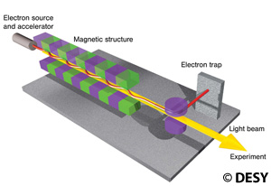

Introduction
Free electron lasers (FELs) - new tools to investigate matter at atomic levels
New possibilities for nano-world imaging:
  structure
  dynamics
  processes
Single molecule diffraction
European XFEL – Hamburg
Will become operational at 2016

Slide 3
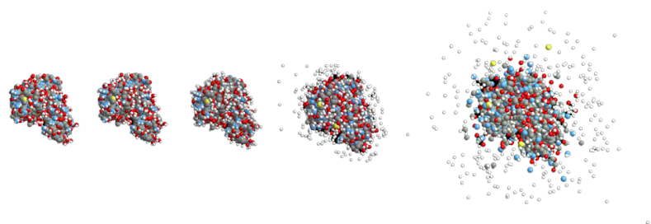
Diffraction before destruction
Short Pulse(<50 fs)
Long Pulse
Capture an image before the sample has time to respond
This principle is not restricted to tiny samples

Slide 4
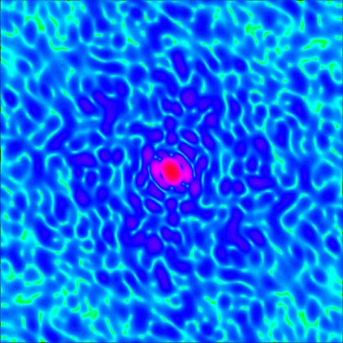
X-Ray diffraction from single molecule
No crystal, no Bragg peak
Continuous diffraction pattern
The pattern changes as the sample rotates
One pulse, one measurement
Random hits in random orientations

Slide 5
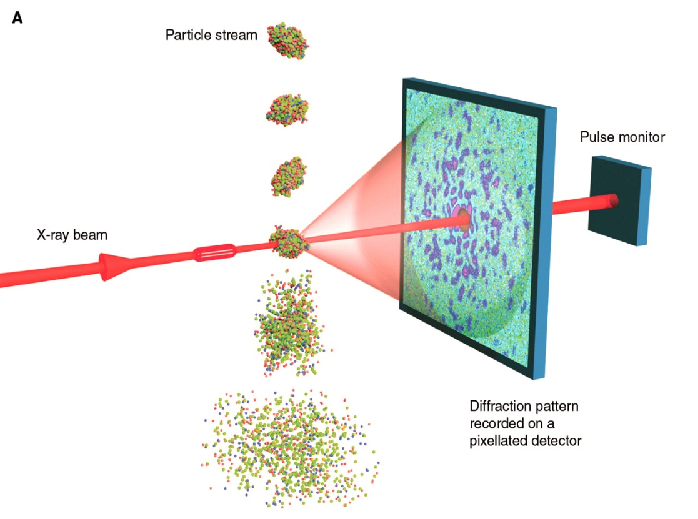
XFEL Coherent imaging
Electron energy up to 14.3 GeV
27 000 FEL pulses per second
Wavelength ~ 6Å
Pulse time ~ 10 fs

Slide 6
New experiment – new challenges
IT Infrastructure
  2.3 billions of diffraction images daily
  Big data needs management: storage, transfer, indexing, publishing
New data – new analysis methods
  images are not reproducible
  particle orientation is random
  molecular dynamics

Slide 7
The Task
We present a new method for automated diffraction images sorting
Can be used for:
  Uninformative images filtering
  To get high quality images for structure reconstruction
  To select diffraction images from a particular molecule
  Images datasets indexing and search

Slide 8
Images feature extraction
A new method for feature extraction is required
Visual descriptors from computer vision methods doesn’t work
Connect spatial structure with diffraction images

Slide 9
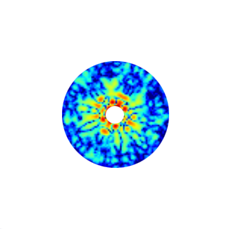
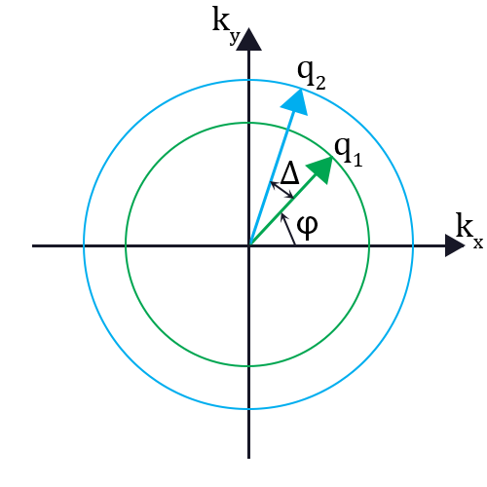
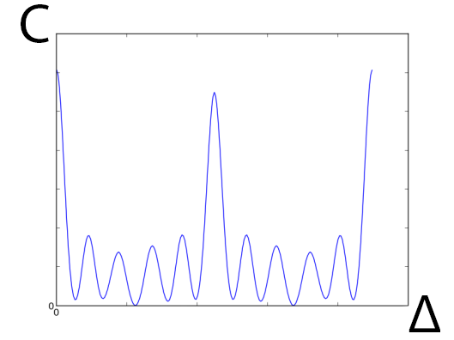
Feature vector – CCF spectrum
Cross correlation function
Autocorrelation, q₁ = q₂

Slide 10
The Method
Calculate feature vectors for diffraction patterns
Use some images as a learning dataset for some machine learning algorithm
Classify the rest

Slide 11
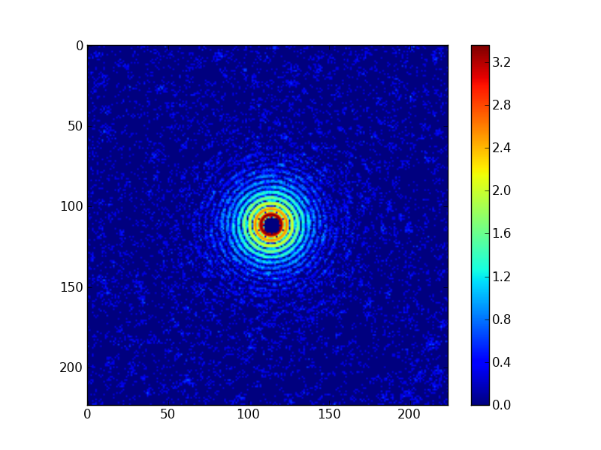
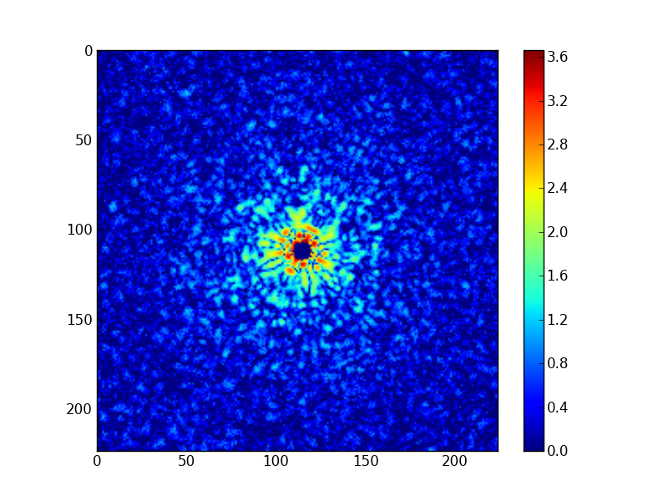
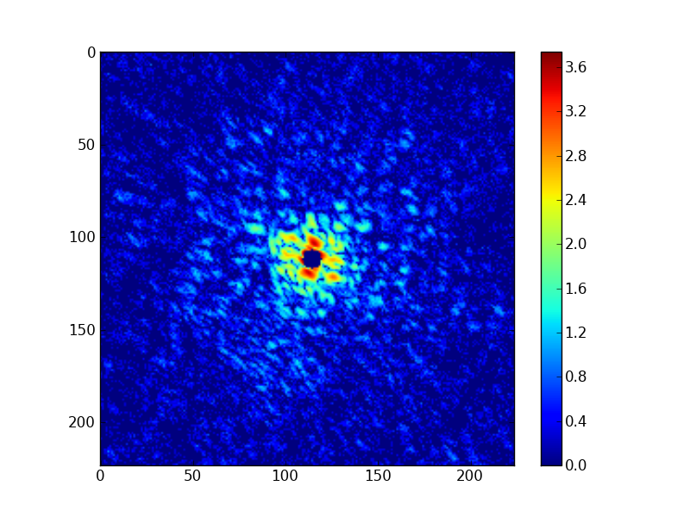
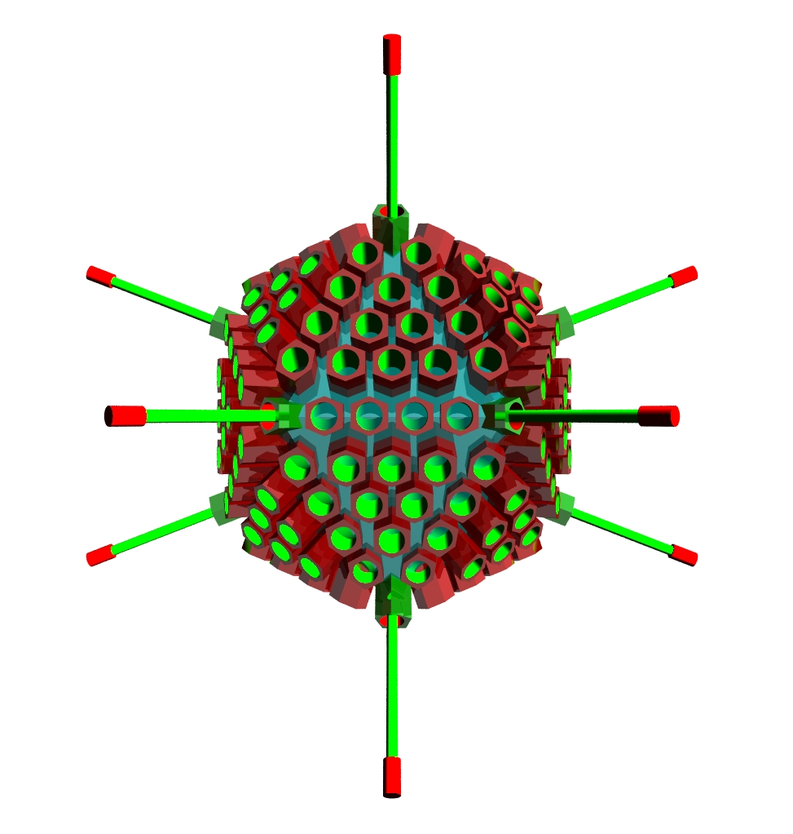
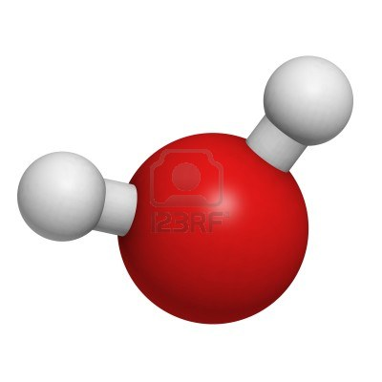
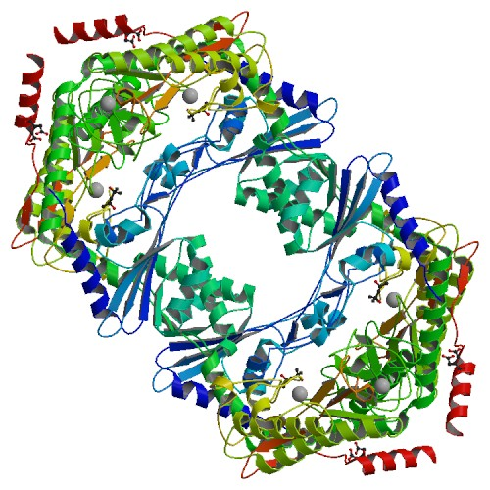
The Model Data
Three types of diffraction images
Adenovirus capsid
Water
2bwt

Slide 12
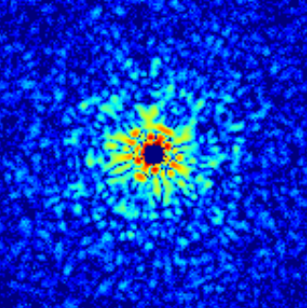
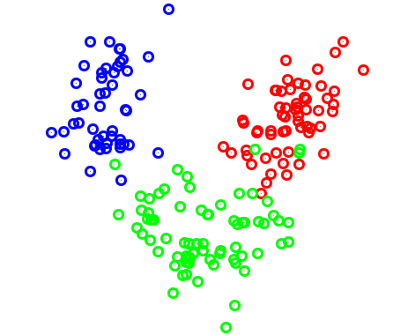
Algorithm
Data Matrix
Feature vector calculation
Principle component analysis

Slide 13
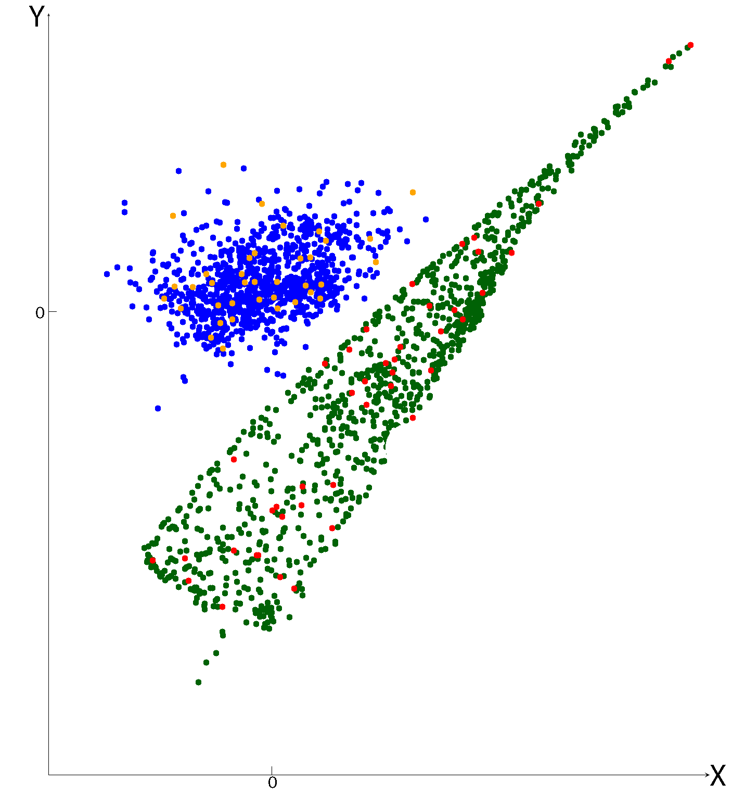
Simulated data results
All three image classes can be separated from each other

Slide 14
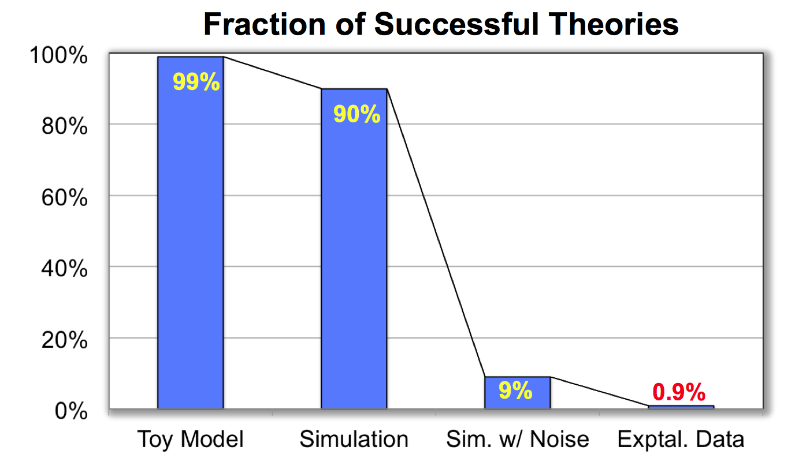
What about experimental data?

Slide 15
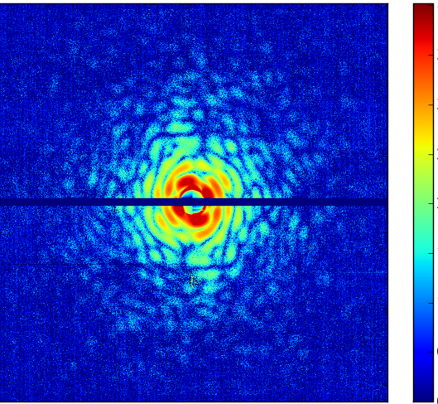
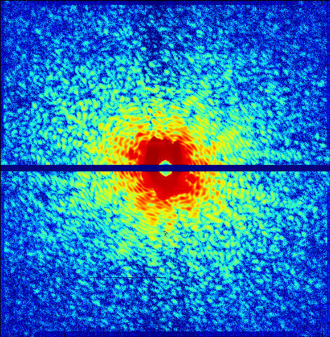
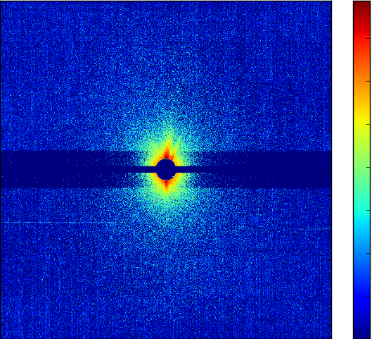
Experimental data
Dataset from LCLS (Stanford), two types of molecules
First type
Second type
Empty pattern

Slide 16
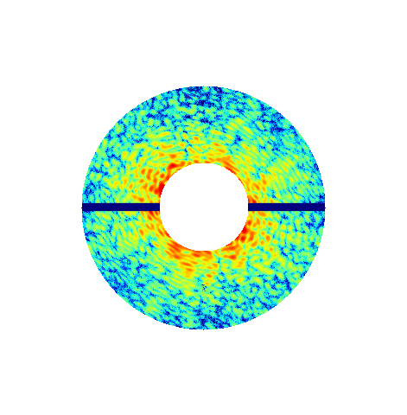
Algorithm improvements
Particle position estimation for every pattern
Variable bounds

Slide 17

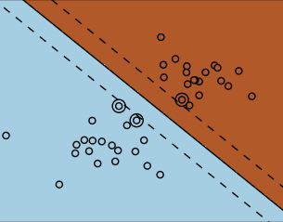
Algorithm improvements
Support vector machine (SVM) for machine learning
Provide better results than PCA
Data Matrix
Feature vector calculation
Support vector machine

Slide 18
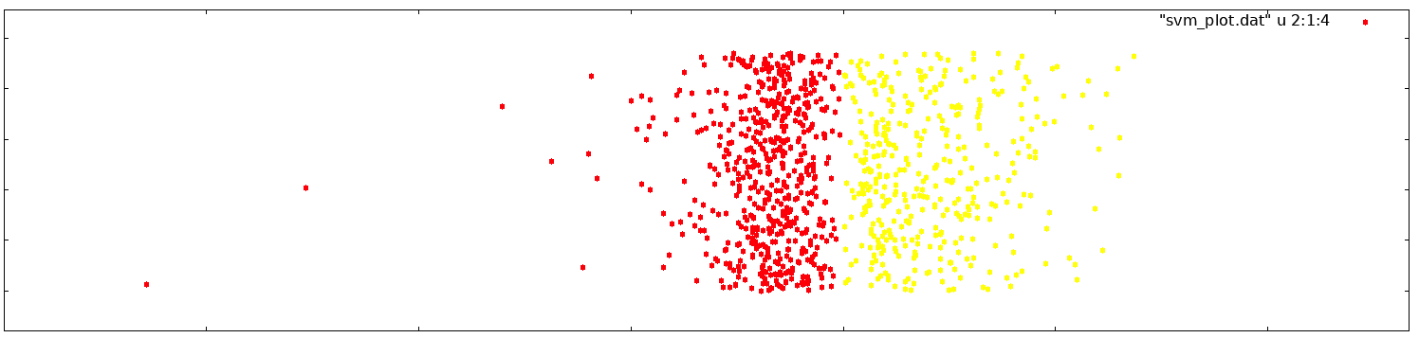
Experimental data results
SVM-based method successfully separates two classes of molecules
Empty patterns were classified and filtered out
More than 85 percent of images were separated properly

Slide 19
IT Background
We use Python + Numpy + Intel MKL
OpenMP parallelization
24 Core server – realtime image processing
Kurchatov Supercomputer Centre (complex for modeling and data analysis for mega-facilities)

Slide 20
Summary
We have presented a method for diffraction pattern classification
Our method was tested on simulated and experimental data and it works!
The method will be used to develop a software for automatic data clustering, separation, indexing and search
Special particle database will allow quickly analyze experimental data

Slide 21
Thank you!

