Slide 1
CMB Polarization generated by cosmological gravitational waves
Alexander Polnarev
QMUL, School of Physics and Astronomy, London, UK
Tarusa , 10 September 2015

Slide 2
Talk Overview:
Introduction:
Free electrons + Anisotropy = Polarization
The History of Polarization in Cosmology:
1968 - 2015
Gravitational waves predicted by Einstein
Calculating B-modes in CMB Polarization as imprints of Primordial Gravitational Waves on the CMB polarization
Summary and Conclusions

Slide 3



At a given observation point, for a particular direction of observation the radiation field can be characterized by four Stokes parameters conventionally labeled as I,Q,U,V:
Choosing a x,y coordinate frame in the plane orthogonal to the line of sight, these are related to possible quadratic time averages of the electromagnetic field:
In order to proceed let us firstly recap the main characteristics of the radiation field…
I is the total intensity of the radiation field
Q and U quantify the direction and the magnitude of the linear polarization.
V characterizes the degree of circular polarization

Slide 4
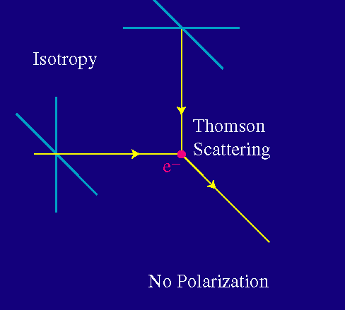
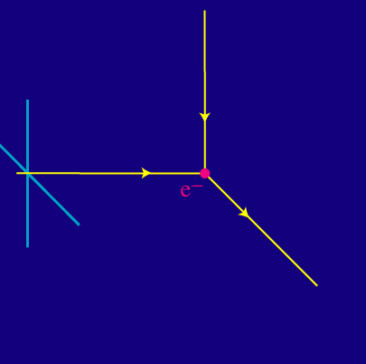
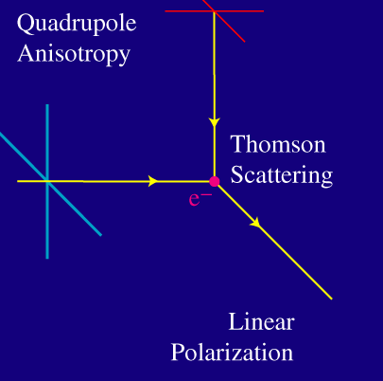
  Polarization is generated from anisotropy by Thompson scattering

Slide 5
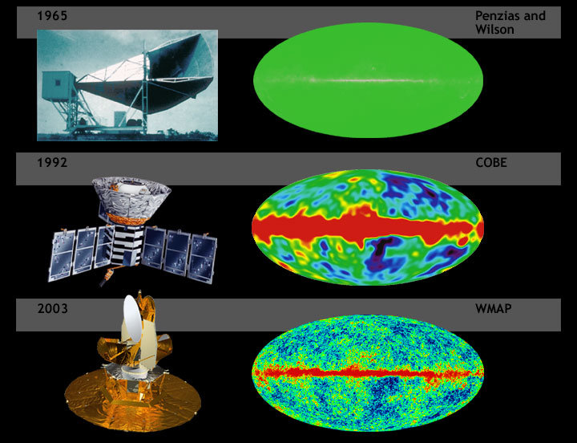

Slide 6
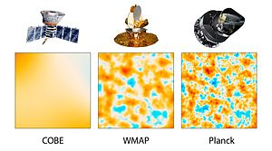

Slide 7
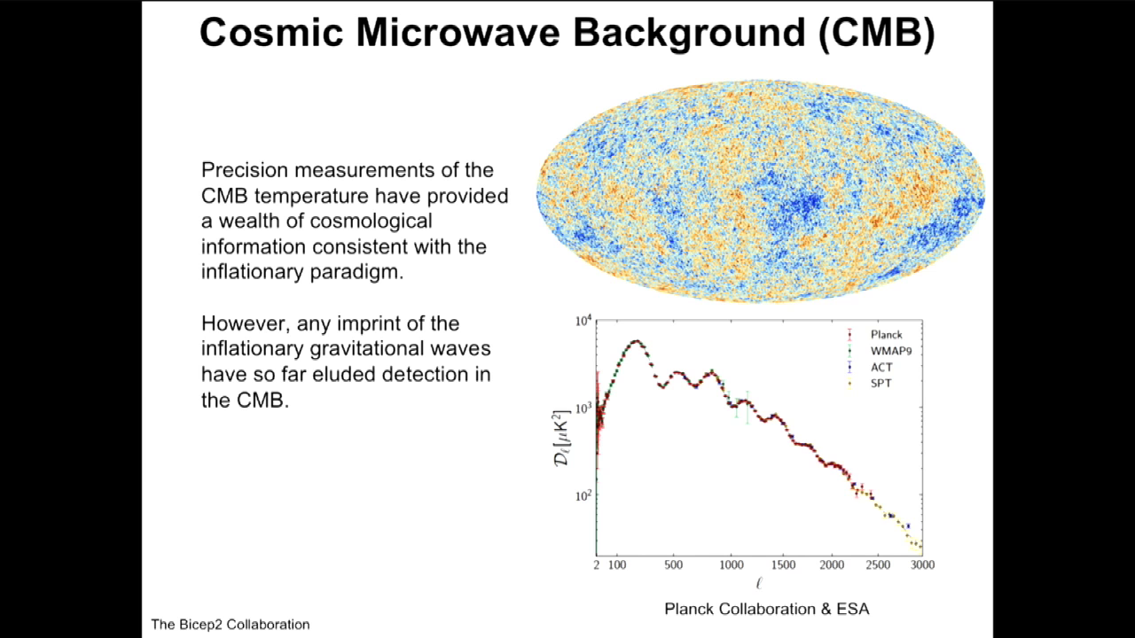

Slide 8
The very beginning of Polarization in Cosmology
Originally proposed by Rees (1968) as an observational signature of an axi-symetric anisotropic Universe (then Caderni et al (1978), Lubin et al (1979), Nanos et al (1979), YaB was in doubts.
General case of anisotropy corresponding to scalar (density) and tensor (gravitational waves) perturbations with infinite wave-length: Basko, Polnarev (1979),
Gravitational waves with finite wave-length: Polnarev (1985)
and so on…..CMB polarization was unobserved for 34 starting from Rees and 25 years after 1979 when YaB’s predicted that it will be discovered around 2000!!!

Slide 9
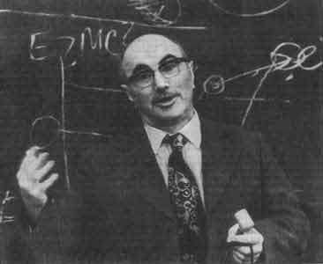
03.08.1914 -12.02.1987
The CMB polarization will be detected around 2000

Slide 10
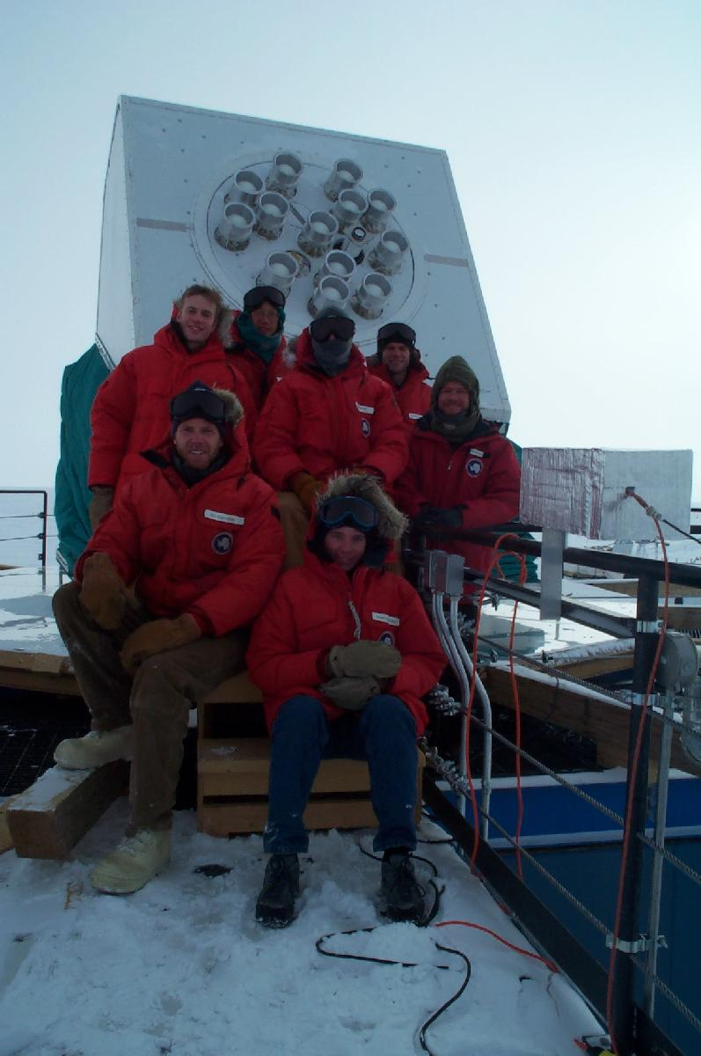
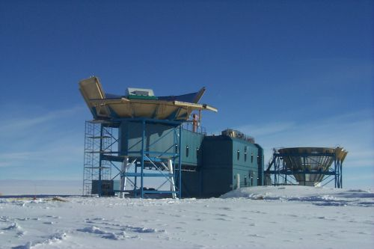
DASI Experiment, 2003

Slide 11
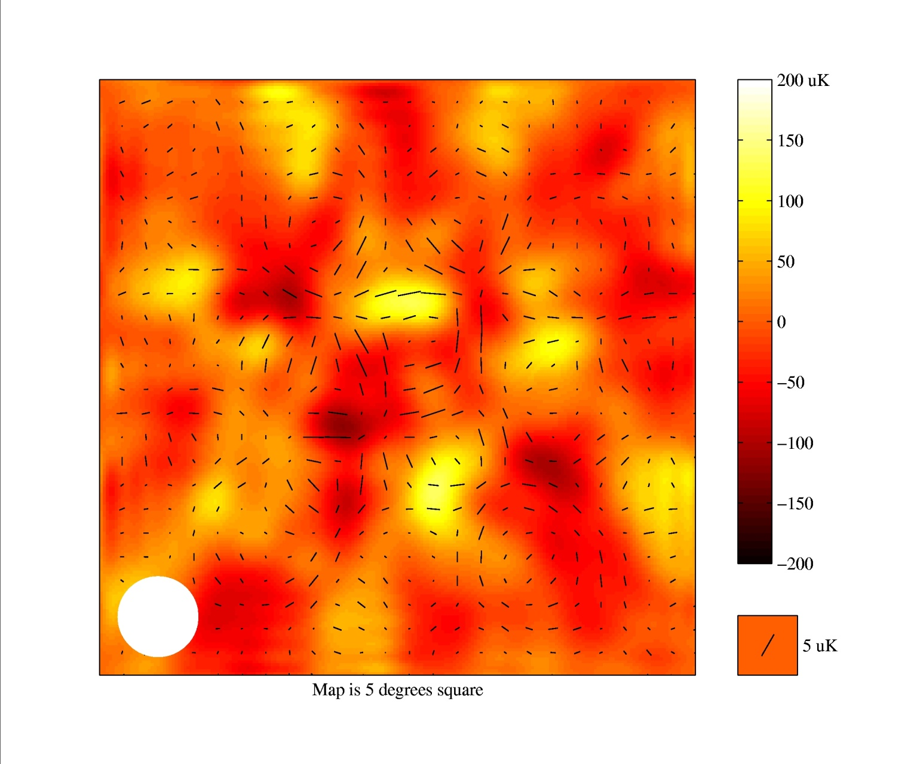
Map of E-polarization

Slide 12
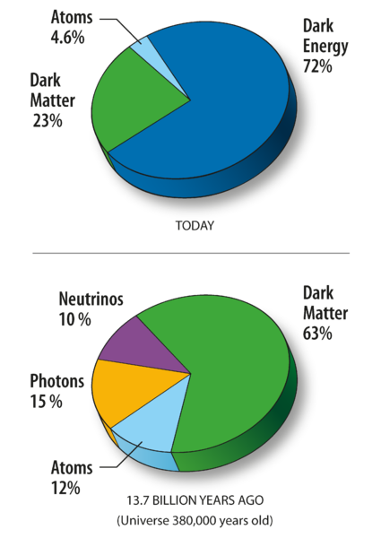
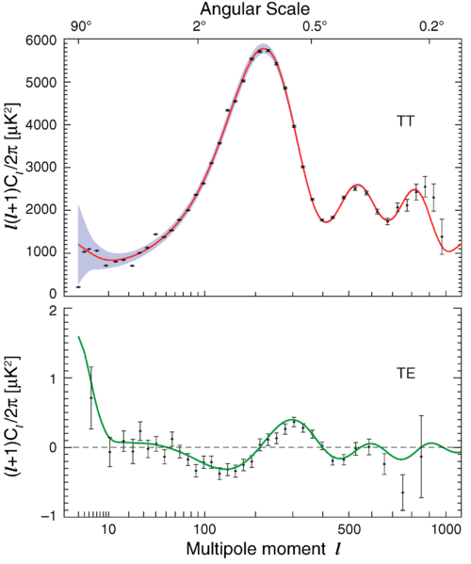

Slide 13
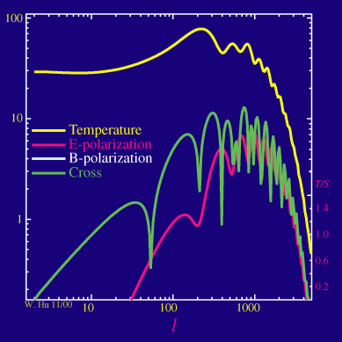
Adding back in the density fluctuations, the power spectrum as a function of the ratio of power in the gravitational wave (tensor, T) versus density (scalar, S) modes becomes:

Slide 14
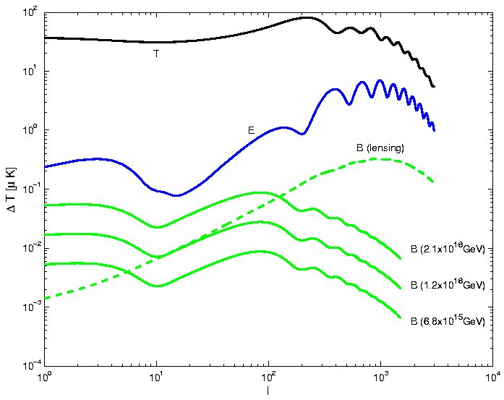

The Challenge of B-Mode Detection

Slide 15
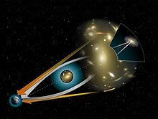

Slide 16
2014: Primordial gravitational waves detected???
March 17: The announcement by the BICEP2 collaboration of the first indirect detection of primordial gravitational waves, an important prediction of the theory.
The BICEP2 collaboration is an international team of astronomers working at the South Pole.
If confirmed by other ongoing experiments, the detection is an important confirmation of the basic picture of cosmology that has been developed over the last five decades.
By studying the polarization of the CMB , the BICEP2 team identified “B-modes” produced by primordial gravitational waves.???
The new detection would give a window to study the interplay of gravity and quantum physics

Slide 17
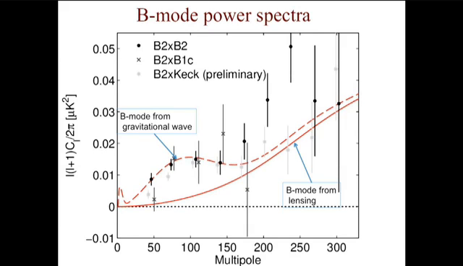

Slide 18
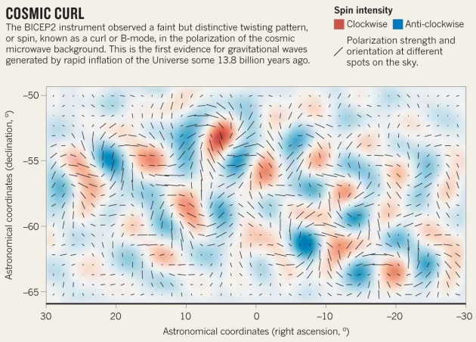

Slide 19
Gravitational waves or dust ?

Slide 20
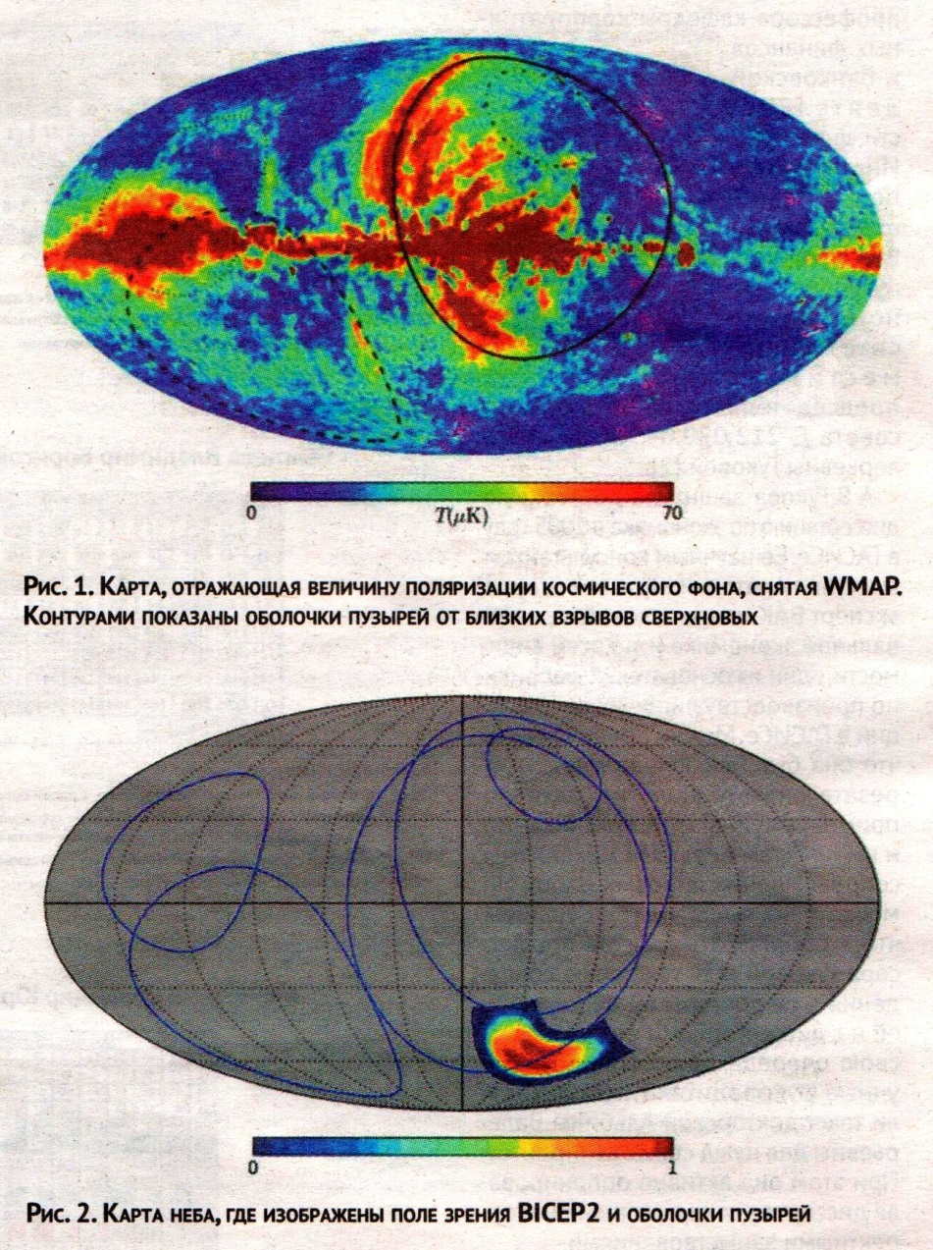

Slide 21
The end of story – the Joint Analysis of BICEP2/Keck Array and Planck Data
( arXiv:1502.00612v1 [astro-ph.CO] 2 Feb 2015)
BICEP2: 400 deg^2 patch of sky.The combined maps reach a depth of 57 nano K x deg in Stokes Q and U at 150 GHz.
PLANK: the full sky in polarization at seven frequencies from 30 to 353 GHz, but much less deeply in any given region (1.2 micro K x deg in Q and U at 143GHz).
In CDM model that includes dust, synchrotron radiation and gravitational waves from inflation (parameterized by the tensor to scalar ratio r)
1) r < 0.12 at 95% confidence.
2) Lensing B-modes are detected at 7:0 sigma level

Slide 22
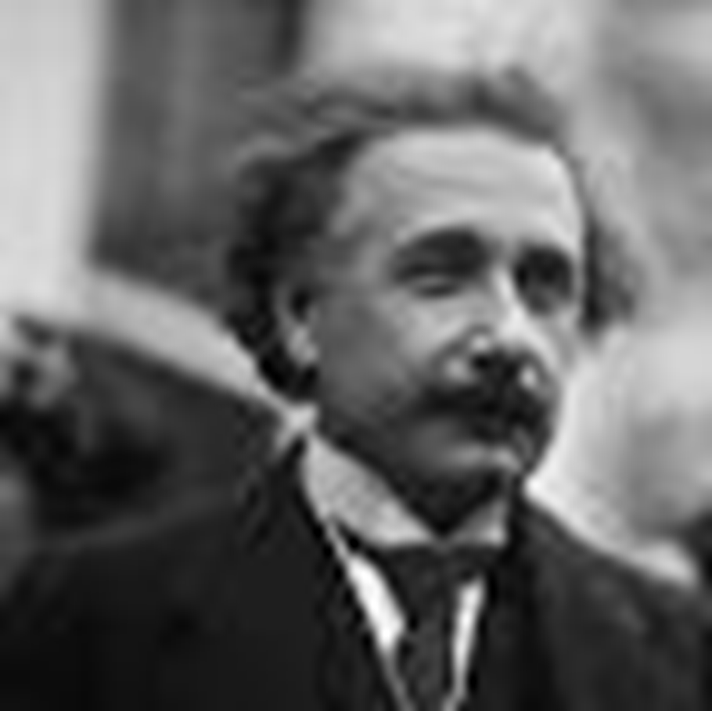
Gravitational waves predicted by Einstein
Gravitational waves predicted by Einstein
Gravitational waves predicted by Einstein

Slide 23
Gravitational waves
Gravity propagates at the speed of light, the maximum speed that information can travel.
Gravity itself is an effect of the curvature of space-time—matter curves spacet-ime,
and the curvature of space-time guides the motion of matter.
This interplay is what we observe as gravity.
Small perturbations in the curvature of spacetime travel at the speed of light
are called gravitational waves.
These ripples can be generated by the acceleration of large masses,
but may also be generated on very small scales by quantum fluctuations.
The connection between these small gravitational perturbations and the cosmic microwave background is provided by a third concept, known as inflation.
Gravitational waves predicted by Einstein

Slide 24
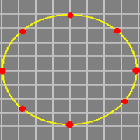
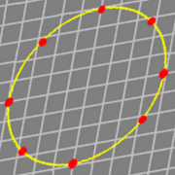
Tensor perturbations: gravitational waves
+ mode
X-mode

Slide 25
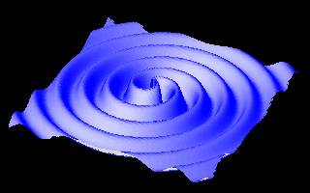

Slide 26
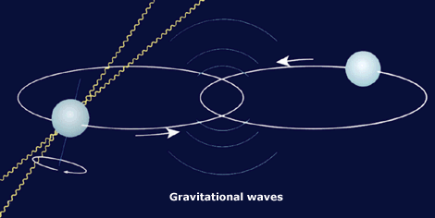
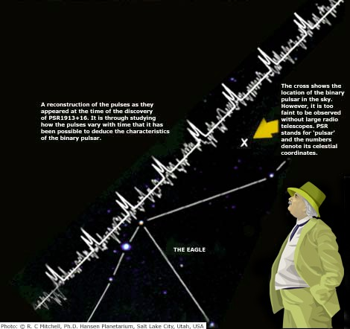
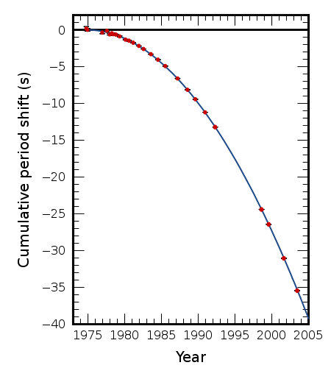

Slide 27
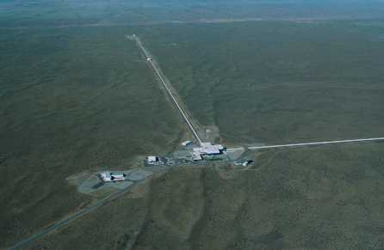
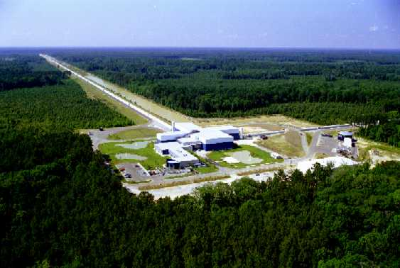
The LIGO Hanford Observatory in Washington State (left); and the LIGO Livingston Observatory (right) in Louisiana.

Slide 28
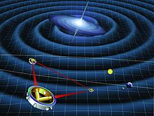

Slide 29
There are 3 possibilities to detect primordial g.w.s
CMB
Space Borne g.w. detectors (LISA)
Ground based g.w.
detectors (LIGO)
CMB seems the most promising, since it captures the gravitational waves at maximum amplitude in the past !!!

Slide 31
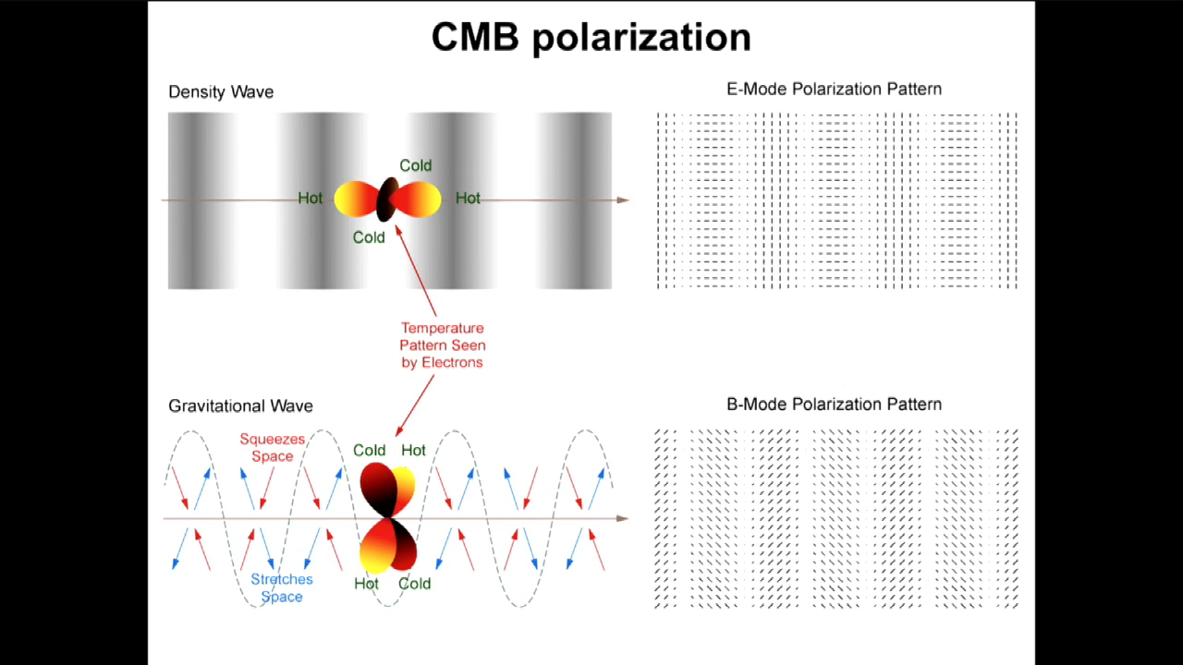

Slide 32
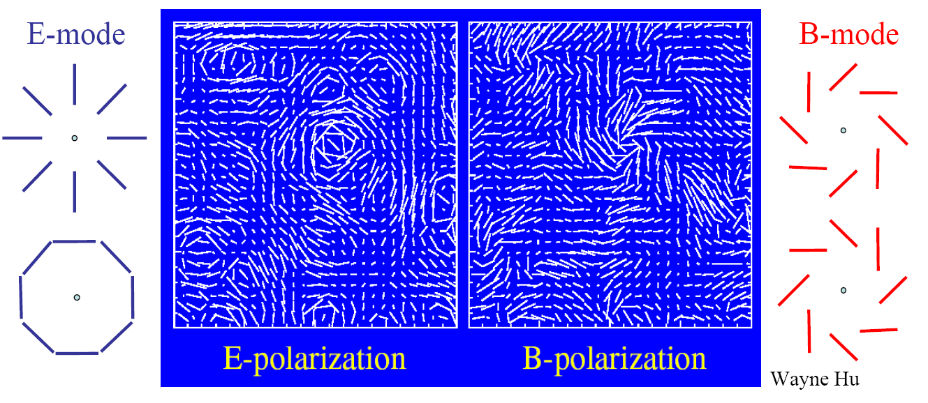
The most important thing is that E mode is different from B mode
The mathematical formulae from the previous slide allow to separate the two types

Slide 33
Calculating CMB polarization generated by cosmological gravitational waves
Polarization and Anisotropy of the primordial radiation in an anisotropic universe, M.Basko, A. Polnarev, Astron. Zh, 57, 465-472(1980)
Polarization and anisotropy induced in microwave background by cosmological gravitational waves,
A.Polnarev, Astron.Zh,62, 1041-1052(1985)
The polarization of the Cosmic Microwave Background due to Primordial Gravitational Waves,
B.G.Keating, A.G.Polnarev, N.J.Miller and D.Baskaran.
International Journal of Modern Physics A, Vol. 21, No. 12, pp. 2459-2479
(2006)
Imprints of Relic Gravitational Waves on Cosmic Microwave Background Radiation”,
D.Baskaran, L.P.Grishchuk and A.G.Polnarev,
Physical Review D 74, 083008 (2006)
CMB temperature polarization correlation and primordial gravitational
Waves, A. Polnarev, N. Miller, B. Keating,
MNRAS, 386, 1053 (2008).
CMB Temperature Polarization Correlation and Primordial
GravitationalWaves:WMAP5
N. J.Miller, B. G. Keating and A. G. Polnarev, Advances in Astronomy
Volume 2009, 309024 (2009).

Slide 34

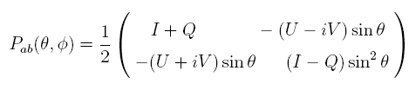


Introducing a spherical coordinate system , as a function of direction of observation on the sky, the four Stokes parameters form the components of the polarization tensor Pab :
The components of polarization tensor are not invariant under rotations, and transform through each other under a coordinate transformation. For this reason it is convenient to construct rotationally invariant quantities out of Pab
Two of the obvious quantities are:
Two other invariant quantities characterizing the linear polarization can be constructed by covariant differentiation of the symmetric trace free part of the polarization tensor:
which (as was mentioned before) characterizes the total intensity, and is a scalar under coordinate transformations.
Which is known as the E-mode of polarization, and is a scalar.
Which characterizes the degree of circular polarization, and behaves as a pseudoscalar under coordinate transformations
Which is known as the B-mode of polarization, and is pseudoscalar.

Slide 35
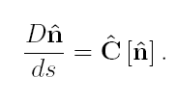








Thompson scattering and Equation of radiative transfer:
Symbolically the radiative transfer equation has the form of Liouville equation in the photon phase space
Where is a symbolic 3-vector, whose components are expressible through the Stokes parameters
Encodes the information on the scattering mechanism
Couples the metric through covariant differentiation
In the cosmological context (for z<<10^6), the dominant mechanism is the Thompson scattering!
Is the Chandrasekhar scattering matrix for Thompson scattering. is the Thompson scattering cross section. is the density of free electrons
Where is the photon 4 momentum, is the direction of photon propagation, and is the photon frequency.

Slide 36

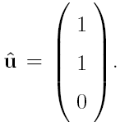



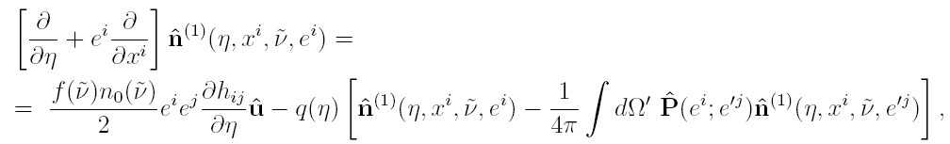


The solution to the radiative transfer equation is sought in the form:
Where the unperturbed part corresponds to an isotropic and homogeneous radiation field:
(Corresponds to an overall redshift with cosmological expansion.)
The first order equation (restricting only to the linear order) takes the form:
Thompson scattering
metric perturbations

Slide 37
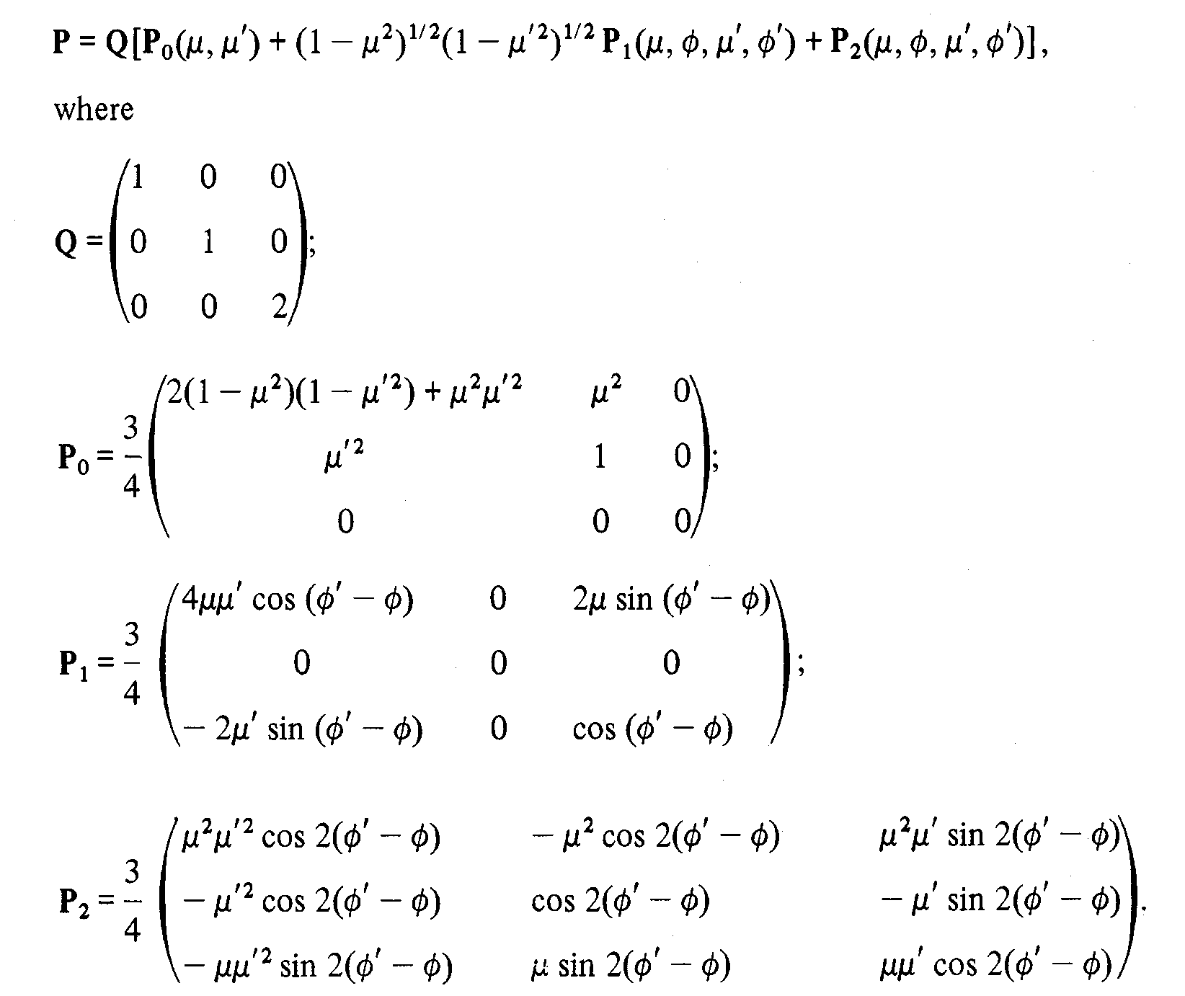

Slide 38

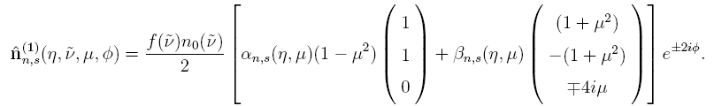

Due to the linear nature of the problem and order to simplify the equations, we can Fourier (spatial) decompose the solution, and consider each individual Fourier mode separately
For each individual Fourier mode, without loss of generality the solution can be sought for in the form (Basko&Polnarev1980):
Here is the angle between the angle of sight e and the wave vector n.
And is the angle in the azimuthal plane (i.e. plane perpendicular to n).
determines the (photon) frequency dependency of both anisotropy and polarization (the dependence is same for both)!
The problem has simplified to solving for two functions and of two variables . (initially we had variables , 1+3+1+2=7 variables. )
determines anisotropy while determines polarization.

Slide 39



The usual approach to the problem of solving these equations:
This procedure leads to an infinite system of coupled ordinary differential equations for each l !
The standard numerical codes like CMBFast and CAMB are based on solving an (appropriately cut) version of these equations!
The expected power spectra of anisotropy and polarization can then be expressed in terms of and .

Slide 40
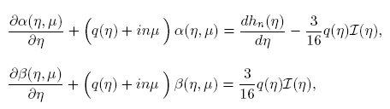


The equations for and have the form of an integro-differential equation in two variables (Polnarev1985):
where
(Thompson scattering term)
(Density of free electrons)
Anisotropy is generated by the variable g.w. field
Polarization is generated by scattering of anisotropy
and by scattering!

Slide 41
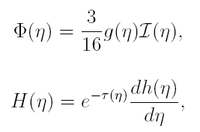





Alternative approach to the problem is to recast the equations into a single integral equation.
In order to do this let us first introduce two quantities that will play an important role in further considerations:
Further introducing two functions
Optical depth
The formal solution to equations for and is given by:
Visibility function
Thus both (anisotropy) and (polarization) are expressible through a single unknown function !

Slide 42
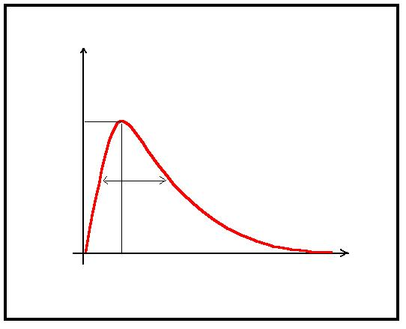
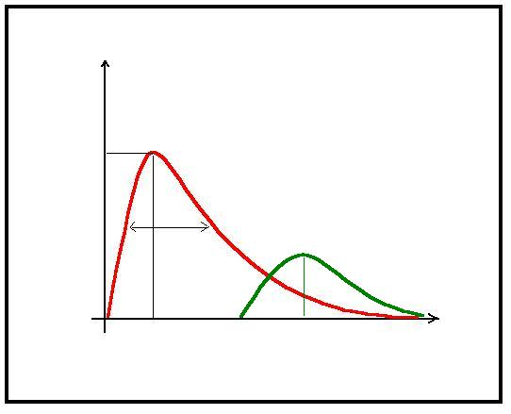



The solution of the integral equation depends crucially on the Polarization window function Q (η)=q (η) exp(-τ(η)) .
Polarization window function
Polarization window function for secondary ionization

Slide 43
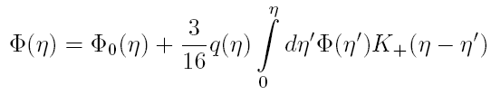

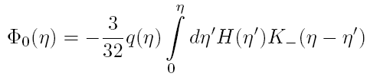


The result is a single Voltaire type integral equation in one variable:
Where is the gravitational wave source term for polarization
and the Kernels are given by:

Slide 44



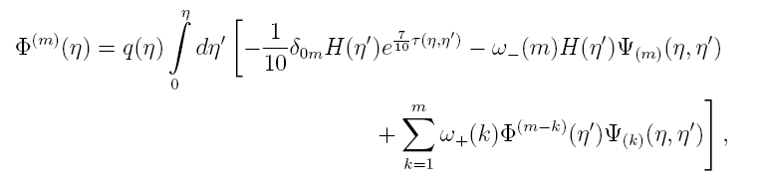




The integral equation can be either solved numerically, or the solution can be presented in the form of a series in over (which for wavelengths of our interest l<1000 is a small number).
where
With each term expressible through a recursive relationship:
The main thing to keep in mind is that in the lowest approximation:
Anisotropy is proportional to g.w. wave amplitude at recombination.
While polarization is proportional to the amplitude of the derivative at recombination.
Where Kernels are dependent only on the recombination history:

Slide 45
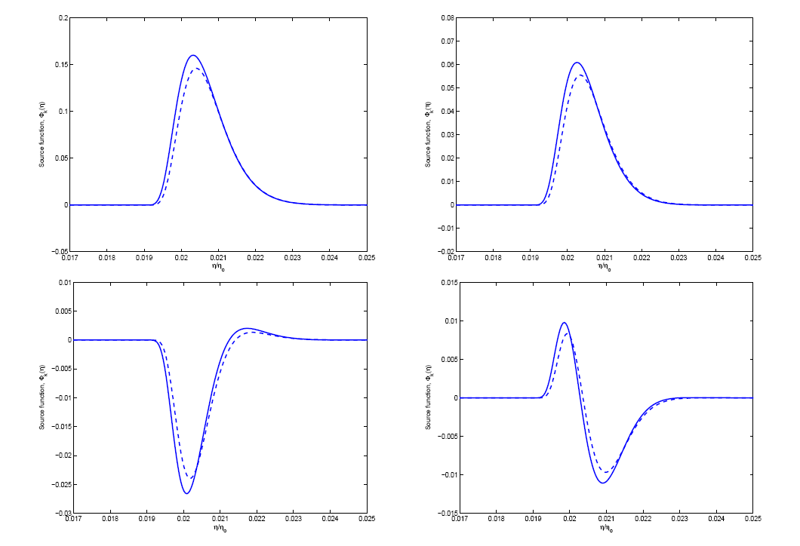
The solution to the integral equation for various wavenumbers:
(Solid line shows the exact numerical solution, while the dashed line shows the zeroth order analytical approximation.)
The solution is localized around the visibility function (around the epoch of recombination). Physically this is a consequence of the fact that:
on the one hand due to the enormous optical depth before recombination we cannot see the polarization generated much before recombination
on the other hand polarization generation requires free electrons, which are absent after recombination is complete.

Slide 46
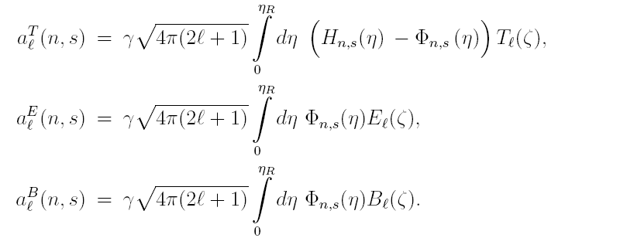
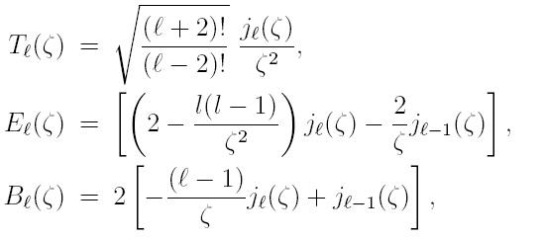

Once the integral equation is solved (either numerically or using analytical approximations) the calculation of the power spectra is a straight forward procedure:
First calculate the individual multipole coefficients for each individual wave:
(Temperature anisotropy)
Where the projection factors are expressible through combinations of spherical Bessel functions
(E mode of polarization)
(B mode of polarization)
Next multiply them with each other and integrate over all wavenumbers and all polarization states:

Slide 47
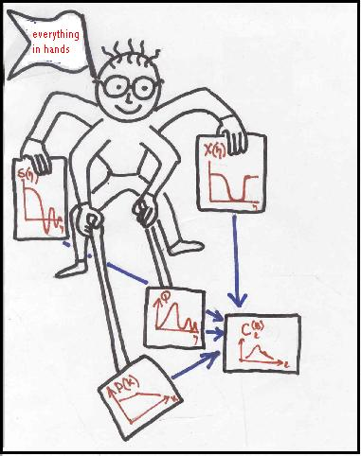
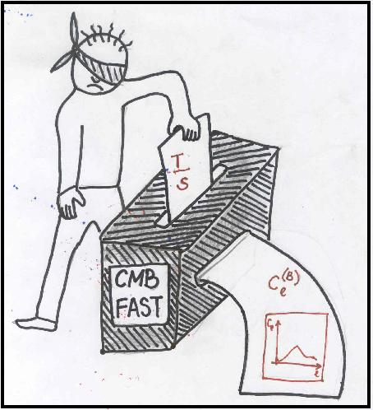
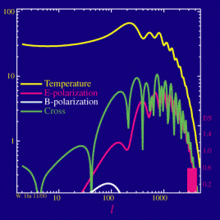
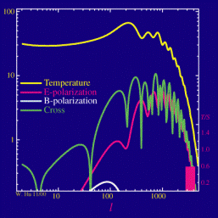

Slide 48






The convenience of the introduced invariant quantities lies in the fact that they can now all be decomposed into ordinary spherical harmonics
The polarization tensor can be reconstructed in terms of the multipoles in the following way:
(Where and are the “gradient” and “curl” type tensor spherical harmonics)
The set of multipoles completely characterizes the radiation field!

Slide 49
The convenience of the introduced invariant quantities lies in the fact that they can now all be decomposed into ordinary spherical harmonics
The polarization tensor can be reconstructed in terms of the multipoles in the following way:
(Where and are the “gradient” and “curl” type tensor spherical harmonics)
The set of multipoles completely characterizes the radiation field!

Slide 50




The exact numerical value of the multipole coefficients depends on the concrete realization of the underlying random process of their generation.
The various cosmological models predict only the statistical properties of the multipole coefficients!
A homogeneous and isotropic cosmological model with statistically homogeneous and isotropic perturbations predicts an isotropic statistics for the multipoles:
Thus we are left with only four possible correlation functions
Circular polarization does not arise in the cosmological context (except possibly due to strong magnetic fields), hence we shall not consider the V Stokes parameter.
which are known as correspondingly :
Temperature anisotropy power spectrum,
E-mode of polarization power spectrum,
B-mode of polarization power spectrum,
Temperature-polarization cross correlation.
A usefull consideration to keep in mind is that a given multipole l roughly corresponds to angular separation on the sky .
Assuming parity symmetric cosmological perturbations (i.e. an equal amount of left and right circular polarized gravitational waves) from parity considerations it follows that cross correlation functions vanish!

Slide 51
Future theoretical problems: for example…

Slide 52

Cosmological Birefringence
Universe is parity - even (?) TB=0=EB

Slide 53


Rotation of Polarization Plane
Beam systematics:
Miller, Shimon & Keating (2009)

Slide 54


Slide 55
  Summary and conclusions
  Gravitational waves show a power spectrum with both E and B mode contributions
  Gravitational waves contribution to B-modes is a few tenths of a μK at l~100.
  Gravitational waves probe the physics of inflation but will require a better understanding of foregrounds and secondary effects for their detection (multi-frequency experiments to exclude dust, synchrotron, lensing…?).
  This is not the end but the beginning of really new field of observational cosmology:
  Gravitational- Wave Cosmology

Slide 56
Thank you

