Slide 1
Поиск жизни в озере Восток — земном аналоге подледных океанов на спутниках Юпитера и Сатурна
Сергей А Булат
Лаборатория криоастробиологии
ФГБУ «ПИЯФ»
НИЦ «Курчатовский институт»
Г. Гатчина Ленинградской обл.

Slide 2
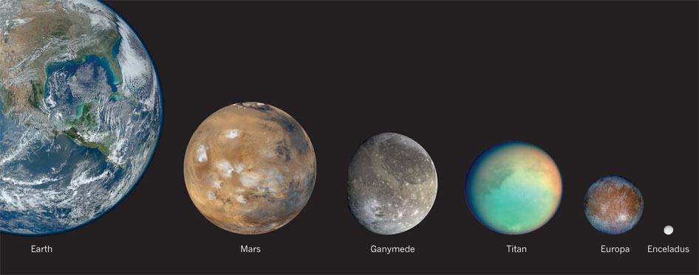
Life around us?
Searching for extraterrestrial life is one of the aims of astrobiology, and there are several potentially habitable worlds in the Solar System, in addition to Earth. Two of Jupiter’s moons (Ganymede and Europa) and two of Saturn’s moons (Titan and Enceladus) harbour liquid-water oceans. And Mars probably had vast liquid-water environments during much of its early history.
Lazcano 2012 Nature 488: 160-1

Slide 3
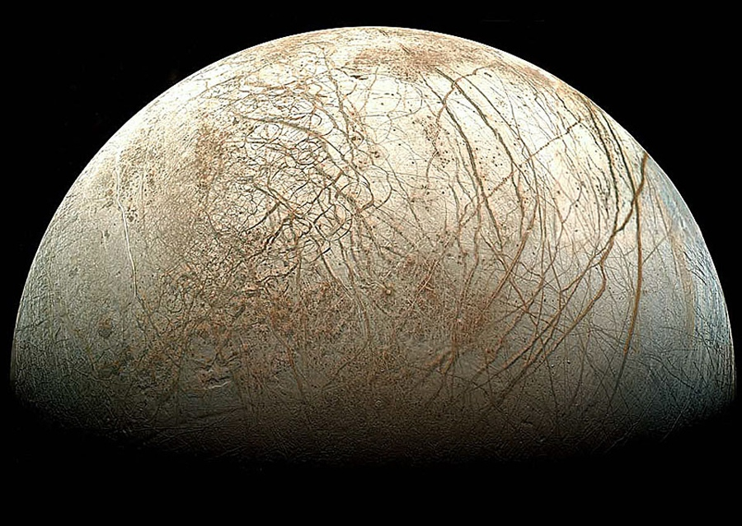
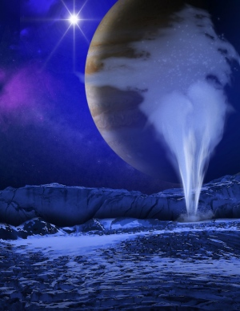
Geysers of water vapour shooting from Europa's surface
K. Retherford/Southwest Research Institute
NASA/JPL/Ted Stryk

Slide 4
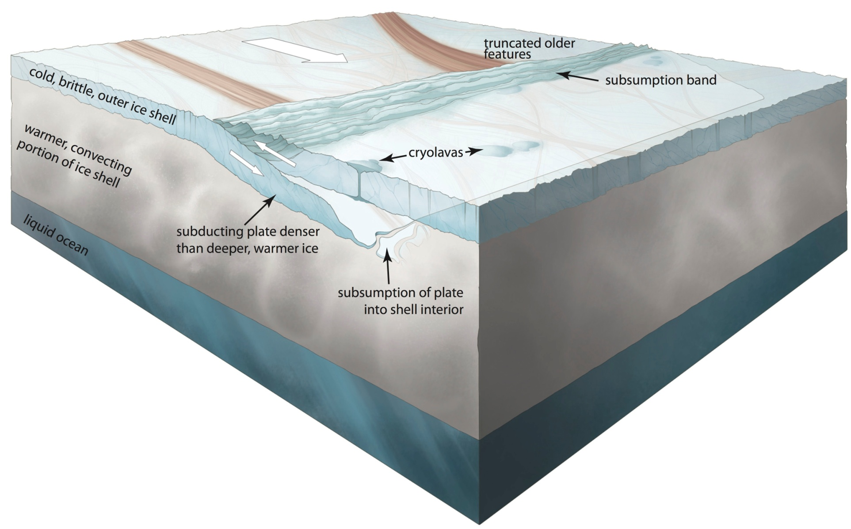
'Diving' Tectonic Plates on Jupiter's Moon Europa
40-90 million years old
K. Retherford/Southwest Research Institute
NASA/JPL/Ted Stryk

Slide 5
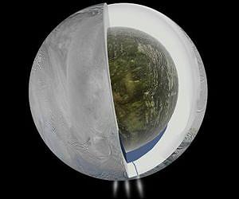
Large subsurface ocean near Enceladus south pole
Cassini Imaging Science Subsystem –courtesy NASA-JPL-Caltech

Slide 6
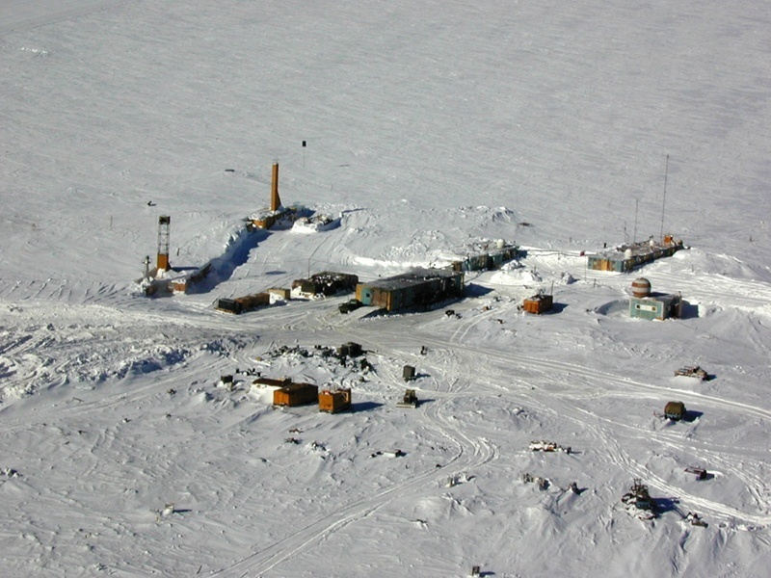
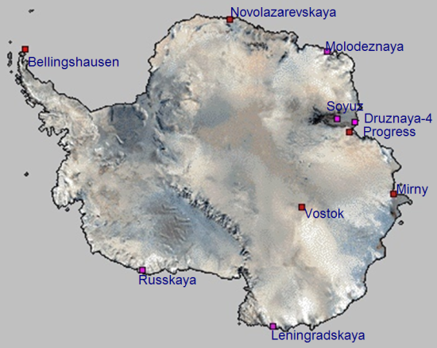
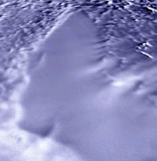
Vostok station (+3488m)
(since dec 1957)
(78°S, 106°E)
67 kPa – 67% oxygen
1260 km from the coast
21 July 1983
Absolute minimum -89.2°C
Average ann. Temp. -55.1°C
Lake Vostok (-3663m)
RADARSAT, CSA

Slide 7
Vostok Surface snow
(0 – 130m ^{up to 4 Kyr})
Below 3m the snow is pristine
Very clean ‘life-hostile’ environ
Low accumulation – 2.1-2.4g /cm²/a
Low Aeolian dust input
  2 μm mode; 18 ppb (Holocene) vs. 730 ppb (LGM)
Harsh irradiation (UV-C etc.) (‘ozone hole’ – Aug-Nov)
  + Water-Oxygen → free radicals
  Oxidized organics (photochemical reactions at ice-air interface)
Low freezing temperatures – below -36ºC (-55.1ºC ann.)
NO FREE (only BOUND) WATER!
(6-6.5 cm/a – snow / needles!)

Slide 8
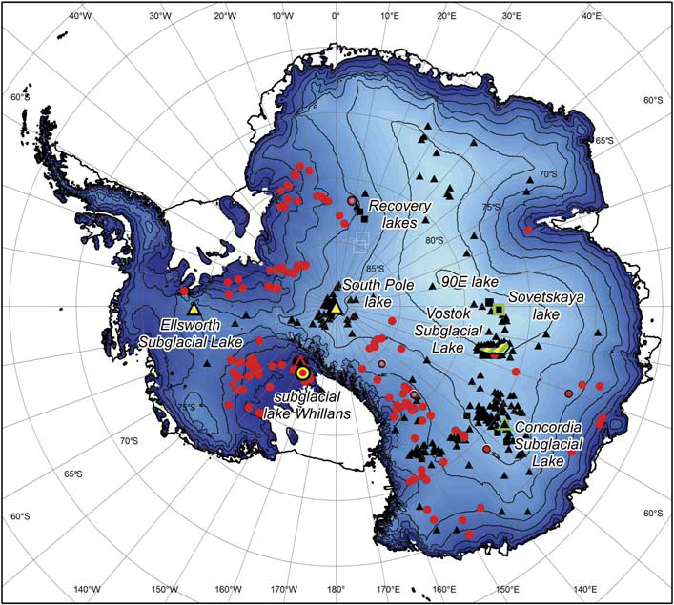
SALE Subglacial Antarctic Lake Environments - 379
CRYOSPHERE
Wright et Siegert , 2012

Slide 9
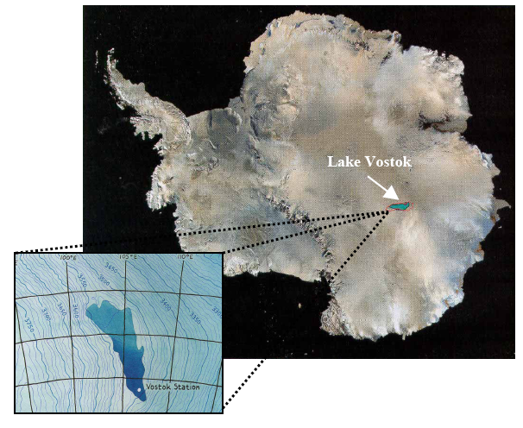
Lake Vostok Discovery
First reported at the 23rd session of SCAR in Rome in 1994
Published in Nature (Kapitsa et al., 1996)

Slide 10
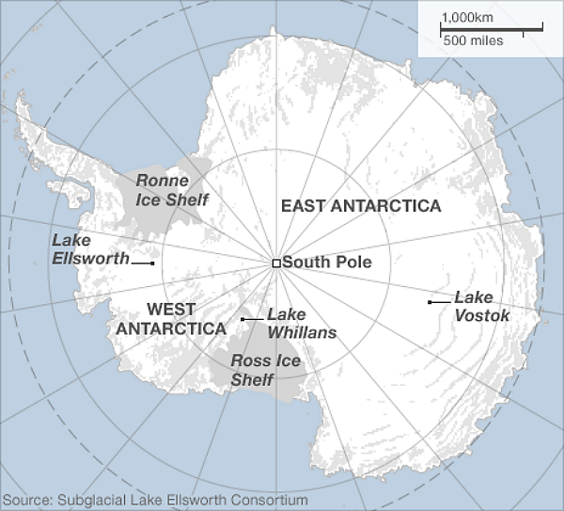
Subglacial Lake Entry on the Horizon in Antarctica
  Subglacial Lake Vostok, the largest known subglacial lake on earth (3769.3m-1.5km)
  Subglacial environments beneath West Antarctic Whillans ice stream (800m- 2m)
  Subglacial Lake Ellsworth, West Antarctica (3200m-160m)
Fev 05, 2012 – Russia
Jan 27, 2013 – US
>2018 - UK

Slide 11
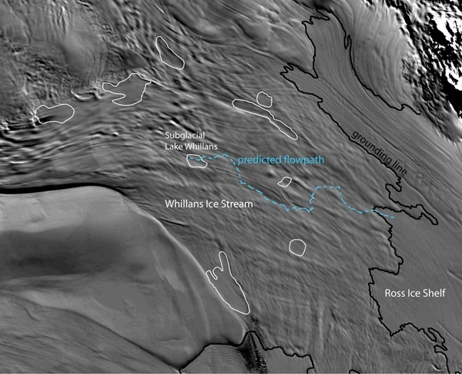
WISSARD
Subglacial Lake Whillans study site for LISSARD, the grounding zone wedge, study site for RAGES, and GBASE will sample both sites.

Slide 12
Lake Vostok _{known since 1994}
Published in Nature (Kapitsa et al., 1996)
RADARSAT, CSA
Friendly environment?
Deeply ice buried (in dark) – 4 km
High pressure – 337-377 bar
Permanently BUT not very cold – -2.65°C
Likely oxygen supersaturated - 800 mg/L (upper bound 700-1300 mg/L)
FREE (LIQUID) WATER!

Slide 13
Lake Vostok settings
RADARSAT, CSA
Huge subglacial lake (Masolov et al., SCAR OSC2008)
  275 x 65 km in size; 15 500 km² area; 6 100 km³ water
  Two main basins with the ridge between 150-200 m deep
  Average depth - 300 m; max depth – ~1650 m (south basin)
  Water renewal – 80-100 Kyr
Buried beneath 2.0-0.8 Myr old 3750-4200 m thick ice sheet
Isolated from surface biota for >14 Ma
  Age of water (melted ice) - ~1 Ma
No hydrological links to other lakes
2.0-0.8 Ma years old

Slide 14
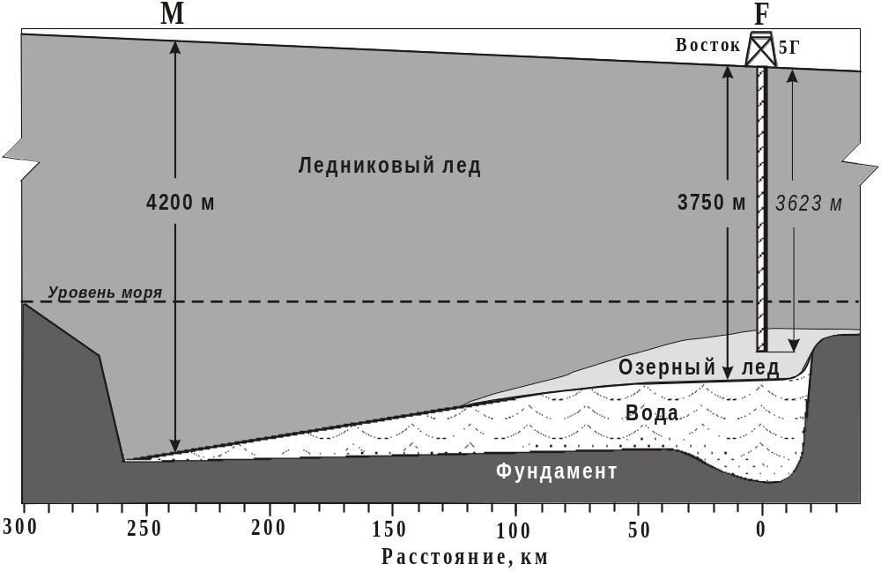
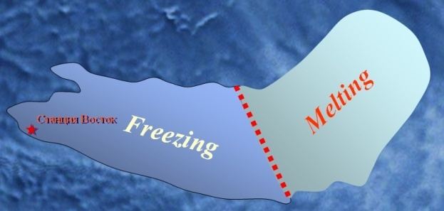
Vostok ice core
19.02.1990
(78°S, 106°E)
North
South
~4km
from coast
3650m
0.8 Ma
2.0 Ma – 3538m
Accretion
Melting zone
Gases
680m
Accretion (lake) ice
Accr. rate – <10 mm/a

Slide 15
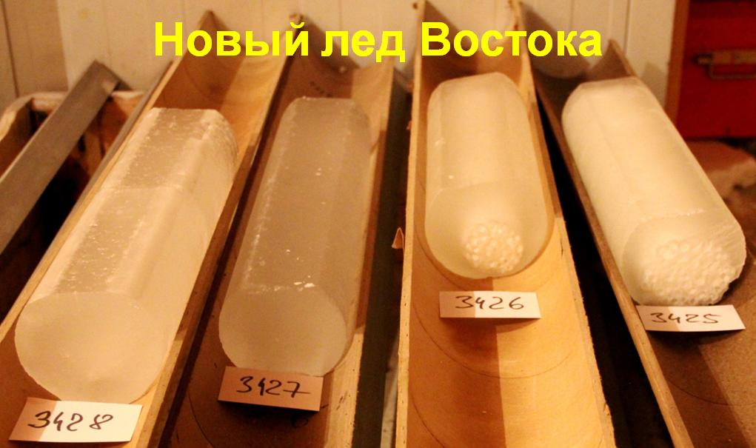
Vostok borehole-frozen water ice core

Slide 16
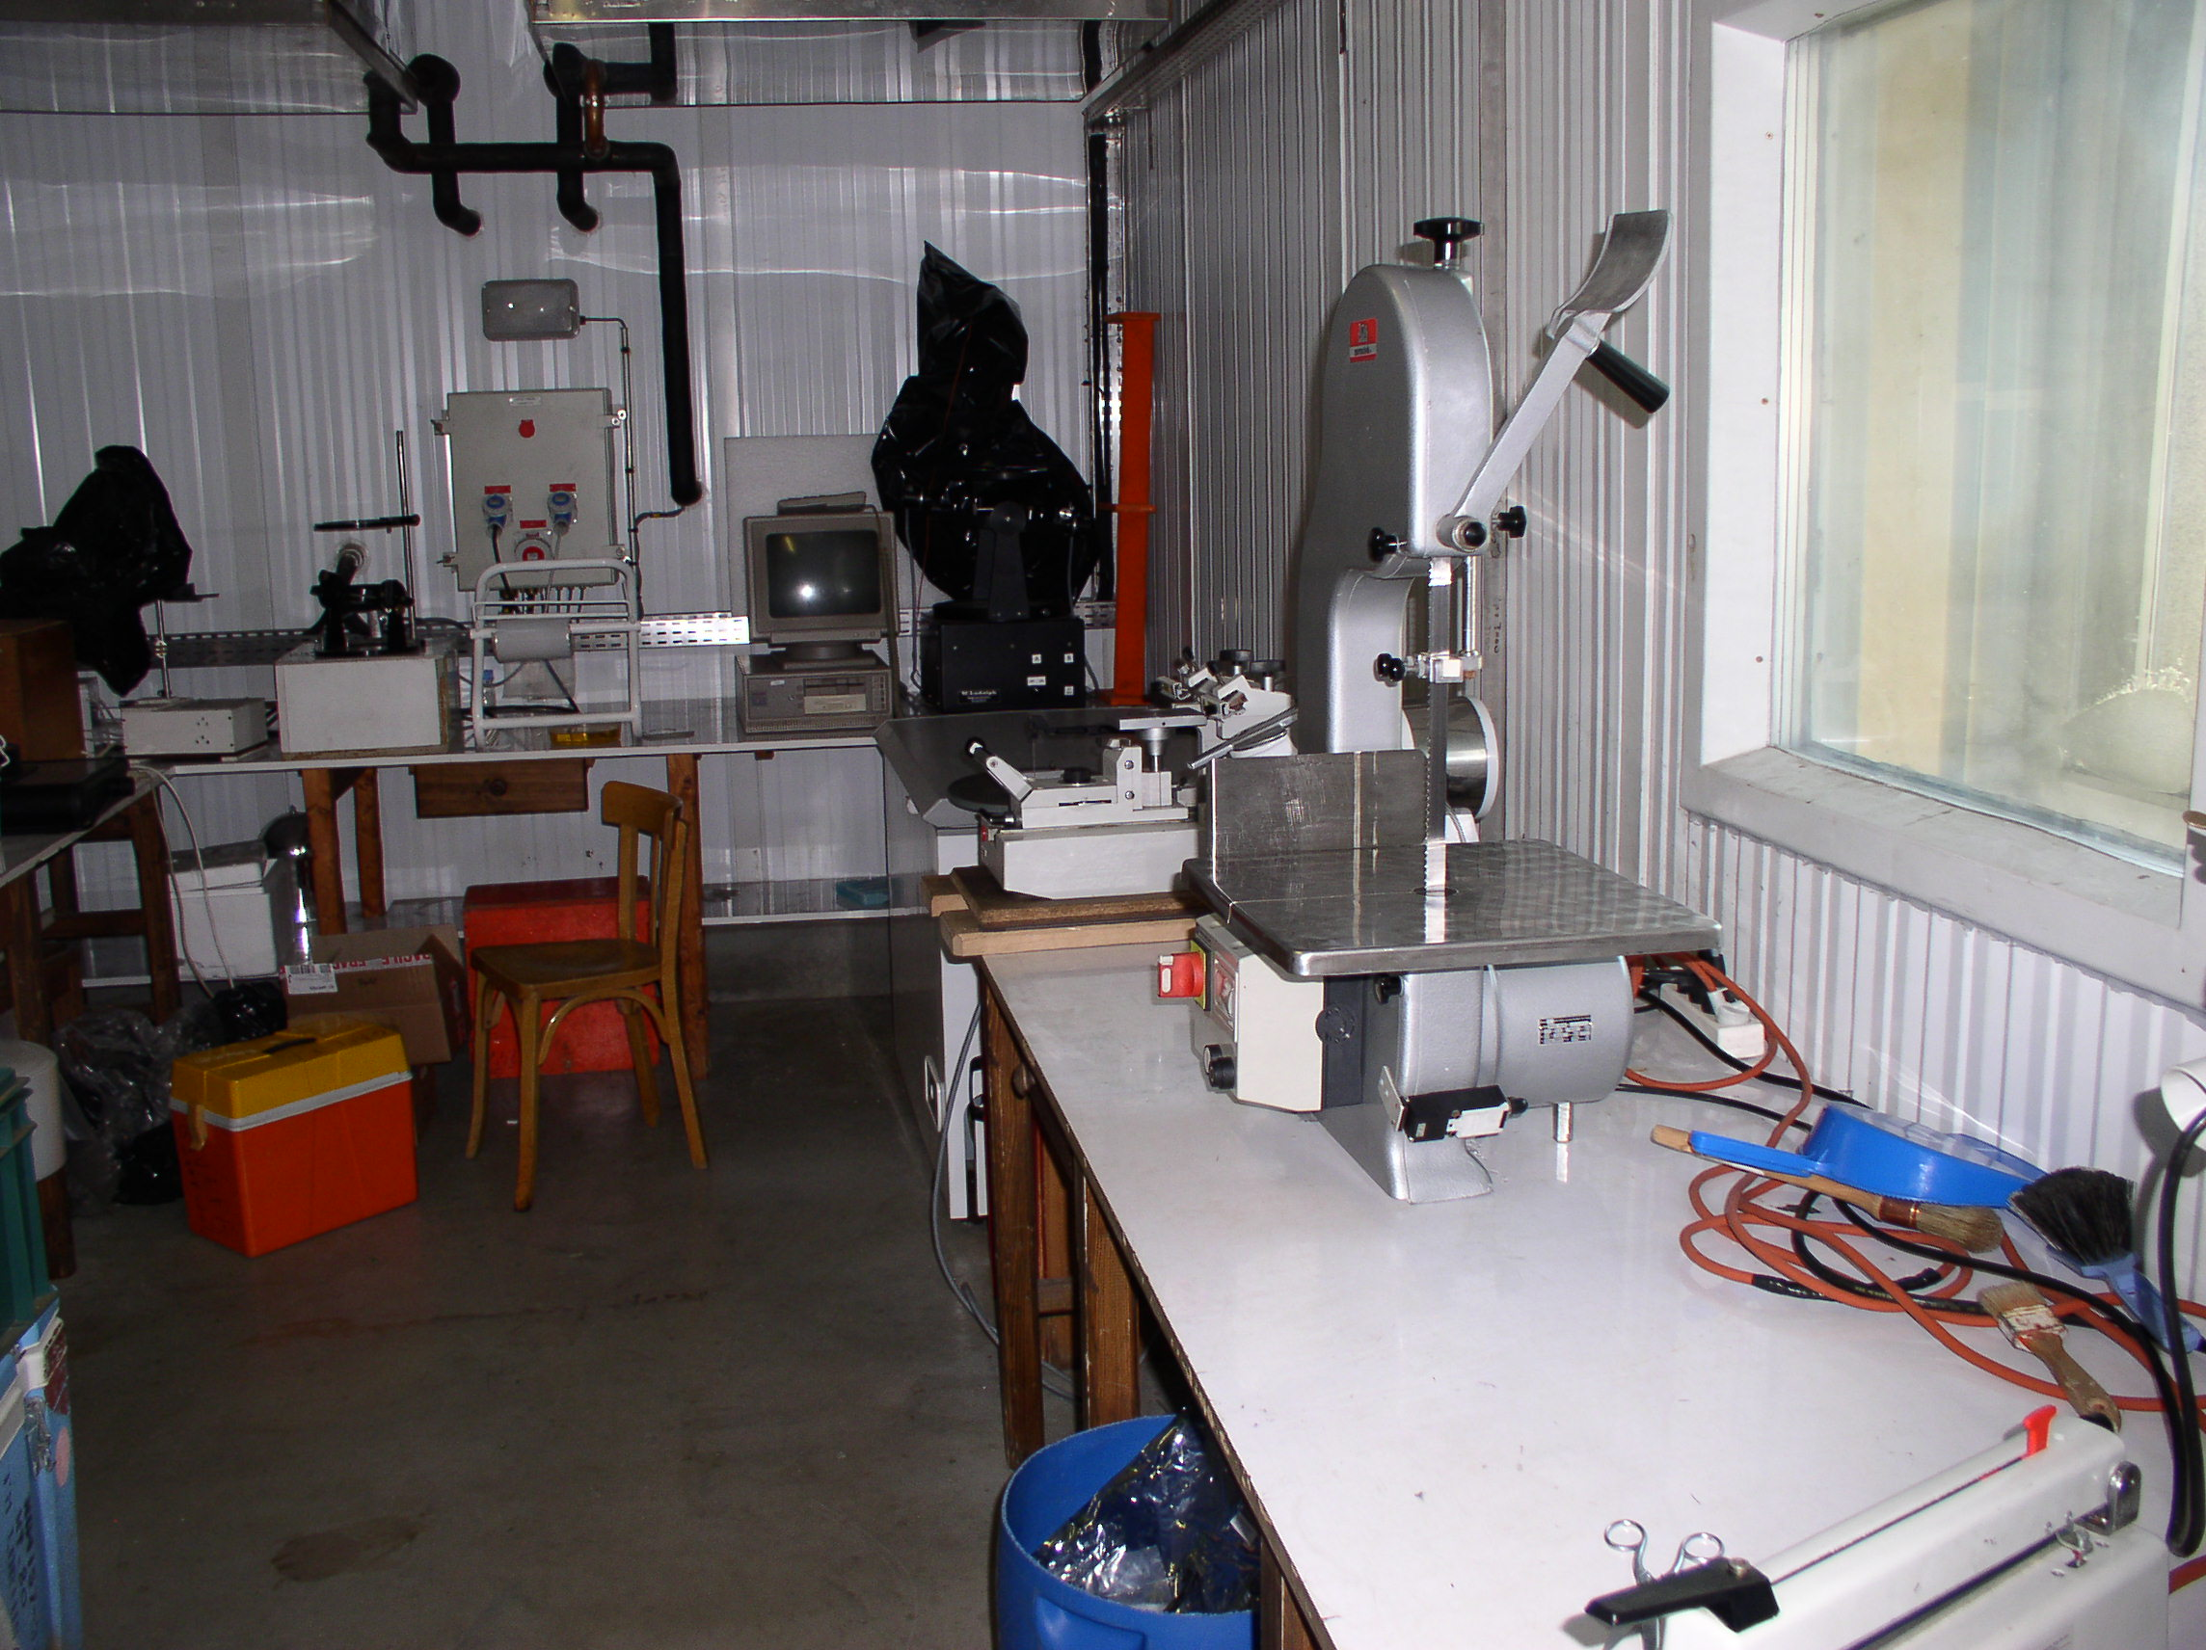
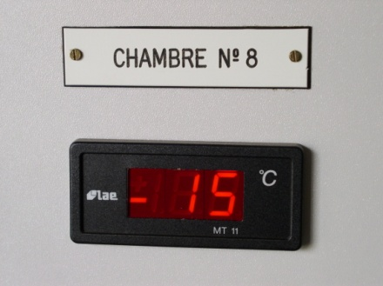
Cold room at LGGE

Slide 17
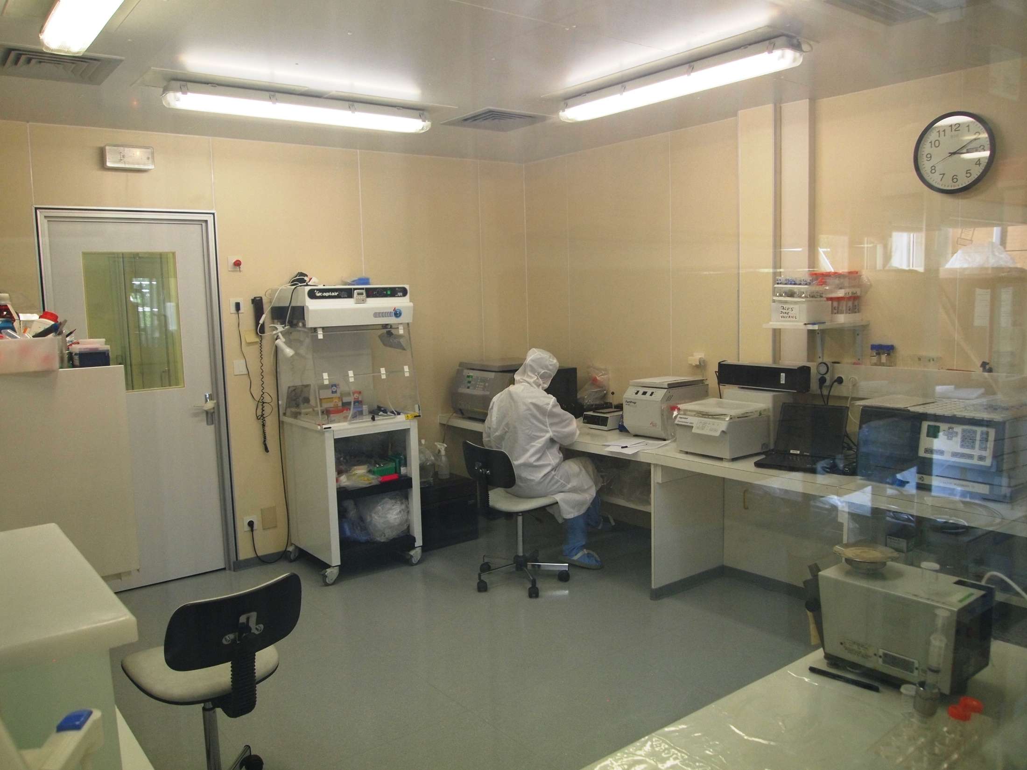
“Dust-free” room at LGGE – class 10,000
Fine snow/ice dust particles et DNA analyses
DNA/RNA BioCap hood class 100

Slide 18
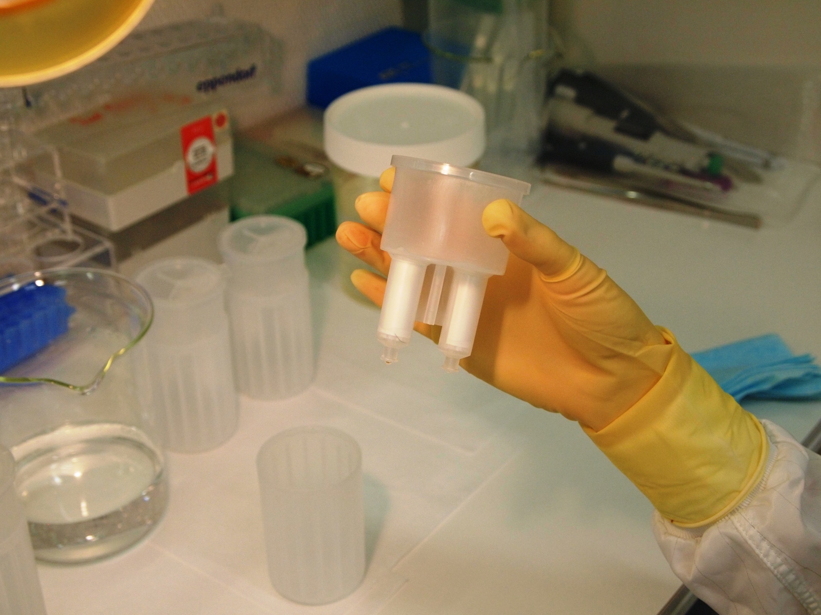
Columns
Centriprep Plus-70 (ml vol.)
Biomax membrane 5 kD
135 bp DNA (45.9 nm)

Slide 19
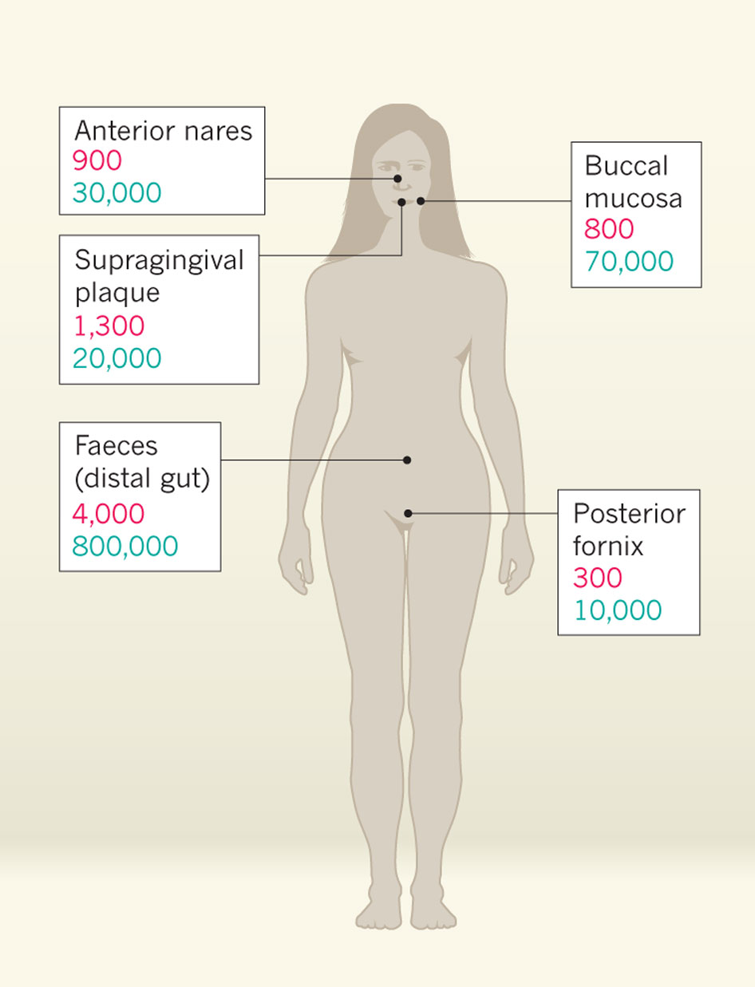
Microbial inhabitants outnumber our body’s own cells by about ten to one
Number of microbial species (red)
Number of microbial genes (blue)
Relman 2012 Nature 486_194-5

Slide 20
Vostok ice for Biology
REQUIREMENTS:
Comprehensive Biological controls
  Sham/mock DNA extraction
  Negative PCR
  Ice core wash water
  Lab Environment (dust)
  Vostok drill fluid
  Outer-core (optionally)
278 seqs ^{Juin 2014}
Contaminant databases

Slide 21
Vostok ice for Biology
REQUIREMENTS:
Authentication of findings by ecology (environmental conditions)
“Everything is everywhere, but, the environment selects” – Baas Becking, 1934

Slide 22
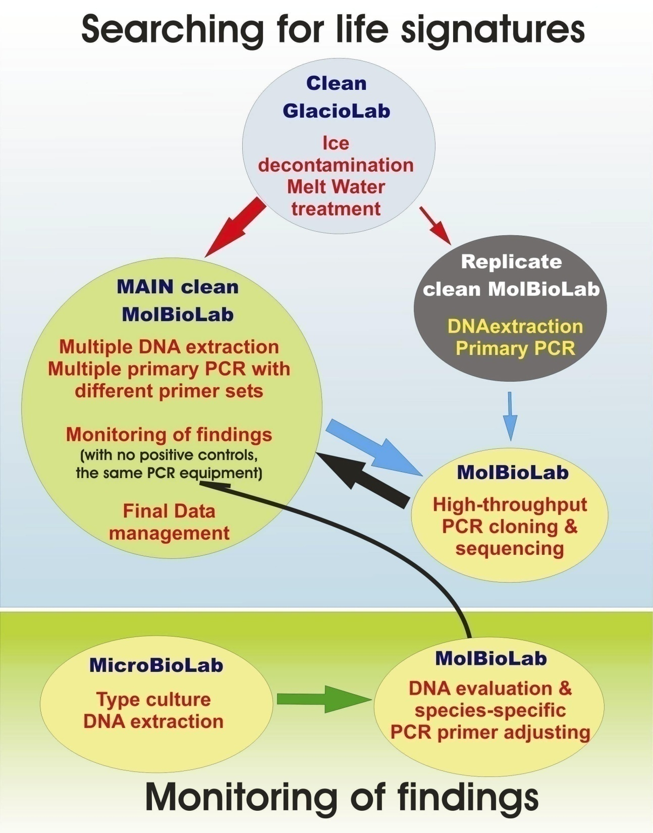
A framework for biological studies adopted for Lake Vostok
Gatchina – PNPI?
Clean cold and certified clean laboratory block
DNA extraction
Primary PCR
No PCR
products
Dubna – JINR?

Slide 23
We believe
Whatever we find
It’s going to be special stuff, unique stuff, life forms we’ve never encountered before

Slide 24
RESULTS
Bacteria in Vostok drill-bit et borehole frozen water

Slide 25
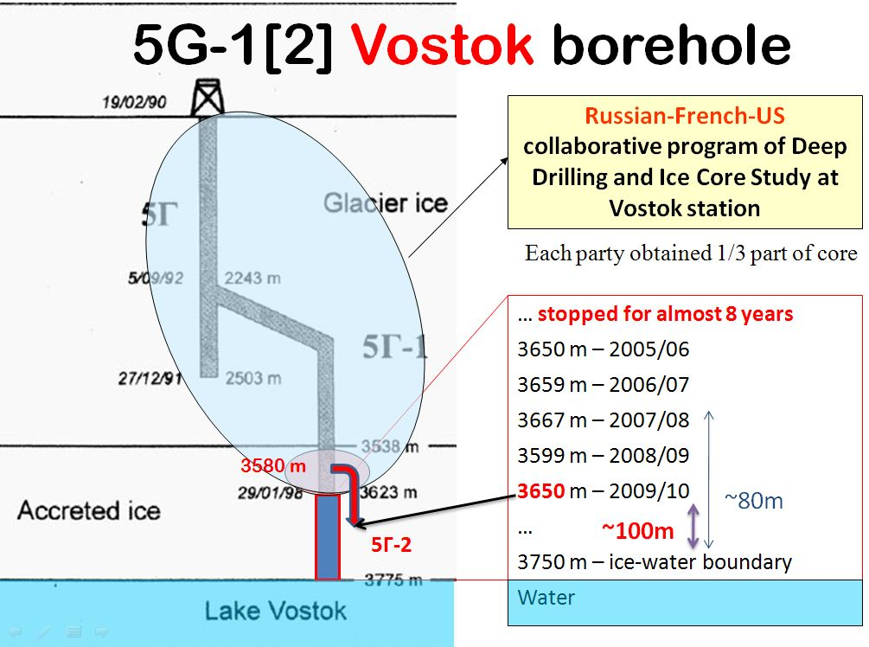
-42m
Max. 575m
~345m
3720 m - Jan 21, 2011
Enter!
3769.3 m – Fev 05, 2012

Slide 26
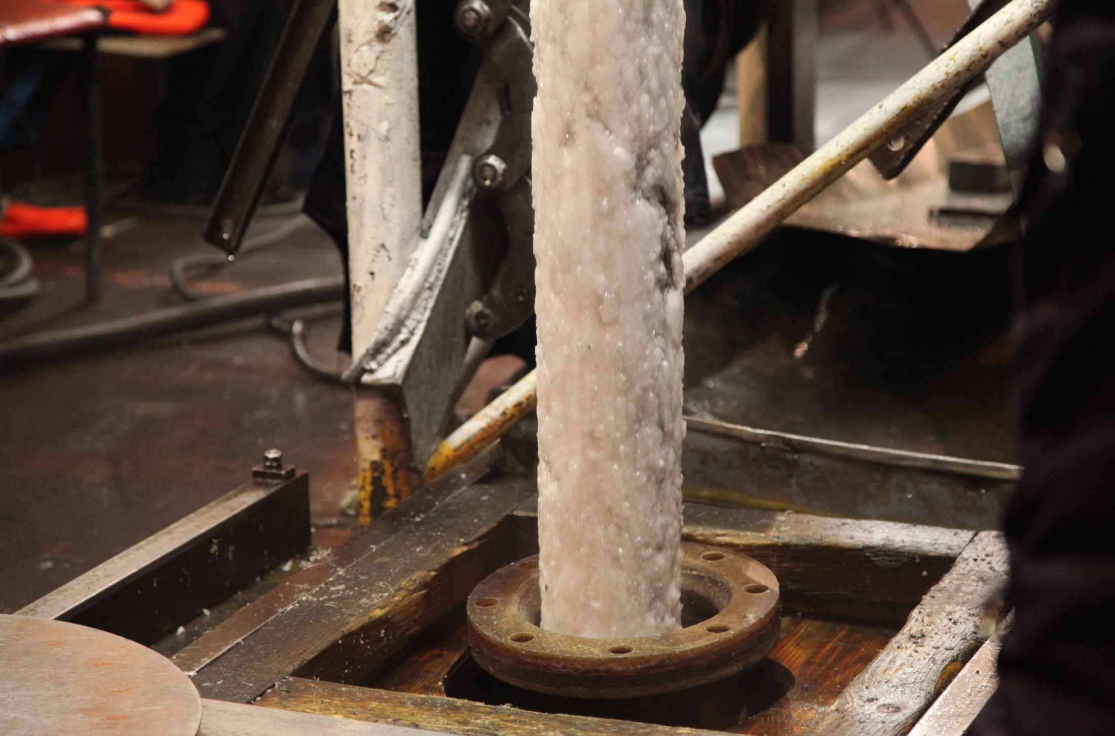
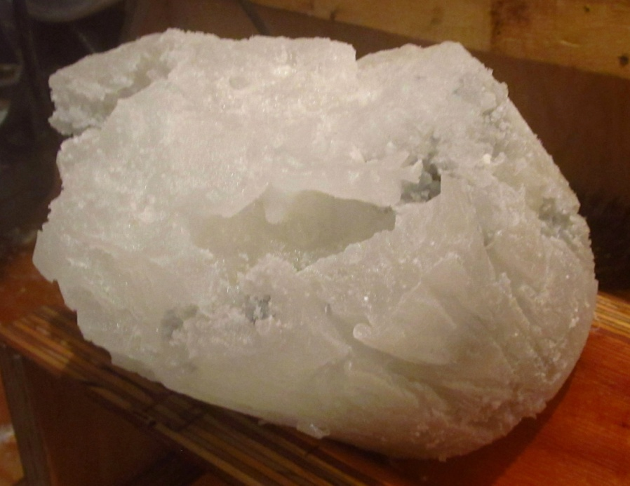
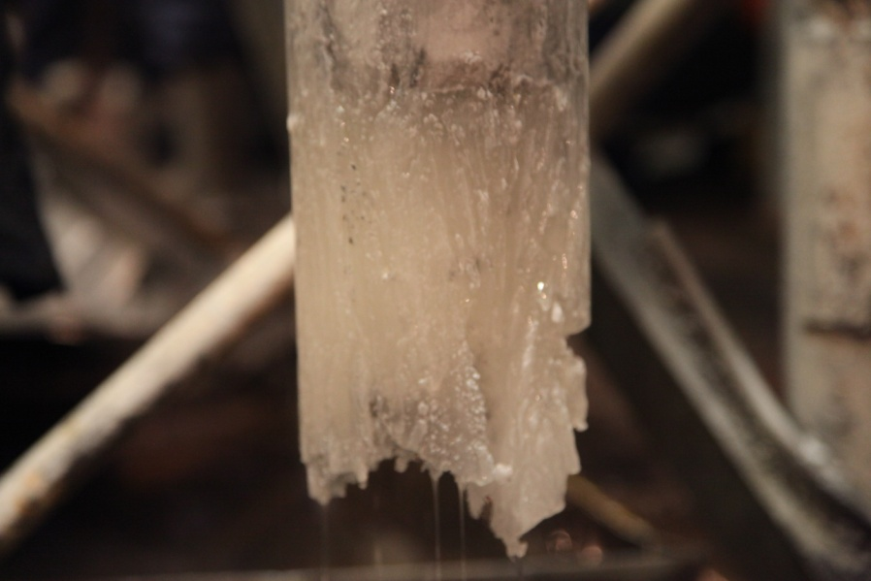
Lake water frozen

Slide 27
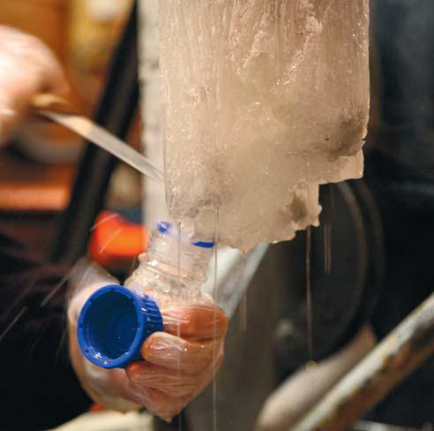
Max. ~50pg gDNA
167 cells/ml

Slide 28
Water-DNA/PCR
Flow-Chart
~20pg gDNA
?
Meta
Genomics
WATER
gDNA
16S rDNA
v3-v5
16S rDNA
v4-v8
16S rDNA
Full gene
~40% bacterial divisions
~40% bacterial divisions
~10% bacterial divisions
16S rDNA
v4
16S rDNA
v4-v6

Slide 29
w123-10 et al <86% known taxa
Unknown bacterium
Max. ~50pg gDNA
167 cells/ml

Slide 30
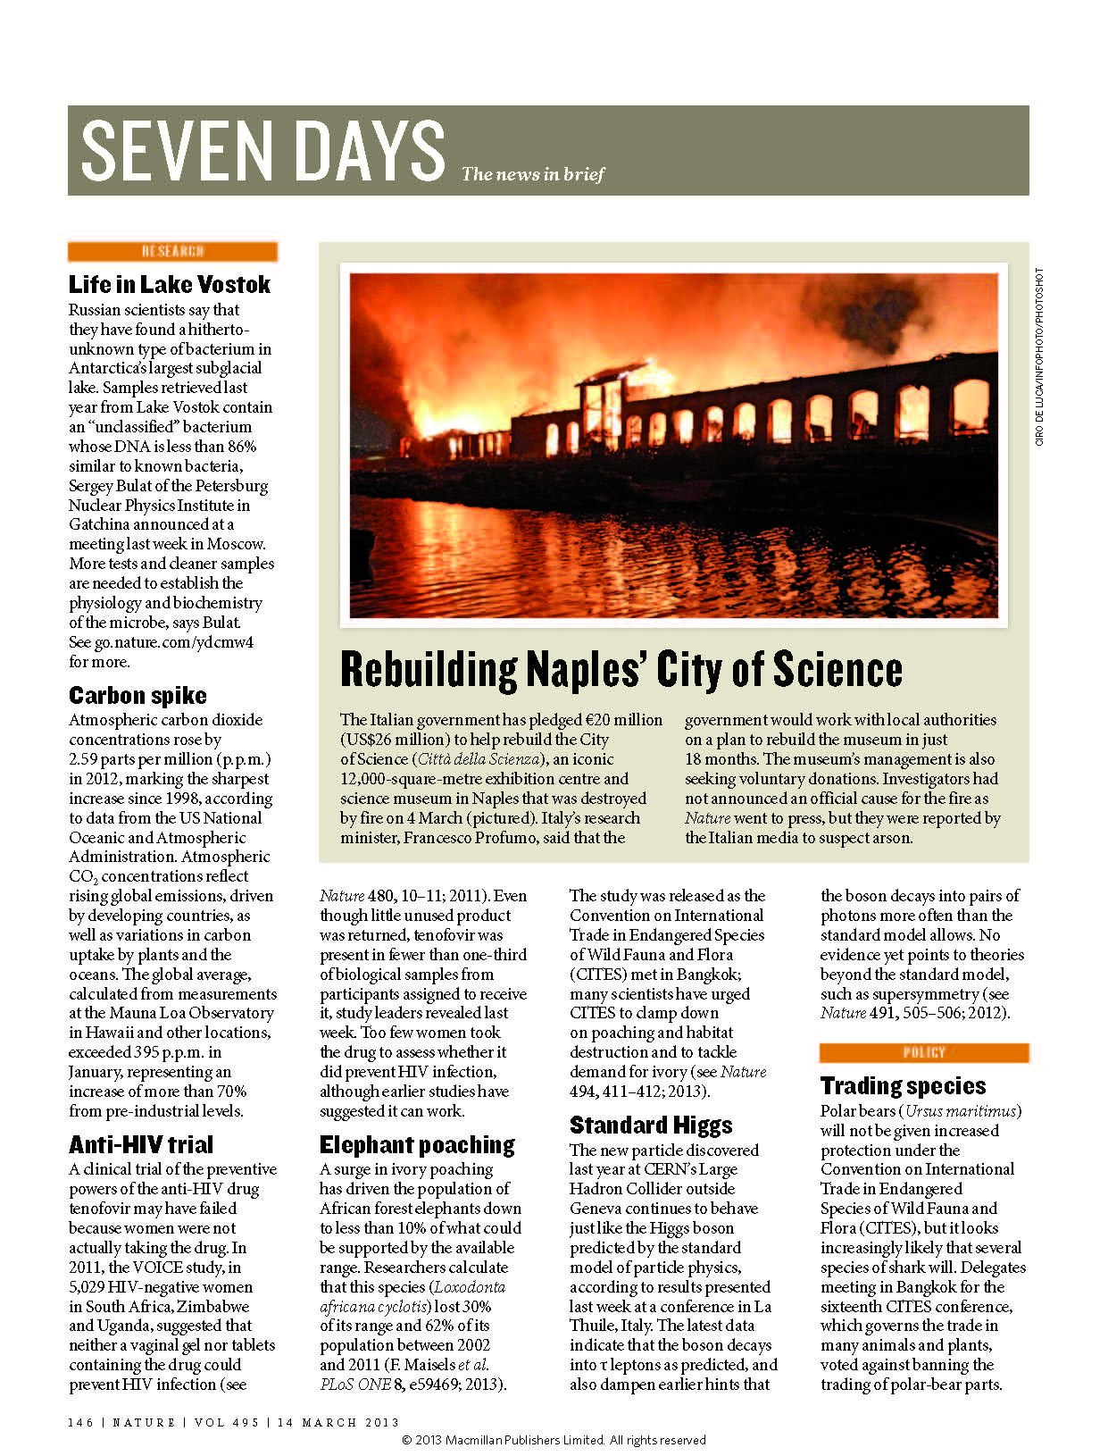
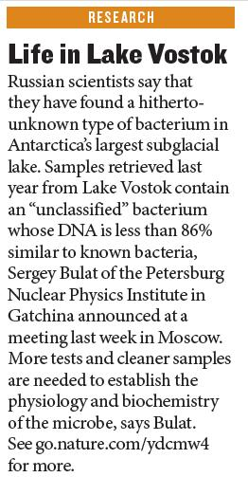

Slide 31
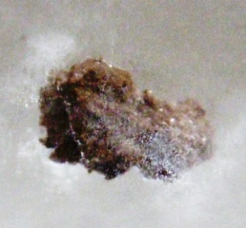
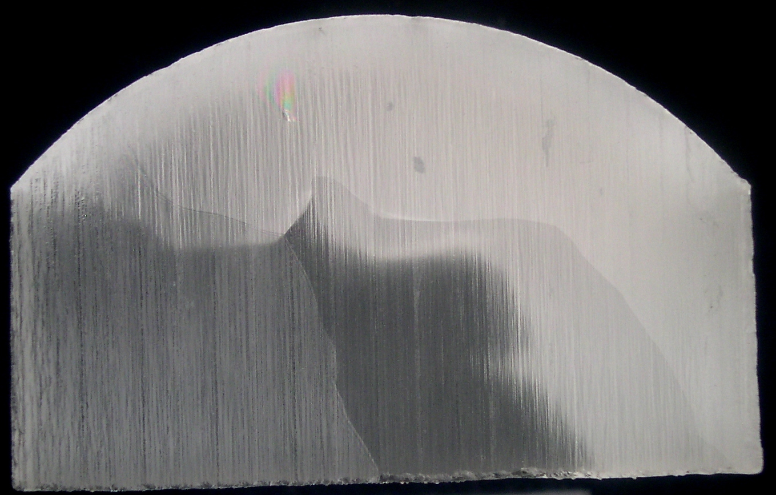

Vostok cells/phylotypes (16S rRNA - v2-v5 reg.) - SUMMARY
Ice type | Sample (m) | Cells/ml | (% Similarity with closest sequence in GenBank)
Snow (50 yr) | 4.0-4.3 | 0–0.02 | Contaminants
Glacier | 122 | 1.9
4.5 - 760 kyr | 2005 | 2.4
 | 2054 | 3–24
 | 3471 | 1-4
 | 3489 | 0
 | 3504 | 1-5
 | 3519 | 0-1 | Contaminants
Accretion I | 3547 | 0 | Contaminants
30 – 40 kyr | 3548 | 1 | Contaminants
 | 3561 | 4–9 | Contaminants + thermophile
 | 3607 | ND | Thermophile (92%) Uncultured bacterium (410 bp, AF532061)
 | 3607-re | 1
 | 3608BK-re | ND | (95%) Ilumatobacter fluminis (526 bp, NR_041633)
 | 5G2-3608 | 0 | Contaminants
Accretion II | 3613 | 3
0 – 30 kyr | 3621 | 2
 | 3622 | 0.6
 | 3635 | 4.7
 | 5G2-3646 | 0 | Contaminants
 | 3650 | 3.1
 | 3650 | 4777 | → untreated surface
 | 3659 | 12
 | 5G2-3714 | 0
 | 5G2-3764 | 0
Lake water | 5G2-water* w2ori | 167 | Refer to below
Sulfate-reducing bacteria
Hydrogen-oxidizing bacteria
Methanogenic archaea
Sulfur-oxidizing bacteria
?
99-100% - thermophile Hydrogenophilus thermoluteolus β-Proteo
Actino
99% - glacier sediment
No more water pockets
Lake water frozen on a drill bit
Bulat et al., 2004; 2012

Slide 32
5G-2[3] Vostok borehole
3425
3424 m – Uppermost frozen water ice
3429
35 m – layer of frozen lake water
3450
3458 m – Bottommost frozen water ice
3539 m – Type I
3543.56 m – Fev 2013
3608 m – Type II
3580-3667m
3724.4 m – Late jan 2014
45 m remained to drill – 2014/2015 season
- at rate ~2m/day
3769.3 m – Fev 05, 2012

Slide 33
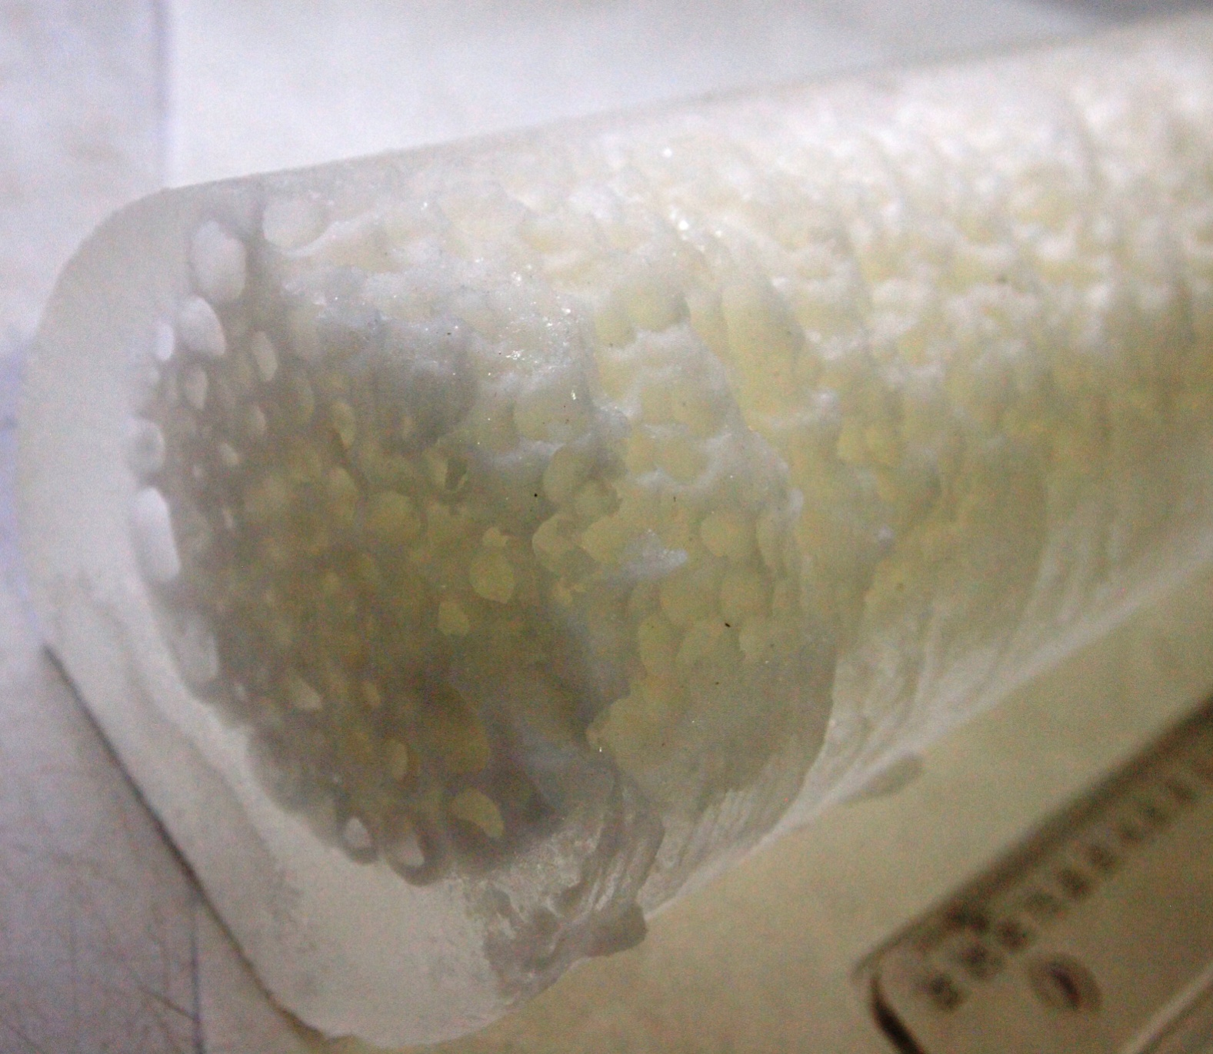
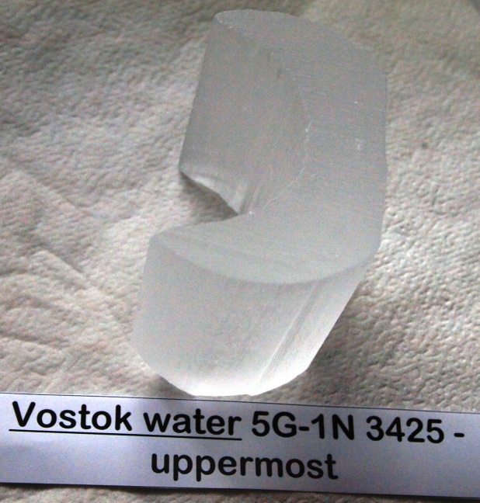
5G-1N-3425 Vostok water ice
40 cells/ml ?

Slide 34
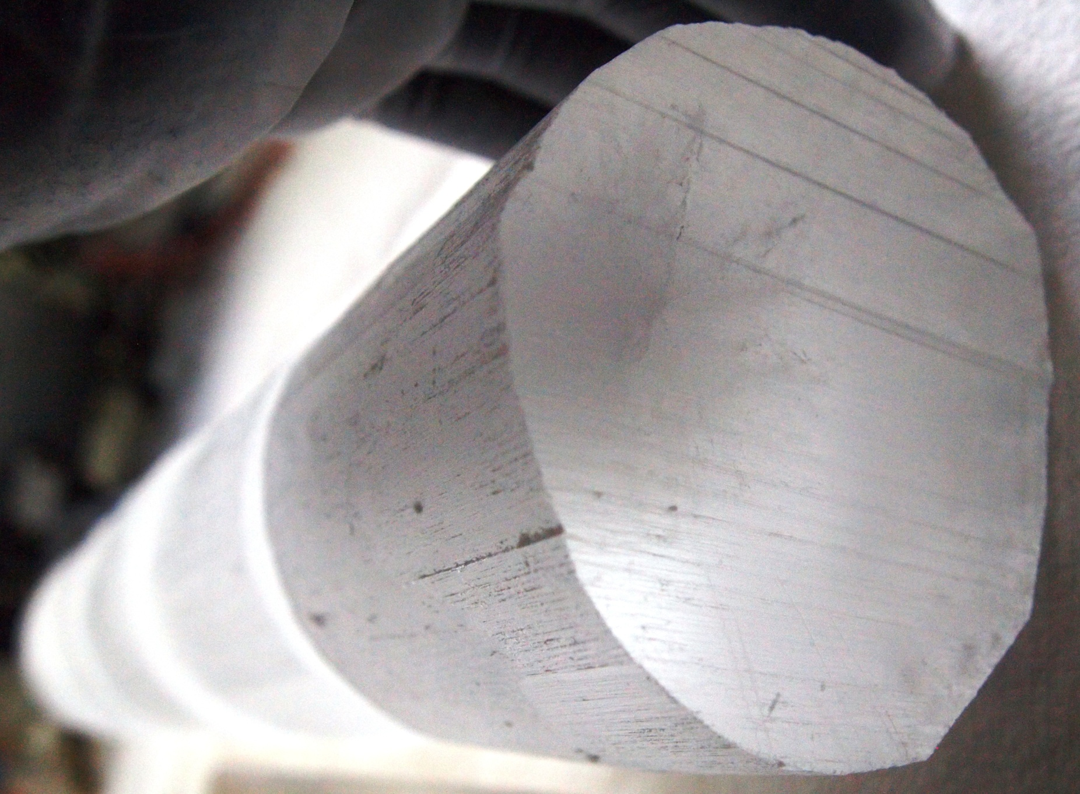
5G-1N-3429 Vostok water ice
5.5 cells/ml
Max. ~30pg gDNA

Slide 35
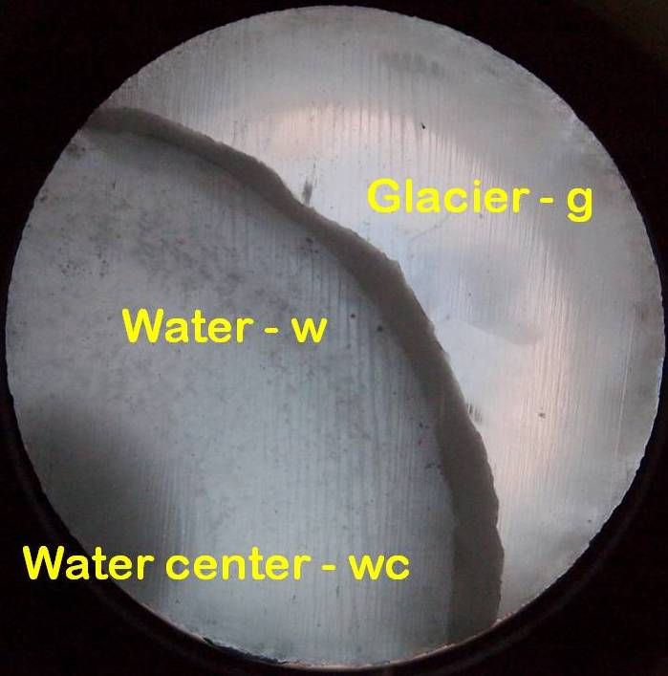
5G-1N-3450 Vostok water ice
No cells
Ongoing analyses
Dust/microparticles
Analytical chemistry
Cell concentrations
gDNA → 16S rRNA gene amplifications
  w123-10 clone specific PCR assay
23 cells/ml
38 cells/ml

Slide 36
5G-1N-3429 16S rRNA gene
Clone v3-v5
3429v3-4 - 93-Janthinobacterium sp
Burkholderiales, Oxalobacteraceae,
Beta-Proteobacteria
1.5 L processed

Slide 37
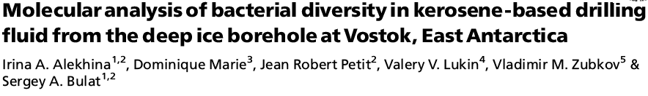
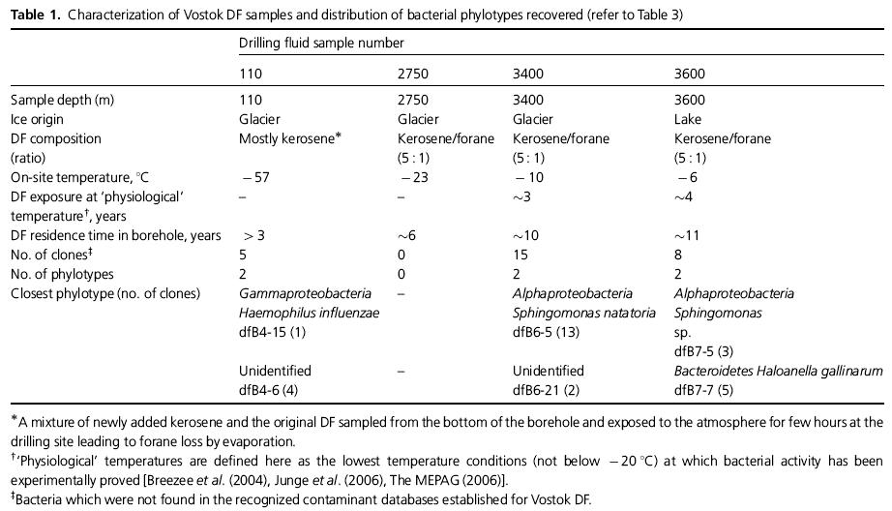
FEMS Microbiol Ecol 59 (2007) 289–299
99% Chryseobacterium sp (human clinical source - FN297836 or soil - EU516352 or Human skin microbiome - JF107956
100% JF096919 Human skin microbiome (skin, antecubital fossa)
100% GQ025214 Human skin microbiome (skin, axillary vault)
DQ422866
DQ422867
DQ422865

Slide 38
CONCLUSION
It seems there is UNKNOWN very tiny LIFE ^{(population)} in uppermost layer of Lake Vostok water

Slide 39
Exciting results seem to come soon?
We need cleanly collected (with no DRILL FLUID) lake water

Slide 40
5G-2[3] Vostok borehole
3425
3424 m – Uppermost frozen water ice
3429
35 m – layer of frozen lake water
3450
3432-3445
3458 m – Bottommost frozen water ice
3539 m – Type I
3543.56 m – Fev 2013
3608 m – Type II
3580-3667m
3724.4 m – Late jan 2014
45 m remained to drill – 2014/2015 season
- at rate ~2m/day
3769.3 m – Fev 05, 2012

Slide 41

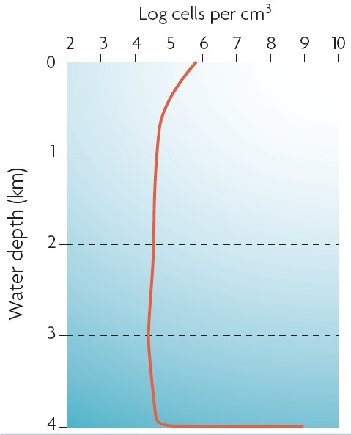
10 years FUTURE DIRECTIONS
X
  Rapidly frozen lake water (within the borehole) – 2012/14
  Lake water column (680m)
  Lake sediments (>300m)
4-5 order difference
Microbial biomass at BIONTRANS
(Jorgensen and Boetius 2007)

Slide 42
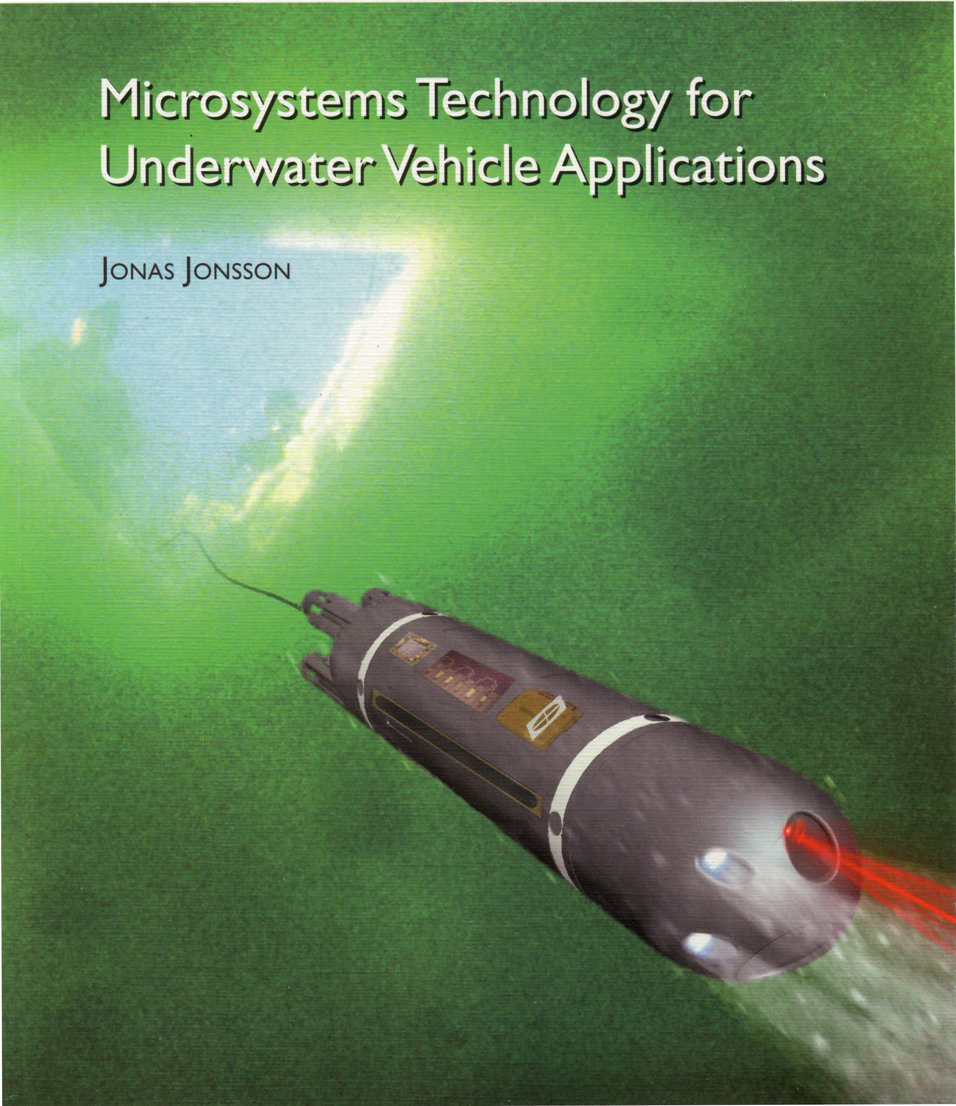

Slide 43
Acknowlegements
LGGE CNRS-UJF, Grenoble, FR
  Jean Robert Petit
  Jean Martins et Frederic Charlot (EDX-SEM)
Station Biologique de Roscoff, Roscoff, FR
  Dominique Marie
AARI, St Petersburg, RU
  Vladimir Lipenkov – ice cores
  Valery Lukin – logistics
PNPI Cryoastrobiol labo, St Petersburg-Gatchina, RU
  D Karlov, M Doronin, L Demchenko, M Khilchenko, L Shestakova

